Slide 1
When Fuzzy is Good: Advances in Filtering Techniques
Jason Yang AMD
jasonc.yang@amd.com
Advances in Real-Time Rendering in 3D Graphics and Games

Slide 2
Outline
Edge-Detect Custom Filter AA
Approximate Image Based Lighting
Depth of Field
Experiences with Real-Time Ray Tracing

Slide 3
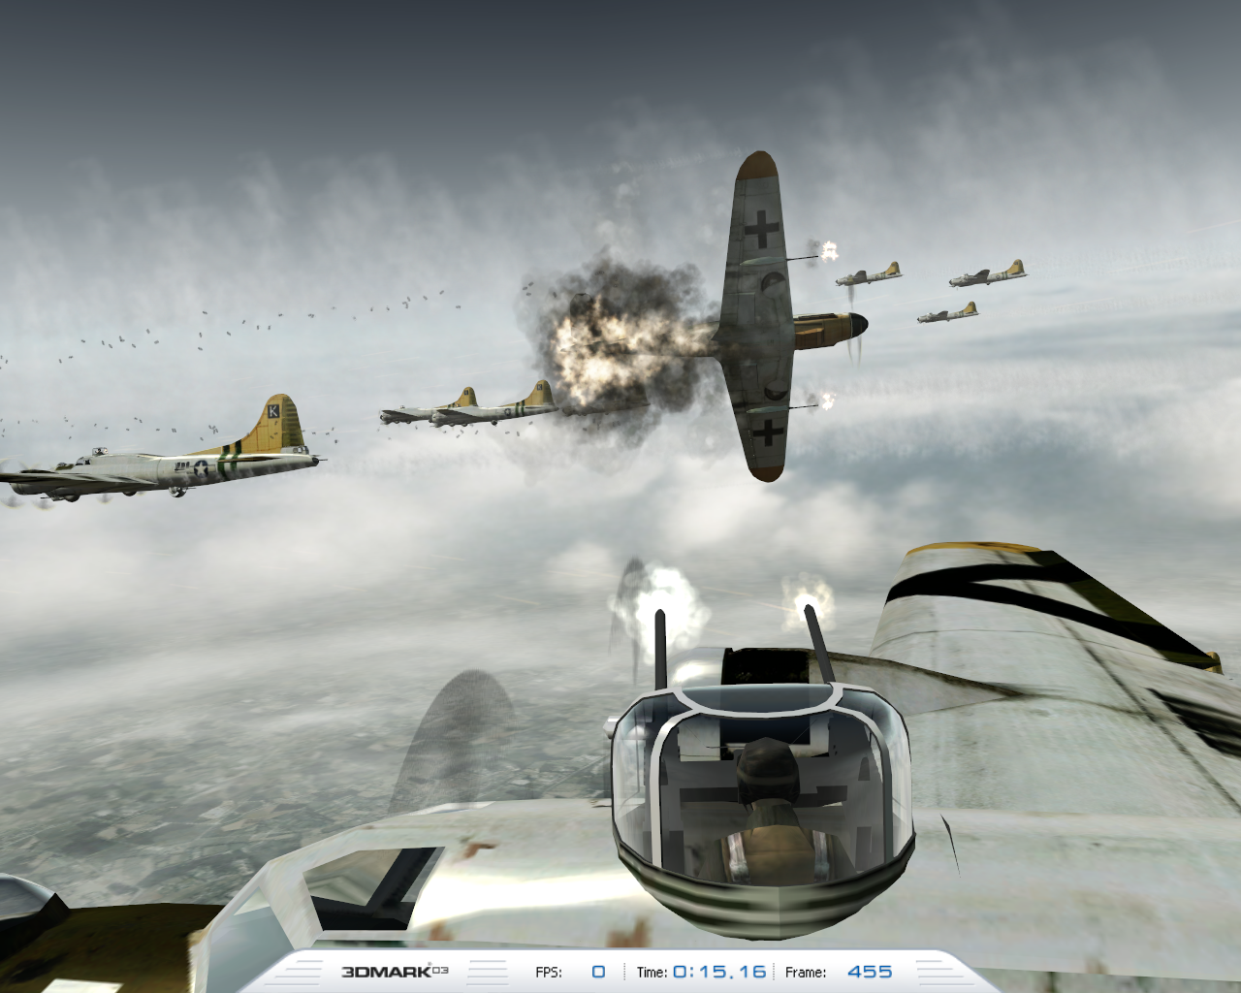
Edge-Detect Custom Filter AA

Slide 4
Introduction
Iourcha, K., Yang, J., and Pomianowski, A. 2009. A Directionally Adaptive Edge Anti-Aliasing Filter. High Performance Graphics.
Shipping as a driver feature on ATI Radeon HD GPUs: Edge-Detect Custom Filter AA
This topic will be slightly more implementation than theory
Slightly condensed, but see details are in paper

Slide 5
Motivation
Can we use the GPU’s shader processing power and flexibility for better edge anti-aliasing (AA)?
Goal
Improve primitive edge appearance (vs. “standard” MSAA processing) using the same number of samples and better software filtering algorithms

Slide 6
Motivation
Benefits
Rendering time (sans post-processing) and memory footprint stay the same
Software filters can be easily modified if needed
Constraints
Needs to run in real-time on the same GPU as rendering
Needs to use existing HW features (no HW modification)
Access to MSAA samples and sample data

Slide 7
Motivation
Can we use the GPU’s shader processing power and flexibility for better edge anti-aliasing (AA)?

Slide 8
Can we use the GPU’s shader processing power and flexibility for better edge anti-aliasing (AA)?
No AA

Slide 9
Can we use the GPU’s shader processing power and flexibility for better edge anti-aliasing (AA)?
8x AA

Slide 10
Can we use the GPU’s shader processing power and flexibility for better edge anti-aliasing (AA)?
Our New Filter

Slide 11
Contribution
Developed an approach to edge AA using non-linear filtering with significant quality improvements over “standard” linear filters
Developed a filtering algorithm feasible for real-time rendering on the GPU by taking advantage of existing MSAA data
Implemented algorithms on the GPU

Slide 12
Current Hardware Approach: Multisample Anti-Aliasing (MSAA)
Estimate primitive pixel coverage by testing at sample points
Calculate a single color value per pixel per primitive (usually at the center of the pixel or at the centroid of the covered samples) and assign it to all covered samples
Notes:
This pixel is considered ¾ filled by primitive even though it’s about ½ filled
4 samples at most 4 levels of gradation (5 including non covered)

Slide 13
Traditional MSAA
Speeds up rendering by not calculating values for each sample separately
Non-uniform sampling grid is used to improve pixel coverage estimate

Slide 14
Traditional MSAA
Primary goal is anti-aliasing of primitive and Z edges

Slide 15
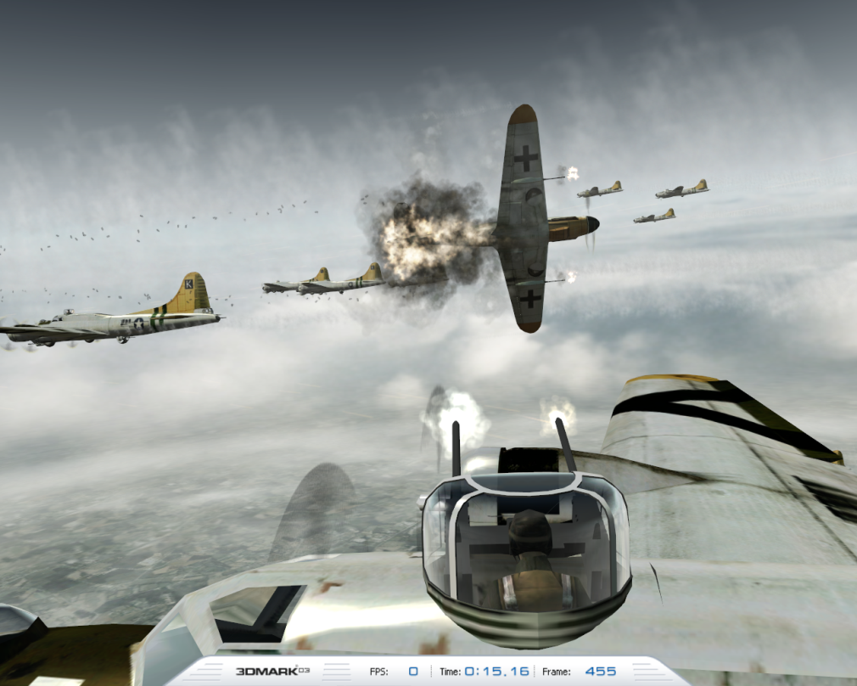
Traditional MSAA
Texture resampling performed elsewhere (mipmapping)
High frequency texture details are lost in the MSAA color buffer and cannot be easily post-processed further

Slide 16
Anti-Alising Model Revisited
If we consider a single channel (gray-scale) image as an intensity function over continuous [x, y]
Pixel value can be computed by integrating the intensity over the pixel area [Catmull78]
Minimal RMS error when a box filter (LCD display) is used for reconstruction
Some Moiré patterns can be visible due to high frequency leakage; they can be reduced by a low pass prefilter
Standard MSAA computes an estimate of this integration over the pixel
We want to improve this estimate

Slide 17
Integration Approach and Isolines
If we know isolines (isophotes) of the image function
Sample values outside of the pixel can be used
Weight them by the length of the corresponding isoline segment in the pixel and add all of them

Slide 18
Isoline Evaluation in Three Channels
Need to find isolines
But only in the case of low curvature (as this is the case near the actual primitive edges)
Then we can model them as a straight lines
Fit a plane into three channels to compute a gradient estimate
Use linear approximation
Solve least squares problem
Please see paper for more details
Notes:
Effectively doing a linear fit of the RGB samples

Slide 19
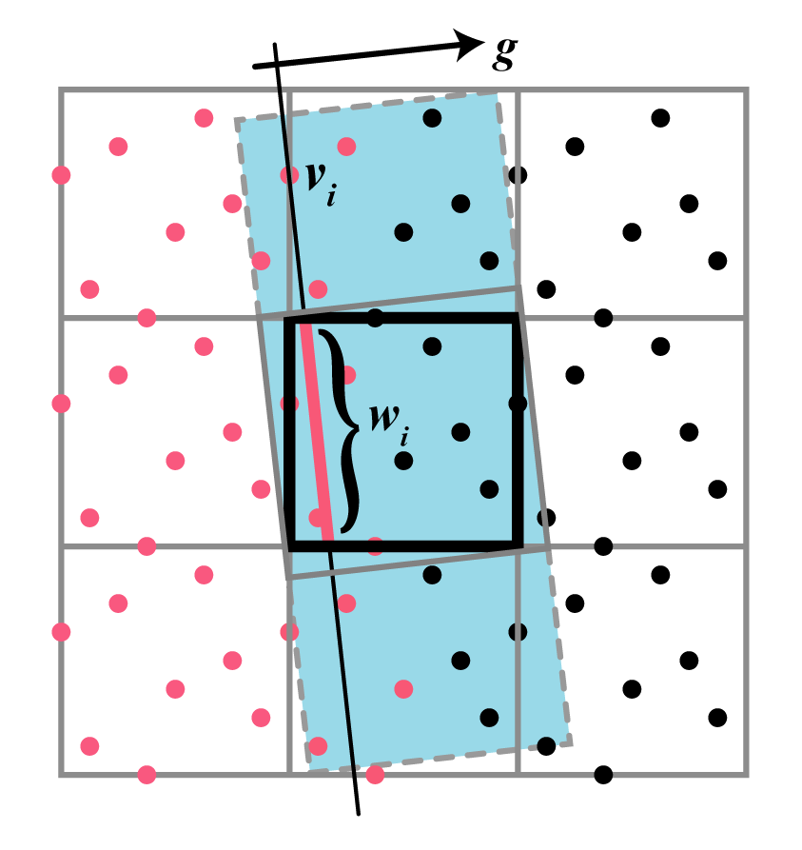
Filter Computation (Integration)
Construct a square around the pixel, with two sides orthogonal to g
Extend the rectangle, in the direction orthogonal to g until it meets the 3x3 pixel boundary

Slide 20
Filter Computation (Integration)
For every sample v_{i}, length of the segment of the line passing though v_{i} and orthogonal to g inscribed by the pixel is its weight w_{i}
Calculate the weighted sum of all samples in the rectangle

Slide 21
Masking
If a pixel has two or more samples with different colors it is an “edge” pixel, otherwise it is “non-edge”
“Internal” primitive pixels will have samples all of the same color due to MSAA (some edges can generate such pixels too; we ignore this)

Slide 22
Masking
We use “edge” (X) / “non-edge” (O) 3x3 pixel patterns to eliminate cases where filtering should not be performed

Slide 23
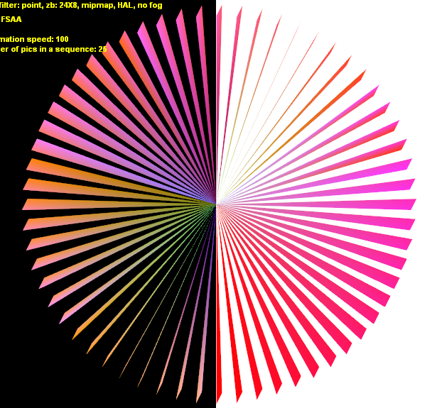
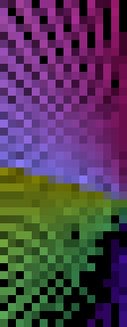
Masking
For instance, if all 3x3 pixels are “edge” ones, there is no long dominating edge, and we do not want to smooth-out high-frequency in this case, etc.

Slide 24
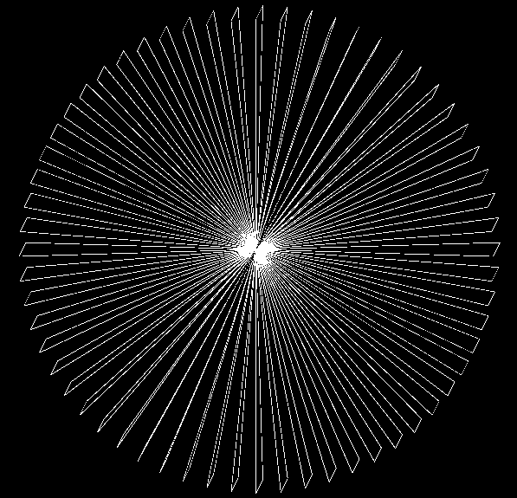
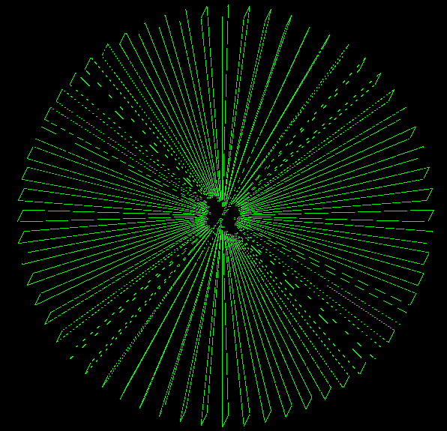
Masking
Can help avoid excessive corner smoothing
Reduces processing time
“Found” Edges
After Masking

Slide 25
Bringing It All Together: Sample Implementation
Implemented using MS DirectX 10.1
Four shader passes:
Input from rendering
MSAA Buffer
Pass 3
Pass 1
Gradient Calc.
Gradient Buffer
Resolve
Pass 4
Pass 2
Edge Finding
Edge Buffer
Masking
Depth Buffer
Integration
Frame Buffer
Display

Slide 26
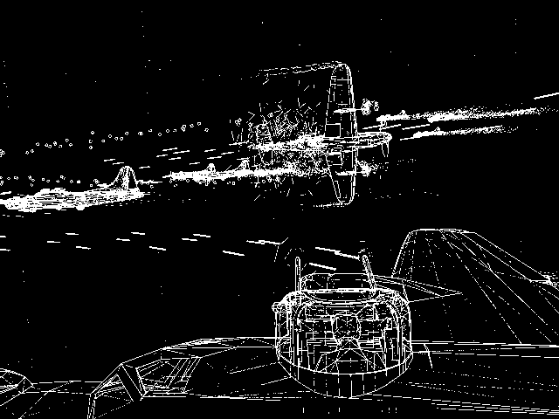
Pass 1
Identify edge pixels using the MSAA buffer. Seed the frame buffer by performing a standard resolve at each pixel

Slide 27
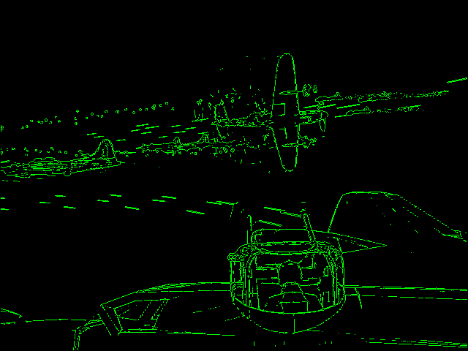
Pass 2
Mask out candidate pixels using edge patterns
Computed in shader vs. tables
Notes:
Notice elimination of pixels from masking

Slide 28
Sample Code for Pass 1 (4 samples)
Texture2DMS <float4, 8> sInput0;
struct Output_PS
{
float4 Col[2] : SV_Target;
};
Output_PS main(float4 _pos : SV_Position)
{
Output_PS ret = (Output_PS) 0.f;
_pos = floor(_pos);
float2 tex = _pos.xy;
float4 col0 = sInput0.Load(tex.xy, 0);
float4 col1 = sInput0.Load(tex.xy, 1);
float4 total = col0 + col1;
float4 a = min(col0, col1);
float4 b = max(col0, col1);
col1 = sInput0.Load(tex.xy, 2);
total += col1;
a = min(a, col1);
b = max(b, col1);
col1 = sInput0.Load(tex.xy, 3);
total += col1;
a = min(a, col1);
b = max(b, col1);
ret.Col[0] = total/4.f;
float4 zero = float4(0.f, 0.f, 0.f, 0.f);
float4 one = float4(1.f, 1.f, 1.f, 1.f);
ret.Col[1] = (a == b) ? zero : one;
ret.Col[1] = dot(ret.Col[1].xyz, one.xyz);
return ret;
}
MSAA texture
Load
Integer vs. normalized coordinates
Work in normalized color space to handle gamma
Notes:
LOAD non-normalized coordinates
Loads into FLOAT space so we have correct GAMMA and DEGAMMA

Slide 29
Performance Tip
Use the depth buffer as a mask
Z test is usually performed at the top of the pipe
Really fast pixel rejects
Avoids filling the pipe with “empty work”
Often helpful in post-processing effects
Pass 2 writes its output to the depth buffer
Avoids a fetch and a branch as well in Pass 3 and 4

Slide 30
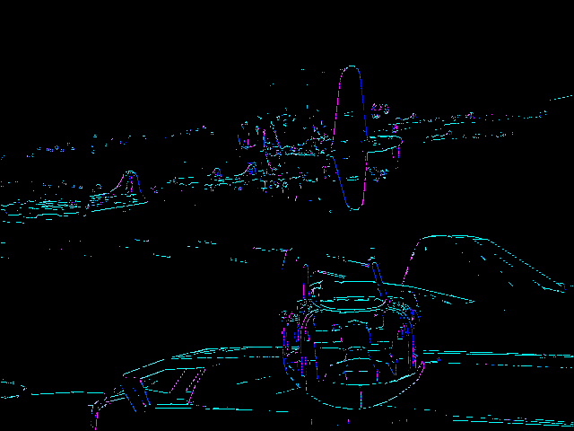
Pass 3
Compute “gradients”

Slide 31
Pass 4
Calculate the final frame buffer color for the pixels from Pass 3 using the presented integration method with input samples from a 3x3 pixel neighborhood
Integration and weights are computed in shader
All other pixels were already filtered in Pass 1

Slide 32
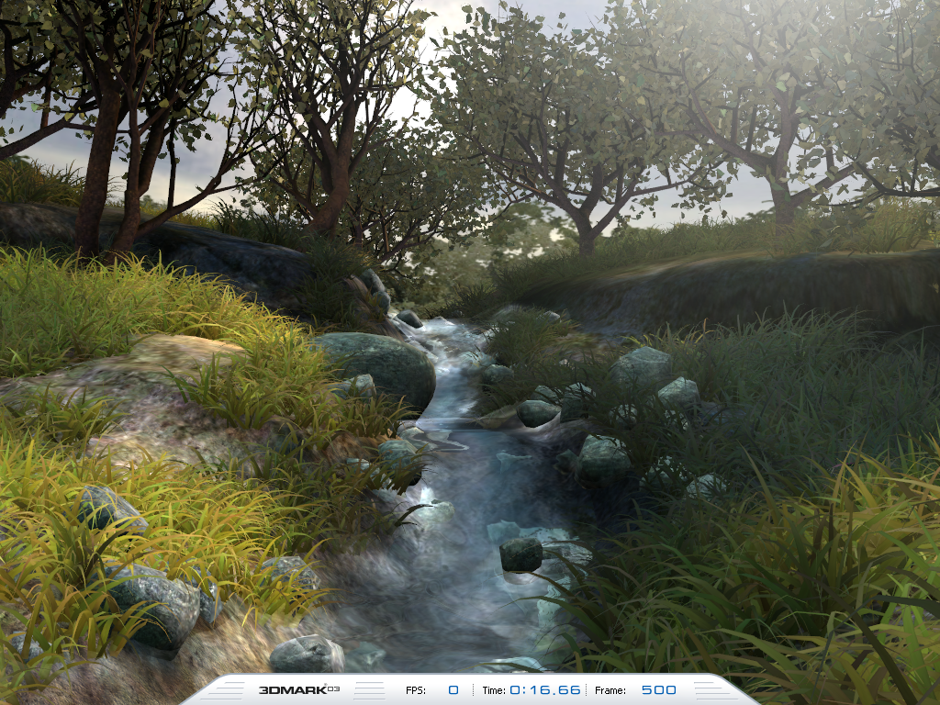
Performance
Filtering performance on scenes from Futuremark 3DMark03 using an ATI Radeon HD 4890 on an AMD Phenom II X4 3.0 GHz
0.25 to 1.7 ms at 800x600
0.5 to 3 ms at 1024x768
1 to 5 ms at 1280x1024
Performance dependent on the number of edges in the scene

Slide 33
Quality
4x AA
4 levels of gradation
New filter using 4x AA samples
10 levels of gradation
8x AA
8 levels of gradation
New filter using 8x AA samples
22 levels of gradation

Slide 34
Other Applications
In-game custom filtering
More advanced filtering
Go further than 3x3 pixels
Finding geometry edges
Deferred lighting AA(?)

Slide 35
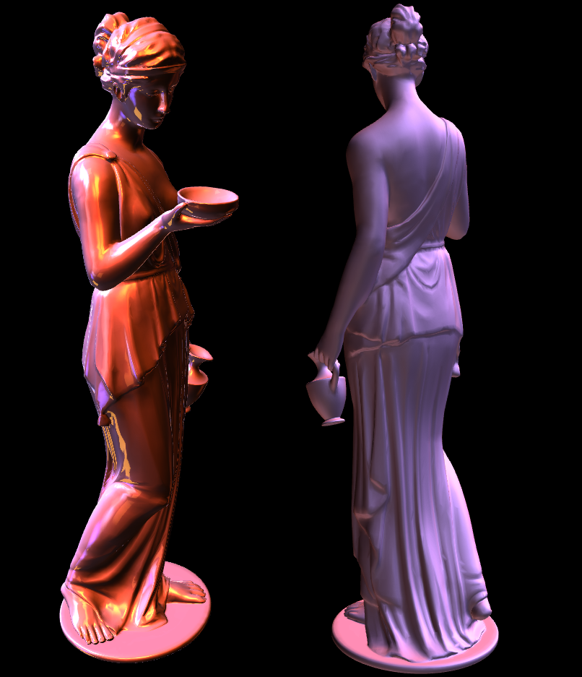
Approximate Image Based Lighting

Slide 36
Overview & Benefits
Summed-Area Tables
What they are, and how to construct them
Higher-order summed-area tables
“Repeated Integration” [Heckbert86]
Approximating BRDFs [Hensley05]
Key Benefits of the technique
All data computed on the fly - no pre-processing needed
Filters can be varied spatially per rendered pixel
Approximate image-based lighting
All lighting in example images computed completely by filtering environment maps
Notes:
Constant time spatial varying filter
Precision issues with summed area tables

Slide 37
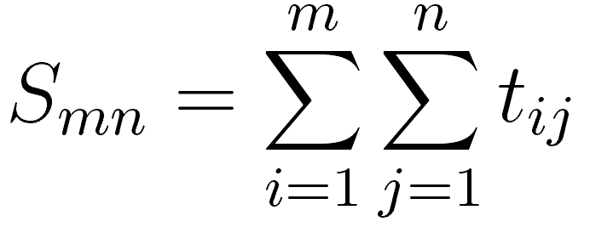
Summed-Area Tables (SATs)
For a left-handed coordinate system, each element S_{mn} of a summed-area table S contains the sum of all elements above and to the left of the original table/texture T [Crow84]

Slide 38
Summed-Area Tables (SATs)
For a left-handed coordinate system, each element S_{mn} of a summed-area table S contains the sum of all elements above and to the left of the original table/texture T [Crow84]
 | 1 | 2 | 3 | 4
4 | 0 | 7 | 2 | 4
3 | 1 | 4 | 1 | 2
2 | 6 | 1 | 2 | 0
1 | 0 | 3 | 5 | 2
 | 1 | 2 | 3 | 4
4 | 0 | 7 | 9 | 13
3 | 1 | 12 | 15 | 21
2 | 7 | 19 | 24 | 30
1 | 7 | 22 | 32 | 40
input texture
summed-area table

Slide 39
Summed-Area Tables (SATs)
For a left-handed coordinate system, each element S_{mn} of a summed-area table S contains the sum of all elements above and to the left of the original table/texture T [Crow84]
 | 1 | 2 | 3 | 4
4 | 0 | 7 | 2 | 4
3 | 1 | 4 | 1 | 2
2 | 6 | 1 | 2 | 0
1 | 0 | 3 | 5 | 2
 | 1 | 2 | 3 | 4
4 | 0 | 7 | 9 | 13
3 | 1 | 12 | 15 | 21
2 | 7 | 19 | 24 | 30
1 | 7 | 22 | 32 | 40
input texture
summed-area table

Slide 40
Summed-Area Tables (SATs)
For a left-handed coordinate system, each element S_{mn} of a summed-area table S contains the sum of all elements above and to the left of the original table/texture T [Crow84]
 | 1 | 2 | 3 | 4
4 | 0 | 7 | 2 | 4
3 | 1 | 4 | 1 | 2
2 | 6 | 1 | 2 | 0
1 | 0 | 3 | 5 | 2
 | 1 | 2 | 3 | 4
4 | 0 | 7 | 9 | 13
3 | 1 | 12 | 15 | 21
2 | 7 | 19 | 24 | 30
1 | 7 | 22 | 32 | 40
input texture
summed-area table

Slide 41
Using a Summed-Area Table
Summed-area tables enable the averaging rectangular regions of pixel with a constant number of reads
+
-
LR
- LL
- UR
+ UL
UL
UR
average =
-
width*height
+
height
LL
width
LR

Slide 42
Efficient SAT Creation - Graphics APIs
Summed-area table construction is linear and separable
Decompose into horizontal and vertical phase each with log₂(texture size) passes
Borrow technique from high performance computing - recursive doubling
Each pass adds two elements from previous pass, ping-ponging between render targets. Horizontal pass:

Slide 43
Horizontal Phase (1D Example)
Sampling off texture returns 0 and does not affect sum
 |  |  | 0 | 1 | 2 | 3 | 4 | 5 | 6 | 7 | 8
Pass 1
 |  | 0 | 0 | 1 | 1..2 | 2..3 | 3..4 | 4..5 | 5..6 | 6..7 | 7..8
Pass 2
 | 0 | 0 | 0 | 1 | 1..2 | 1..3 | 1..4 | 2..5 | 3..6 | 4..7 | 5..8
0
Pass 3
 |  |  |  | 1 | 1..2 | 1..3 | 1..4 | 1..5 | 1..6 | 1..7 | 1..8

Slide 44
Saving Render Passes
Two samples per pass requires 16 passes for a 256x256 texture → 2*log₂(256)
Reduce number of passes by adding more samples per pass
passes =⎡log _{#samples} (width)+log _{#samples} (height))⎤
Only need 4 passes to convert a 256x256 texture into a summed-area table if 16 samples / pass used
Trade extra work and memory pressure versus reducing number of context switches

Slide 45
SAT Creation - OpenCL or DX11
Use a compute API such as OpenCL or DX11 CS5
Scattered writes available in compute APIs
__kernel void verticalSAT( __global float *out, __global float *in,
int w, int h )
{
const int idx = get_global_id( 0 );
int i, index = idx;
float sum = 0.0;
for( i = 0;i < h;i++ )
{
sum = sum + in[index];
out[index] = sum;
index = index + w;
}
}

Slide 46
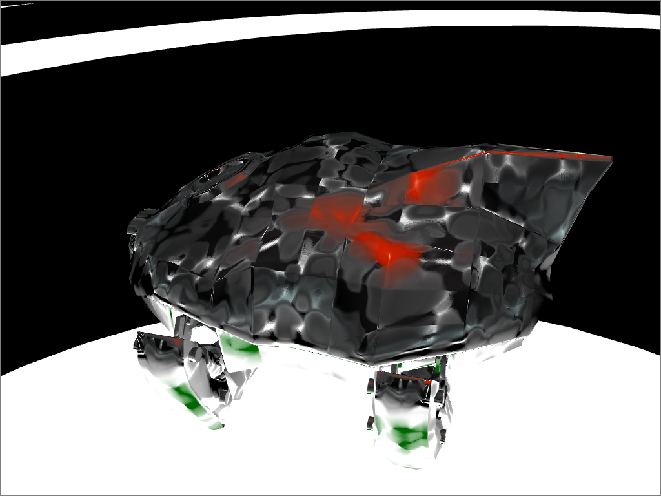
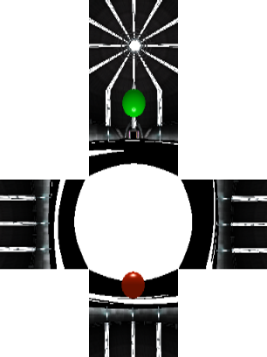
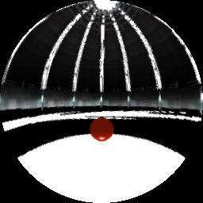
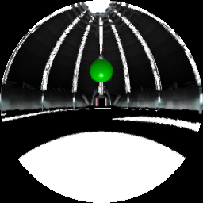
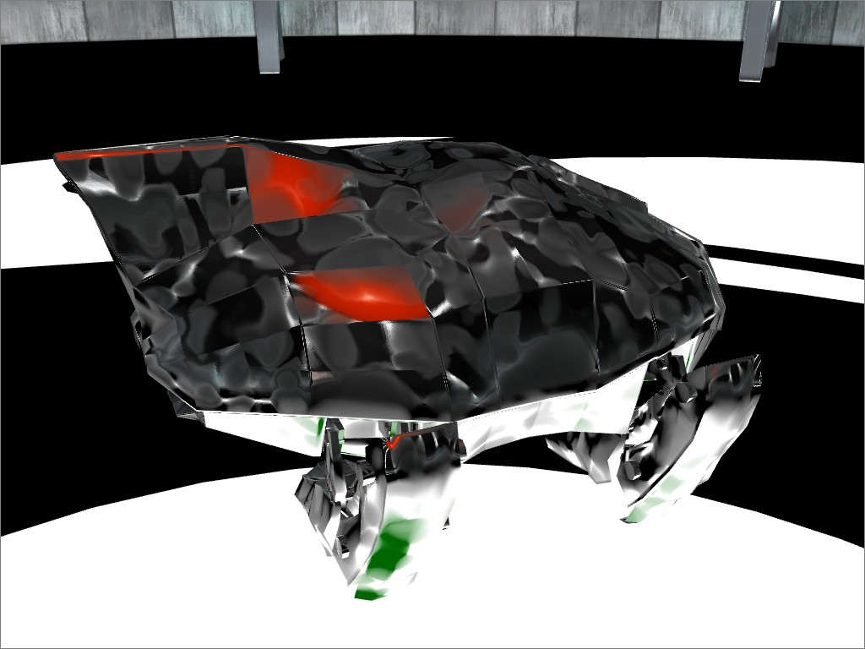
Dynamic Glossy Environmental Reflections [Hensley05]
Sounds like a lot of work, but is actually quite fast on modern hardware
1. Render cubemap
2. Generate dual paraboloid map from cubemap
4. Render final image
3. Generate SAT
Vary filter width procedurally or with an additional texture
Notes:
Error when filtering in env map space is lowest for dual parabaloid maps | Filtering across the corner is difficult for large kernel sizes
This case the filter width is determined with overlapping sine functions that vary over time

Slide 47
Higher-order Summed-Area Tables
Summed-area table → integral of image
Box filter sampling → derivative of filter kernel
Summed-area tables extend to higher-order filters
Precision becomes a problem
Larger filters average error out
f ⊗ g = f′ ⊗ ∫g
[Heckbert86]
f ⊗ g = f′′ ⊗ ∫∫g
n
n
f ⊗ g = f′ ⊗ ∫g
Notes:
F is Filter
G is Image

Slide 48
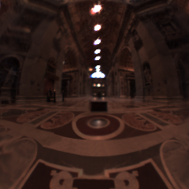
Filtering HDR images
Precision error
original
first-order
(box filter)
HDR data “blows out” filter
second-order
(bartlet filter)
third-order
(quadric filter)
Lightprobe data courtesy of Paul Debevec
Notes:
Offset SATs can help some – see Hensley05

Slide 49
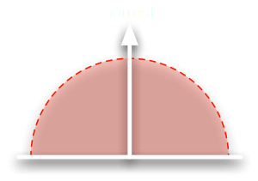
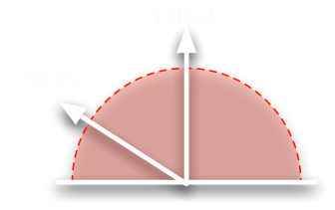
Approximating BRDFs
∧
Average several SAT samples to approximate smoother filter kernels
Approximate a Phong BRDF by combining samples from the normal direction and the reflection direction
Use higher-order SATs to get better filtering
Precision can be an issue above second order
n
∧
n
∧
r

Slide 50
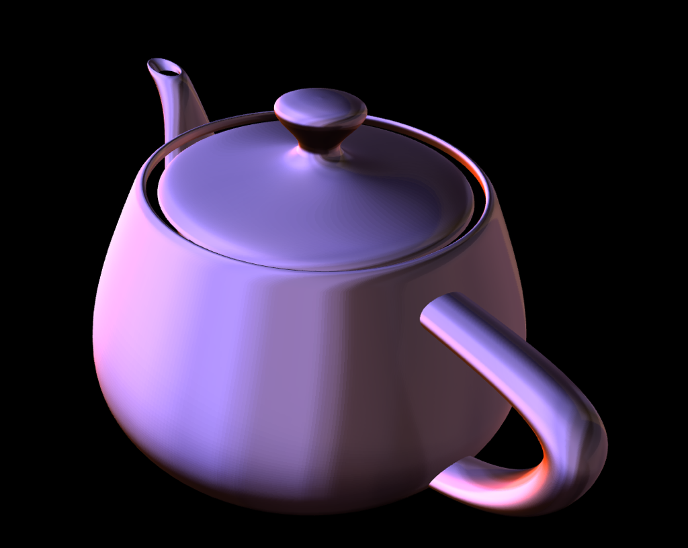
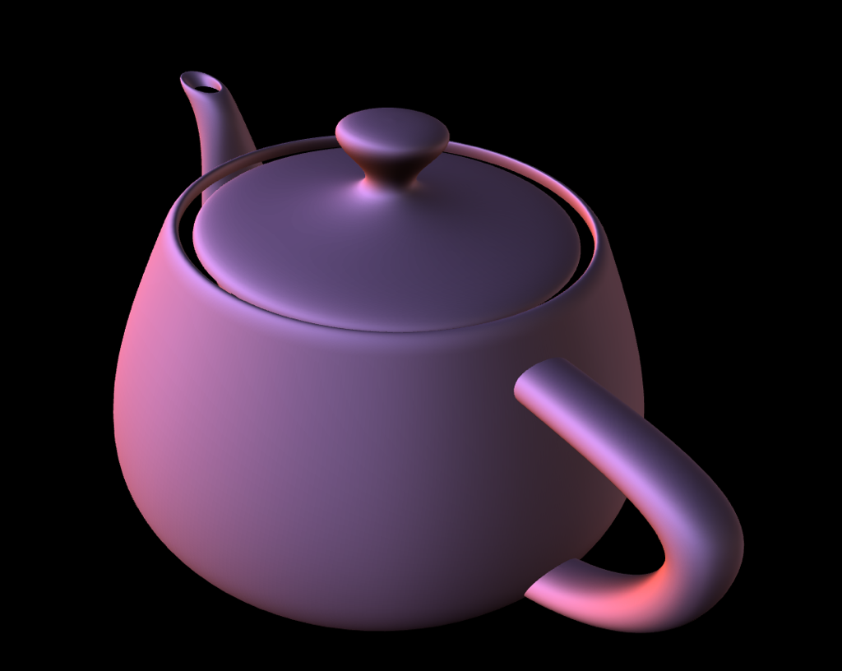
Diffuse Approximation - single filter

Slide 51
Image-Based Lighting
Combine with ambient occlusion
Notes:
Ambient occlusion term + filtered HDR env for lighitng
17 samples - 9 bartlet + 2*4 for box
there is ambient occlusion to help with the folds. pre computed . just modulates filtered value. you don't have to do it. it just makes the creases look better.

Slide 52
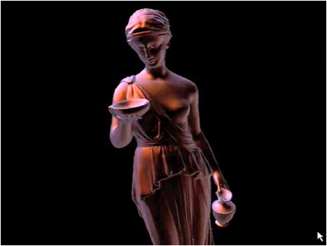
Video
performance: 40 fps when recomputing SATs every frame on an ATI X1900XT
120+ fps when environment map is static
This is a GPU over two generations old!
Notes:
video shows phong apporiximation as camer is moved - all lighting from grace cathedral lightprobe. about half way through we start changing kernel size. kernel can be varied per pixel if desired.

Slide 53
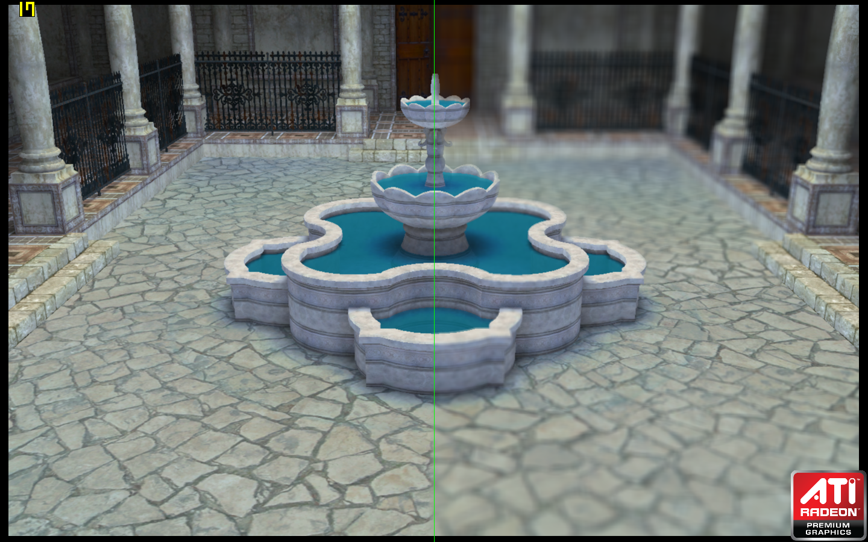
Depth of Field

Slide 54
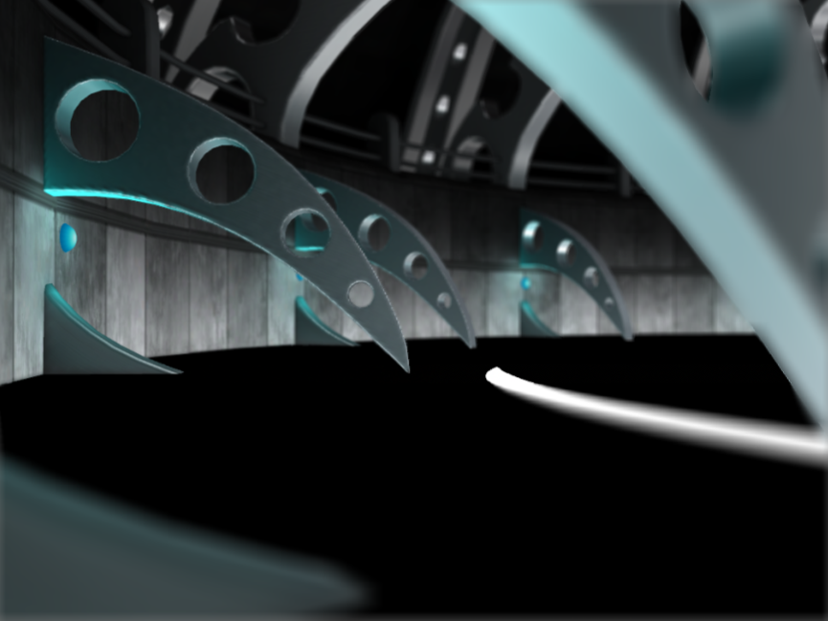
“Gather” based Depth of Field
Render frame to backbuffer
Compute SAT of framebuffer
Sample SAT with filter size modulated by z-buffer
Approximates cameras circle of confusion

Slide 55
Definition of Gathering
Filtering is usually considered a process of taking averages
Weighted average of adjacent pixels taken to produce a blurred pixel
We call this approach “gathering”
Many pixels are gathered together to produce one output
We will show that another approach, “spreading” that is better for depth of field
Similar to splatting, but constant time with size
55

Slide 56
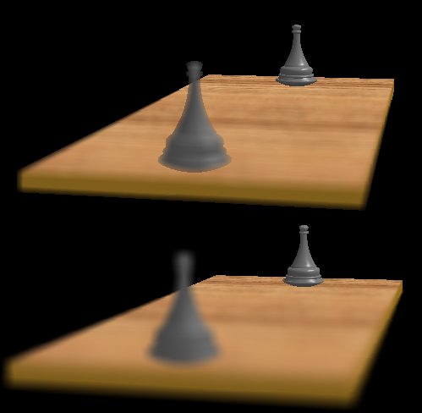
Gather Depth of Field Errors
Silhouette
discontinuous
Intensity
leakage
56

Slide 57
Filter Spreading
[Kosloff09]
Spreading filters operate as follows:
For each pixel in the input image filter
Accumulate filter kernel in the output image
(“spread” pixel data, modulated by kernel, to neighborhood)
Spreading accurately simulates the physics of depth of field
57
Notes:
Why do we see DOF errors in gathering, but not in spreading?
What should I say to the demo?
Are you missing something in the “Filter Spreading” slide (after “gather…errors”)
Don’t I need to compute the SAT of the accumulated output image?

Slide 58
Gathering vs. Spreading
Gathering
Spreading
input
Spreading more correctly blurs the silhouette edge
output
58

Slide 59
Fast Spreading
Naïve implementations of filter spreading require O(N^2) time in the number of image pixels (very slow).
Just talked about constant time “gather” filters
SATs one possible technique
Modify SAT methodology to implement fast spreading
Basically run operations in “reverse”
1. Accumulate delta functions
2. Integrate result
AMD session @ Beyond Programmable Shading, Thurs.
59

Slide 60
Demo

Slide 61
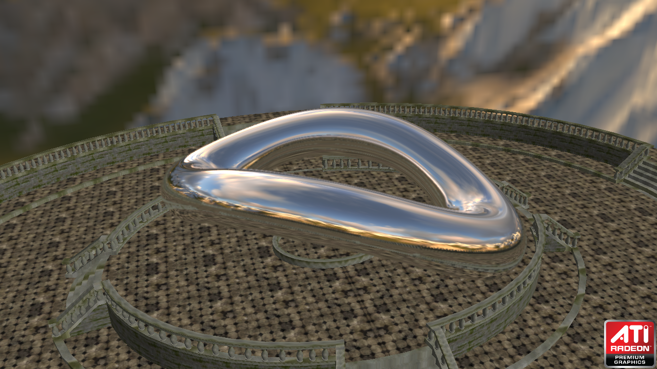
Hybrid Ray Tracing Using a Standard Graphics API

Slide 62
Recent Activity
Intel
Quake Wars
20-30 fps @ 1280x720 on an Intel 2.66 GHz Dunnington [Intel Visual Adrenaline Issue 2, 2009]
NVIDIA
Bugatti Demo
Caustic Graphics

Slide 63
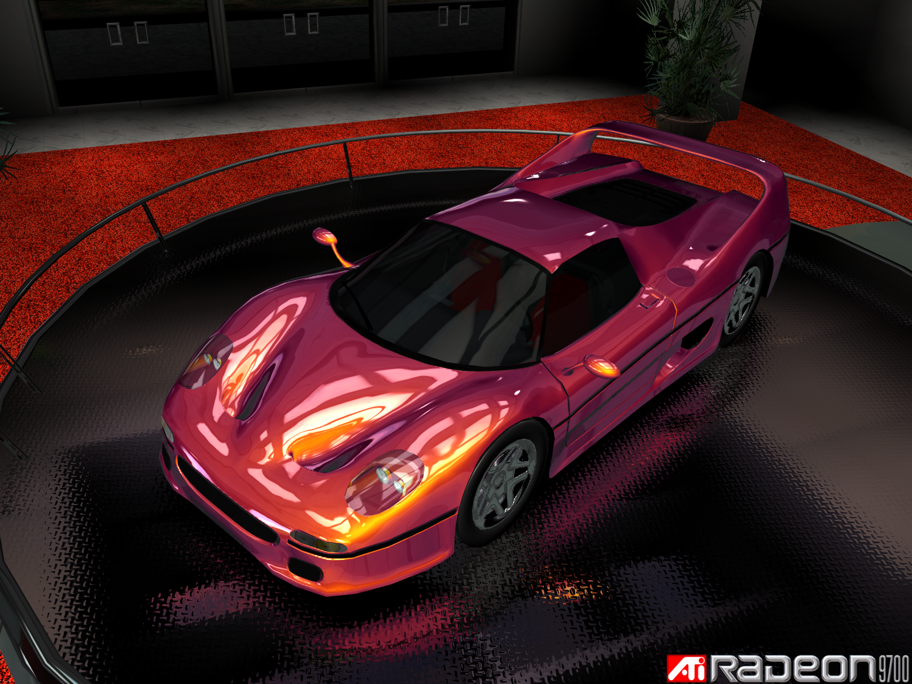
Ray Tracing vs. Rasterization
Rasterization is still “faster” than ray tracing
Ray tracing can handle some effects better than rasterization
Reflections
Soft shadows
Global illumination
Gratuitous Car Shot
Rasterization!
Radeon 9700 Demo!

Slide 64
Motivation
Investigate hybrid ray-tracing
Ray trace only reflections
Rasterize everything else (including primary rays)
Identify issues game developers must address when integrating into an existing game engine infrastructure
Game engines are designed and optimized for GPUs
Art assets and material shaders
Notes:
Easier said than done
Tracing rays in a pixel shader, while difficult to make fast, is relatively straightforward to implement. However, integrating raytracing into an existing rendering engine and material framework is a much more difficult task, and could be a significant hurdle to the adoption of raytracing in games.
Game engines often require the ability to define a large number of different materials, with a large number of distinct textures and shading properties. In the stereotypical game engine, objects with different material properties are submitted to the GPU as separate batches of geometry, so that the resources used for each material (shaders and textures) can be kept separate from one another.
In a raytracer, this separation of materials is no longer possible, because a given ray may hit any object in the scene. We therefore need the ability to compute the color of any material at any location in the scene, all within a single shader. In a complex material system, this is a non-trivial problem.

Slide 65
Experimental System Architecture
Integrate into ATI’s rendering engine used for the Ruby demos
Implement in MS DirectX 10.1
Tested on an ATI Radeon HD 4870
We do not handle deformable objects

Slide 66
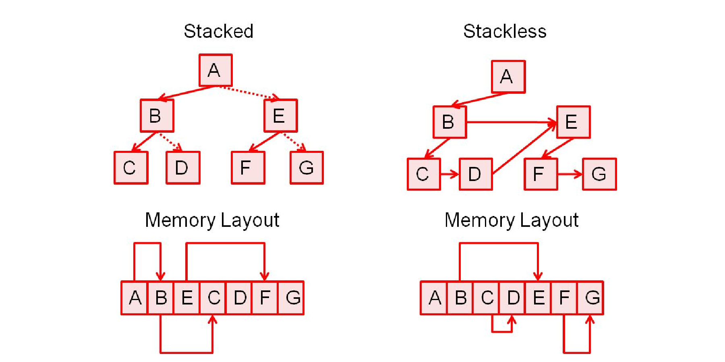
Data Structure
Bounding Volume Hierarchy
Stackless Bounding Volume Hierarchy
KD Tree
Bounding Interval Hierarchy

Slide 67
Data Structure Test Scene
Four materials → Four separate trees
Torus (20,872 triangles)
Park (255,488 triangles)

Slide 68
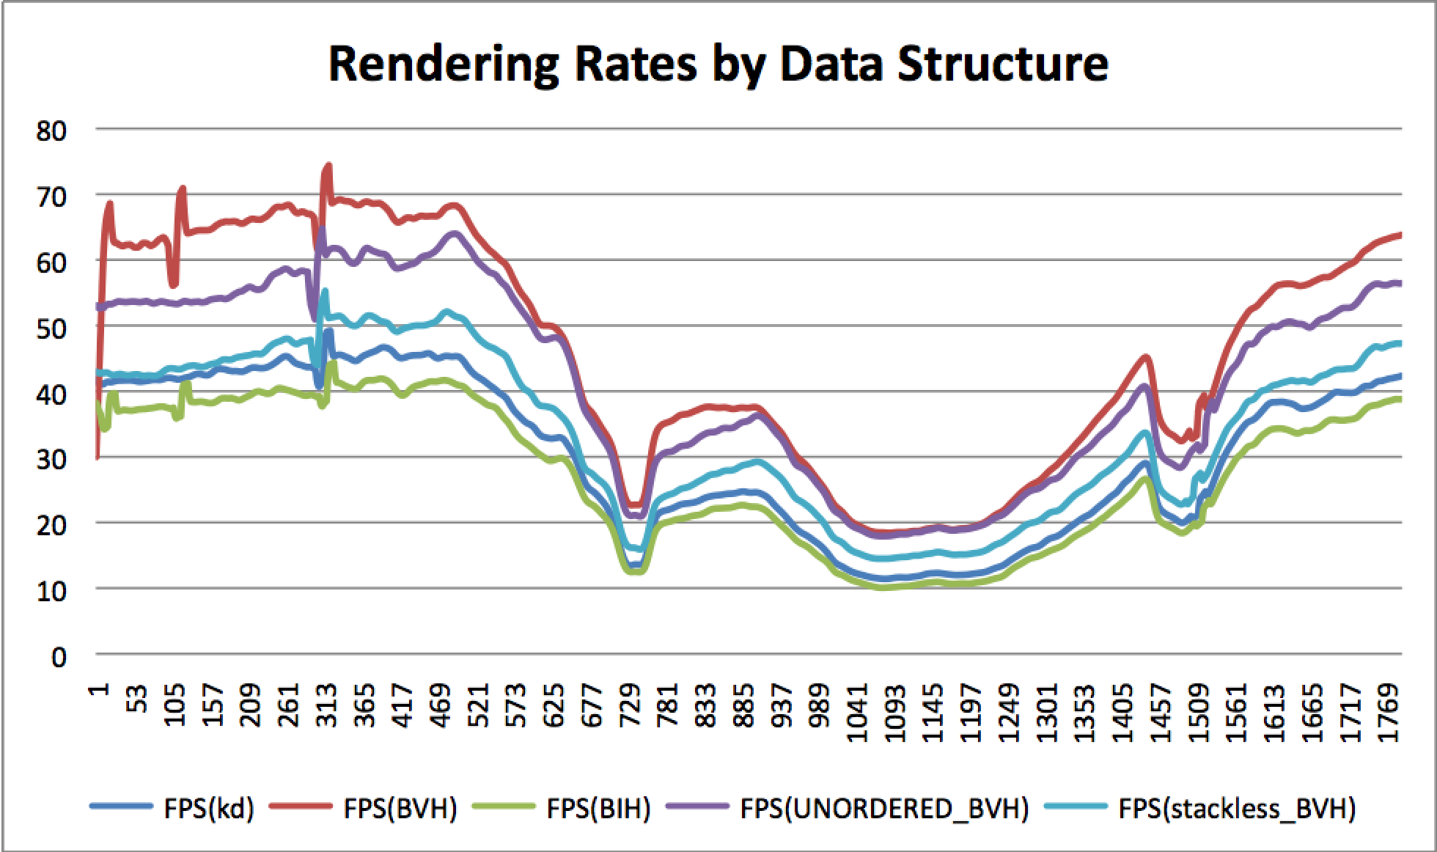
Results

Slide 69
Metrics
 | Nodes | Max Depth | Avg Depth | Triangles | Avg Tris/Leaf | Tree Size (MB)
BVH | 113994 | 21 | 15.4 | 288852 | 5.07 | 3.48
KD | 171048 | 27 | 19.8 | 834996 | 9.76 | 4.49
BIH | 140944 | 27 | 19.1 | 288852 | 4.88 | 2.15
Test Scene Data
Algorithm | ALU Ops (VLIW) | Time (s) | % ALU Util | % TEX Util | Traversals | Writes Per Traversal | GPR count
BVH | 7.41555E+12 | 131.68 | 46.92 | 30.57 | 2.15418E+11 | 0.112 | 14
KD | 7.79515E+12 | 184.77 | 35.15 | 22.35 | 3.02104E+11 | 0.168 | 18
BVH_Stackless | 1.56182E+13 | 198.73 | 65.49 | 37.44 | 3.7035E+11 | 0 | 15
BIH | 1.02991E+13 | 210.26 | 40.81 | 15.21 | 3.28972E+11 | 0.165 | 11
10,000 Random Rays
BVH Advantages
Can vectorize tests
Handles empty space better
Stack is not a bottleneck

Slide 70
How to shade?
Vertex Attributes must be interpolated across the triangle
Normals
Texture coordinates
GPU usually handles this in hardware
Must do this in shader at ray hit locations

Slide 71
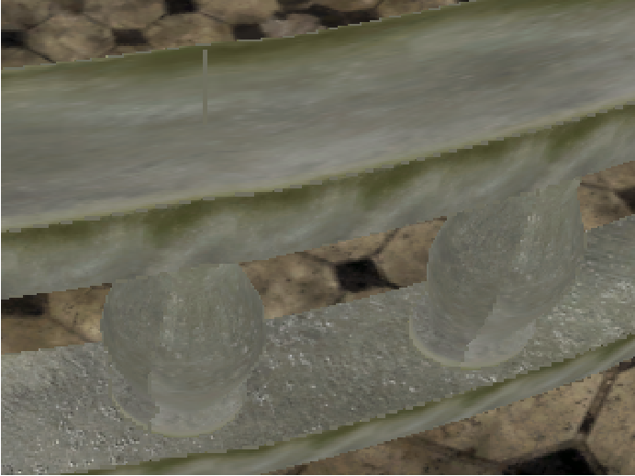
Texture Filtering
Igehy, H. “Tracing Ray Differentials”. SIGGRAPH 1999.

Slide 72
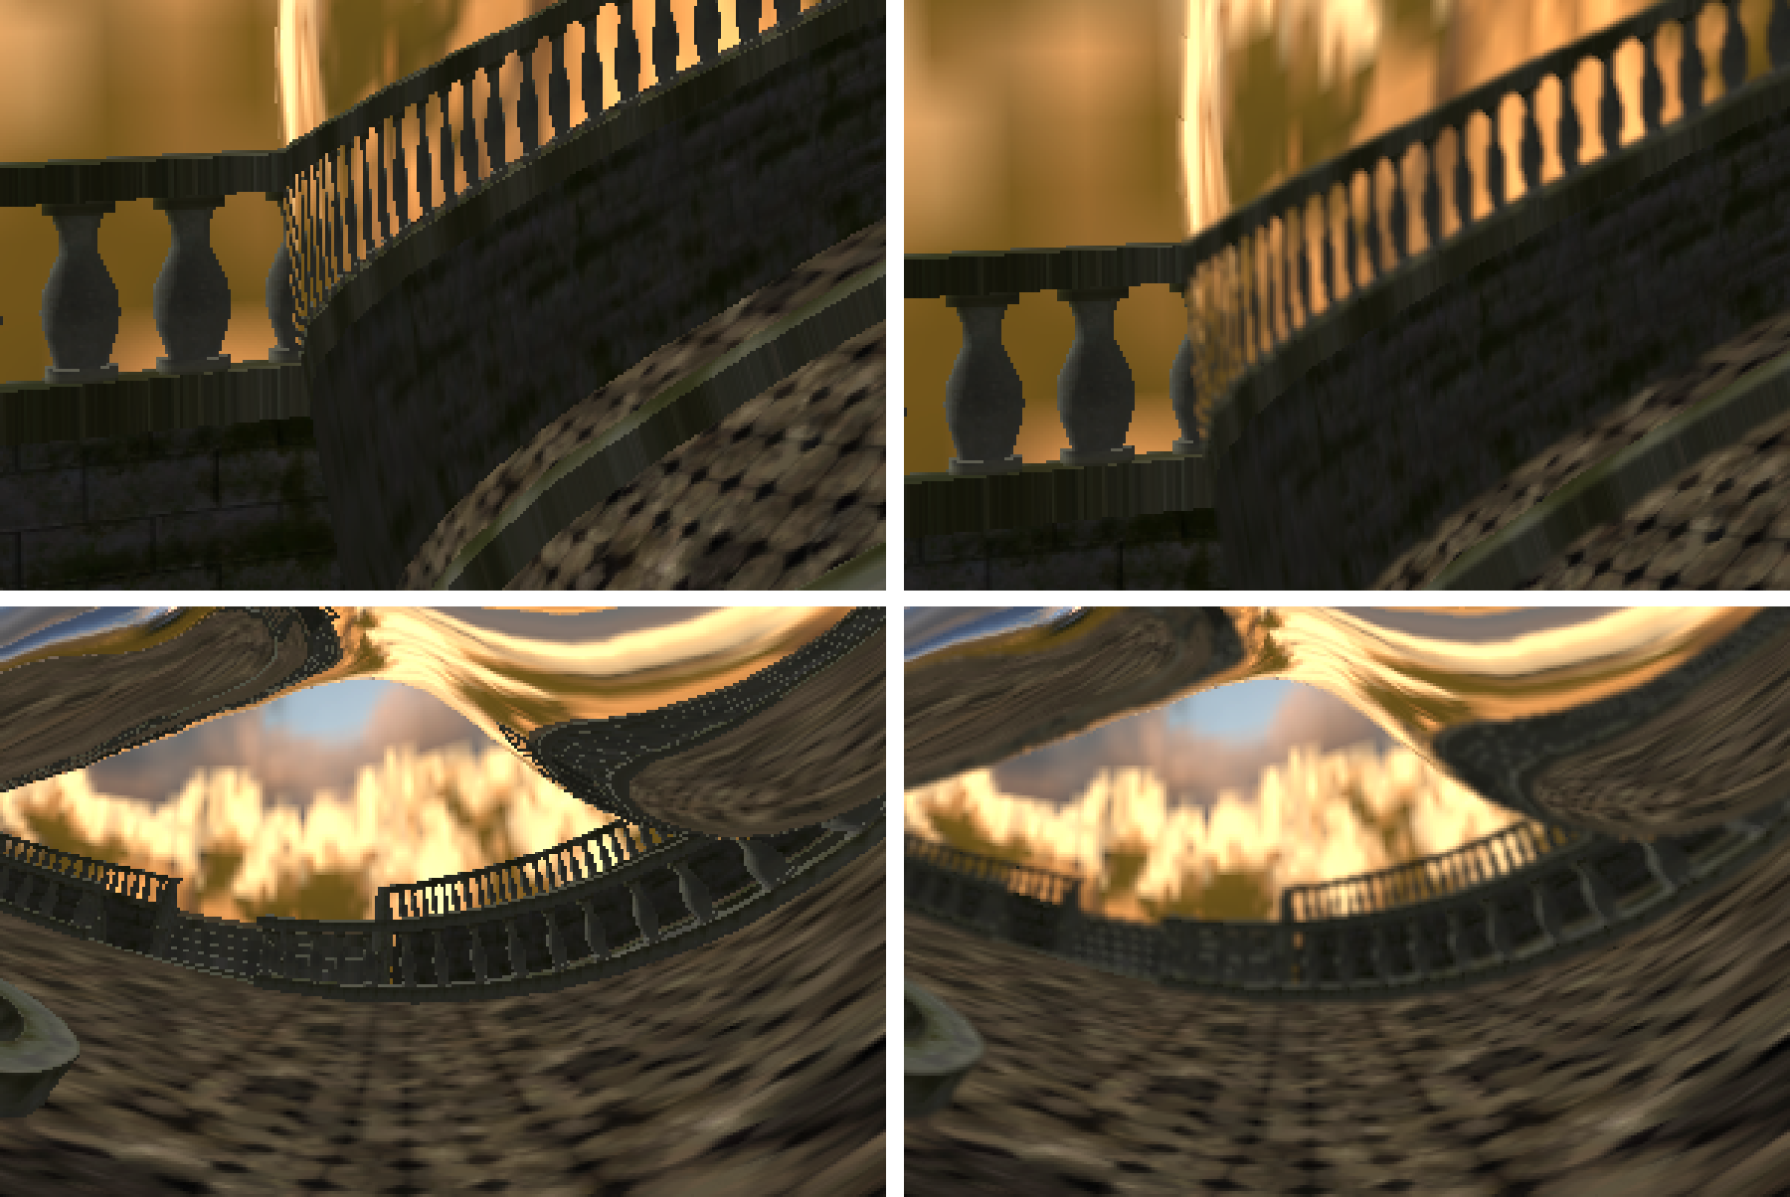
Geometric Aliasing

Slide 73
Geometric Aliasing
Supersample, but expensive
AA only on edges (similar method of deferred shading)
Surface normal variation
Depth discontinuities
Object edges

Slide 74
Number of Bounces
1 Bounce
2 Bounce

Slide 75
Number of Bounces
3 Bounce

Slide 76
Single Pass vs. Multi Pass Shader
Single pass
One rendering pass per reflective object
Easier to manage during rendering
Not well suited during production
Each material change requires shader update
Performance issues
Multi pass
More closely resembles a conventional forward-rendering
Much more flexible

Slide 77
Multi Pass Ray Tracing
Rasterize all objects and save ray reflection info of shiny objects to a MRT and stencil
Render a quad for each potential object to be hit by a ray
Shade every hit and save the hit distance
Discard by alpha if distance is further than previous hit
Distance buffer needs to be ping ponged due to read-write limitation of DX 10.1, but solved using DX 11
Cannot clip because distance is needed

Slide 78
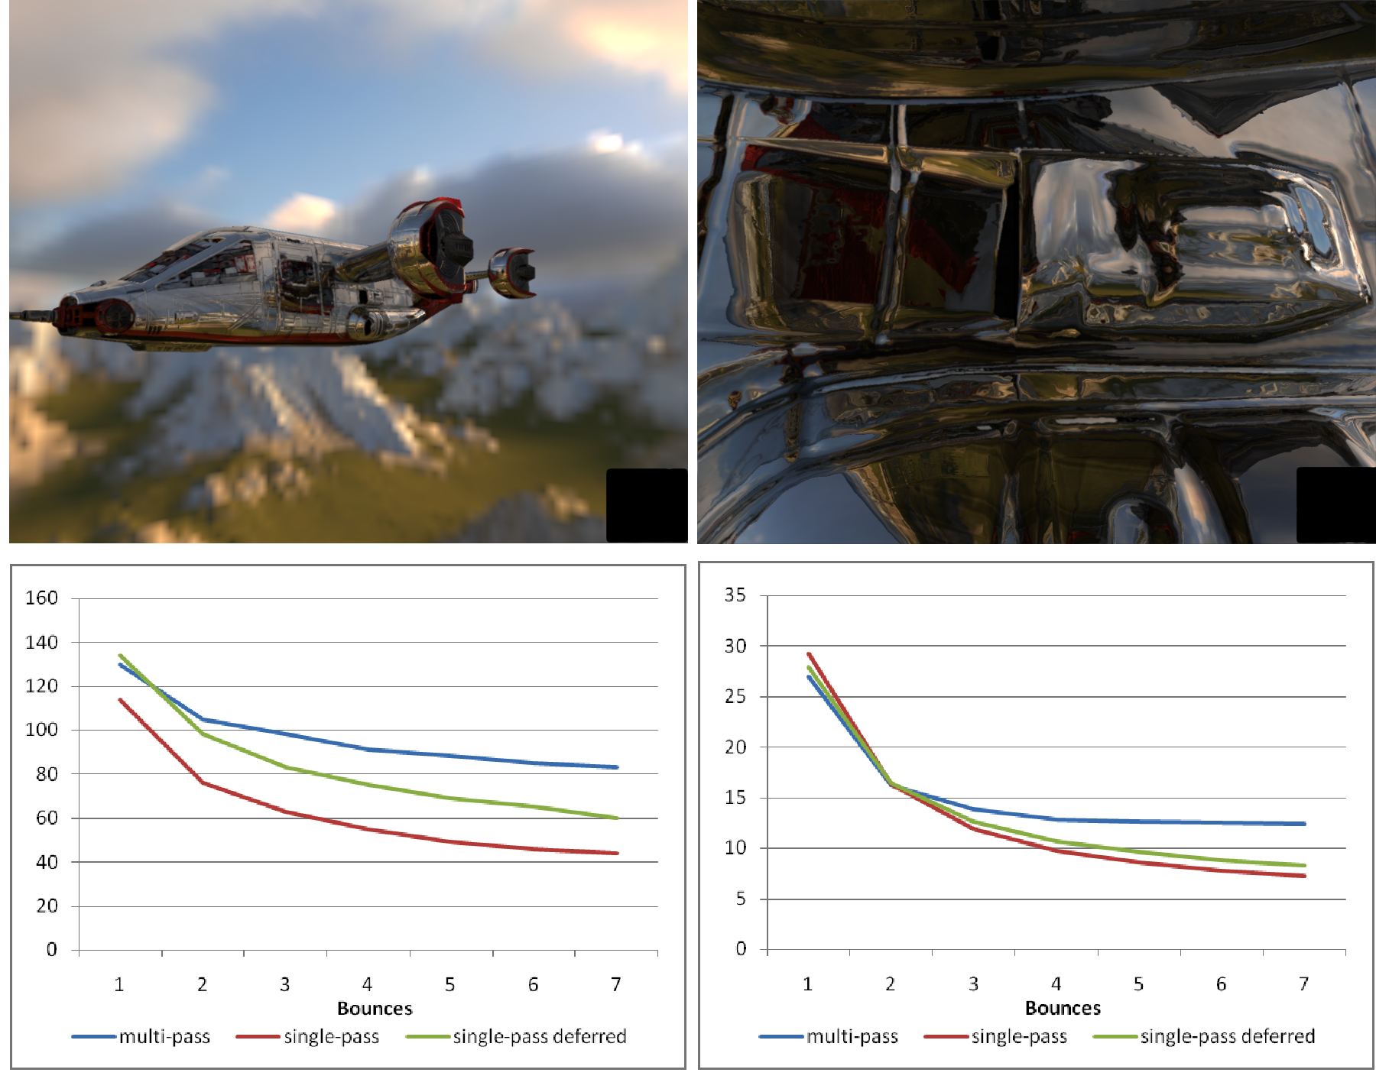
Performance Scaling

Slide 79
Demo
Demo will be running at the AMD booth

Slide 80
Acknowledgements
Konstantine Iourcha (AMD)
Andy Pomianowski (AMD)
Jeff Golds (AMD)
Justin Hensley (AMD)
Joshua Barczak (Firaxis Games)
Todd Kosloff (UC Berkeley)
Futuremark
Tommti-Systems

Slide 81
References
Catmull, E. 1978. A hidden-surface algorithm with anti-aliasing. In SIGGRAPH '78: Proceedings of the 5th Annual Conference on Computer Graphics and Interactive Techniques.
Crow, F. C. 1984. Summed-area tables for texture mapping. In SIGGRAPH '84: Proceedings of the 11th Annual Conference on Computer Graphics and Interactive Techniques.
Heckbert, P. S. 1986. Filtering by repeated integration. In SIGGRAPH '86: Proceedings of the 13th Annual Conference on Computer Graphics and Interactive Techniques.
Hensley, J., Scheuermann, T., Singh, M., and Lastra, A. 2005. Interactive summed-area table generation for glossy environmental reflections. In ACM SIGGRAPH 2005 Sketches.
Iourcha, K., Yang, J. C., and Pomianowski, A. 2009. A directionally adaptive edge anti-aliasing filter. In Proceedings of the Conference on High Performance Graphics 2009.
Kosloff, T. J., Tao, M. W., and Barsky, B. A. 2009. Depth of field postprocessing for layered scenes using constant-time rectangle spreading. In Proceedings of Graphics Interface 2009.

Slide 82
Trademark Attribution
AMD, the AMD Arrow logo and combinations thereof are trademarks of Advanced Micro Devices, Inc. in the United States and/or other jurisdictions. Other names used in this presentation are for identification purposes only and may be trademarks of their respective owners.
©2009 Advanced Micro Devices, Inc. All rights reserved.

