Slide 1

Rendering Technology at Black Rock Studio
Jeremy Moore / David Jefferies
Advances in Real-Time Rendering in 3D Graphics and Games

Slide 2
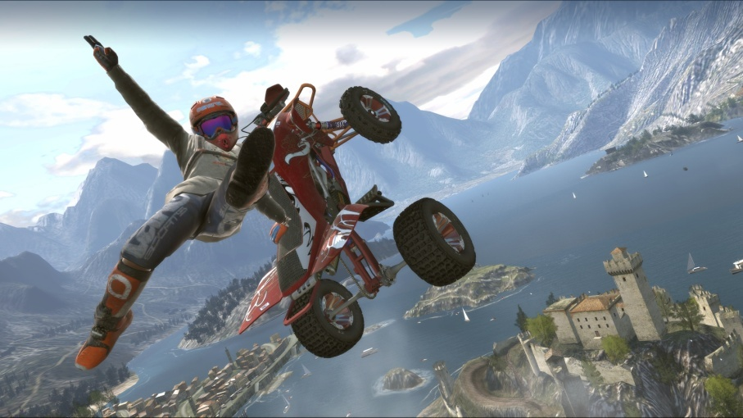

Talk Contents

Slide 3
Part 1: Foliage Rendering in Pure

Slide 4
Talk Contents
Requirements for Pure
Alpha Compositing Basics
Ground Cover Rendering in Pure
Tree Rendering in Pure
Screen-Space Alpha Mask Technique

Slide 5


Pure Game Footage

Slide 6
Pure Game Footage Minus Foliage

Slide 7
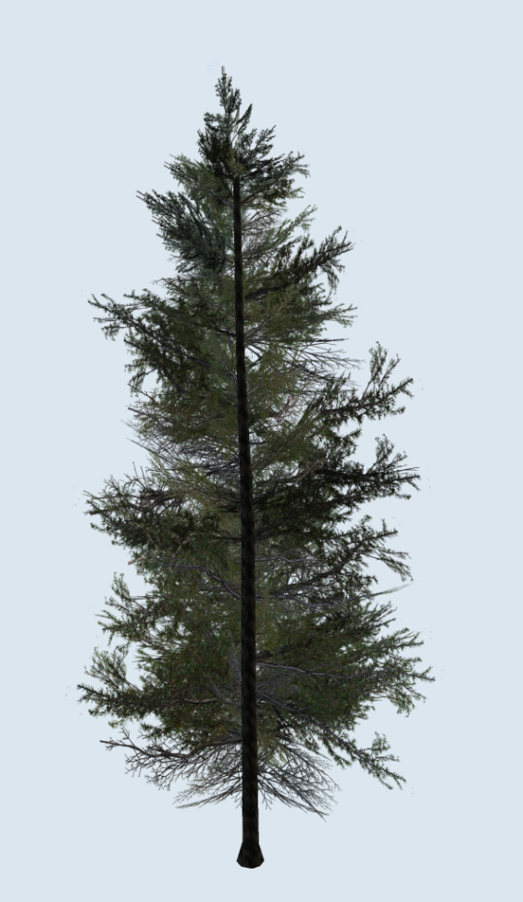
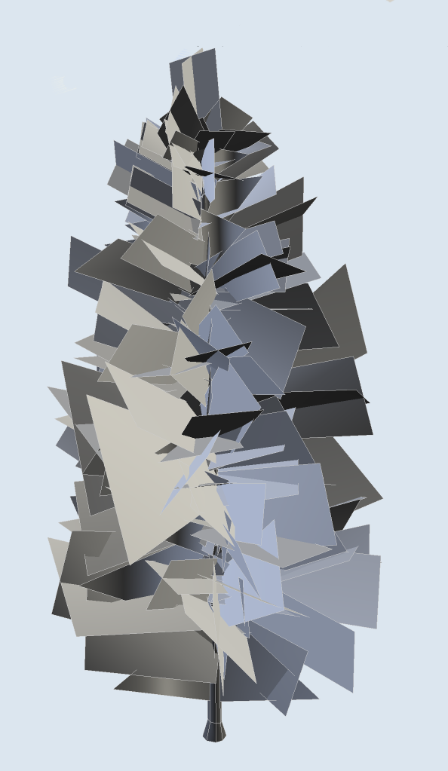
Foliage Rendering Using Alpha Textures

Slide 8
Alpha Compositing Basics
Alpha blending
Alpha testing
Alpha to coverage

Slide 9
Alpha Blending
Blend rendered fragment with destination pixel data according to a scalar blend value
result = (1-alpha)*destination + alpha*source
Requires a read/blend/write operation
Operation is not associative
  Rendered objects should be sorted
  Especially when combined with z-buffer use

Slide 10
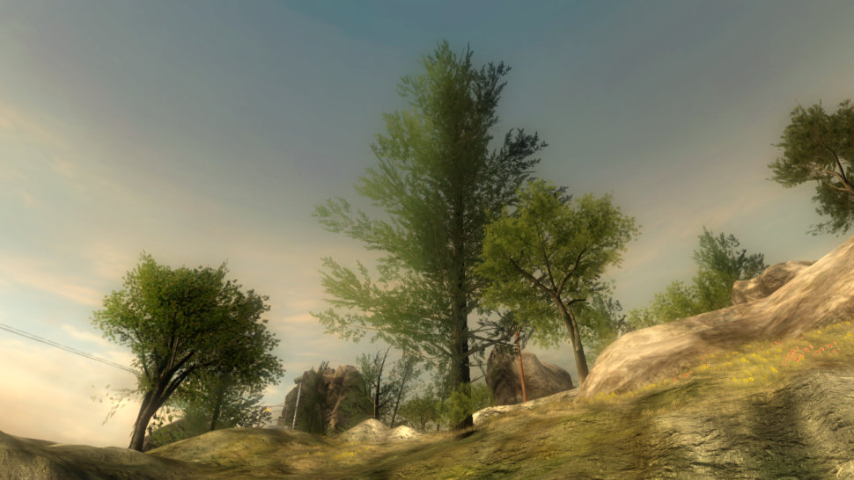
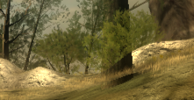

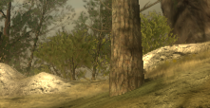
Alpha Blend Depth Ordering

Slide 11
Alpha Testing
One bit value determines if fragment is visible
Works with z-buffer
Can cause aliasing

Slide 12
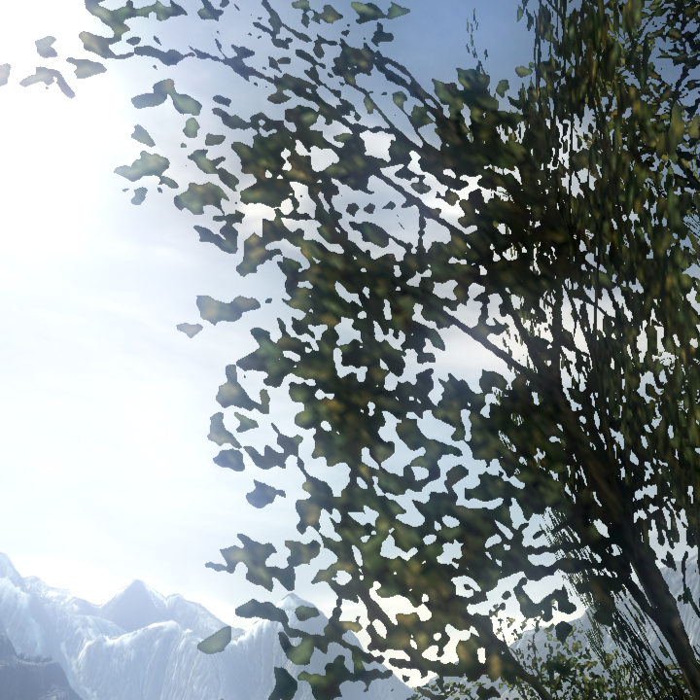

Alpha Test Aliasing

Slide 13
Alpha To Coverage
Converts alpha into a coverage mask for the pixel
Coverage mask is AND'd with MSAA coverage mask
Gives softer edges when combined with alpha testing
Works with z-buffer
But… the resulting alpha gradients don't always look great

Slide 14
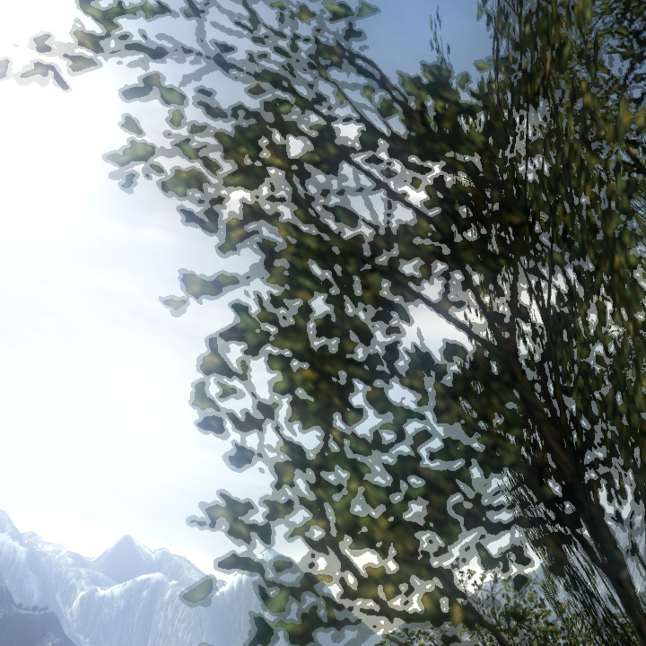

Alpha To Coverage Aliasing

Slide 15
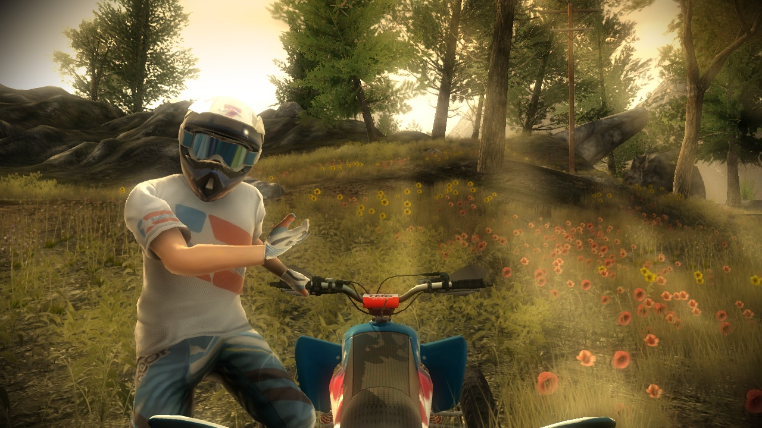
Ground Cover in Pure

Slide 16
Ground Cover Overview
Offline
Density map
2D map used to place cover
Camera movement
Tile cache
Calculated cover type/position/size
Per frame
Vertex buffer
Sprite vertices encoding type/position/size

Slide 17
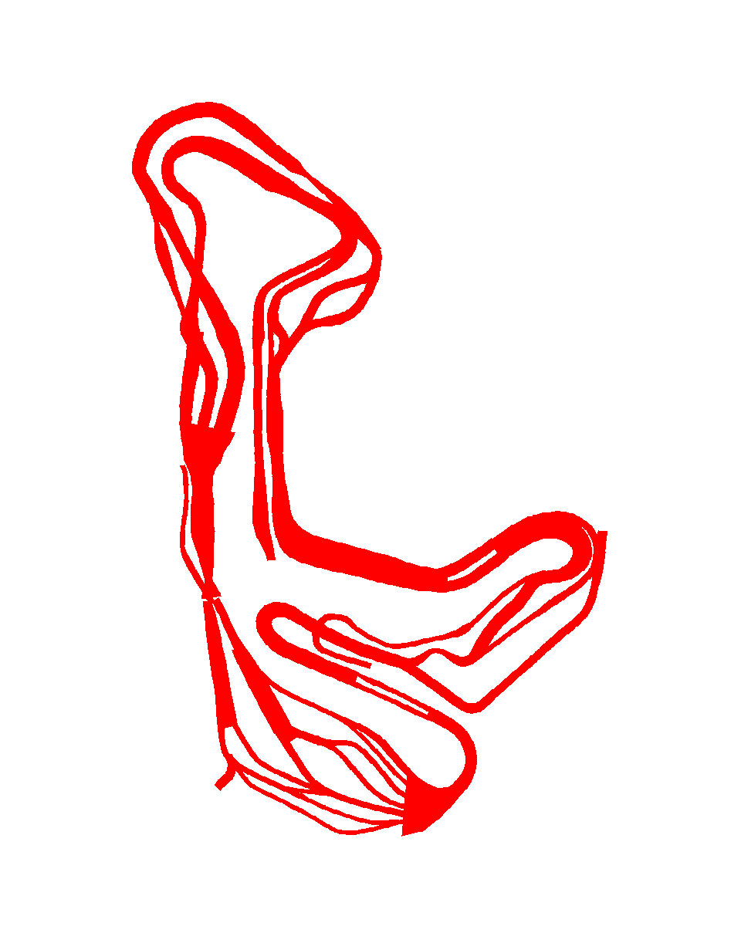
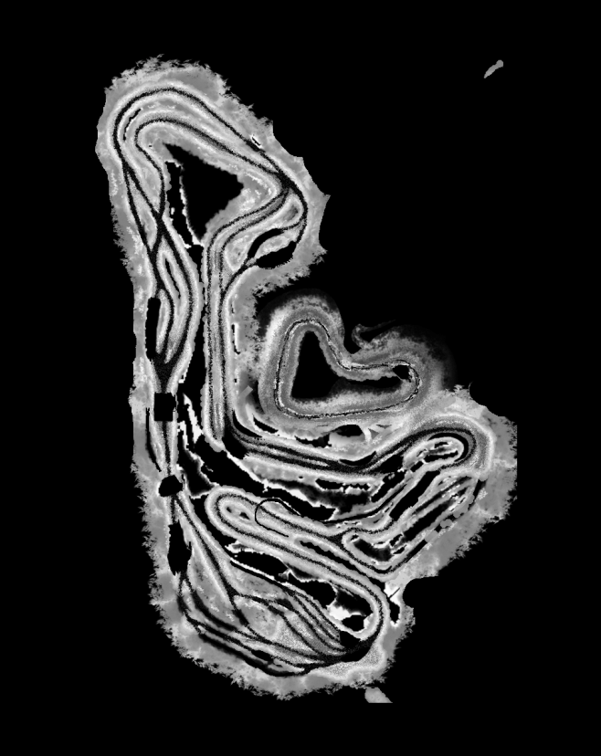
Ground Cover Placement

Slide 18
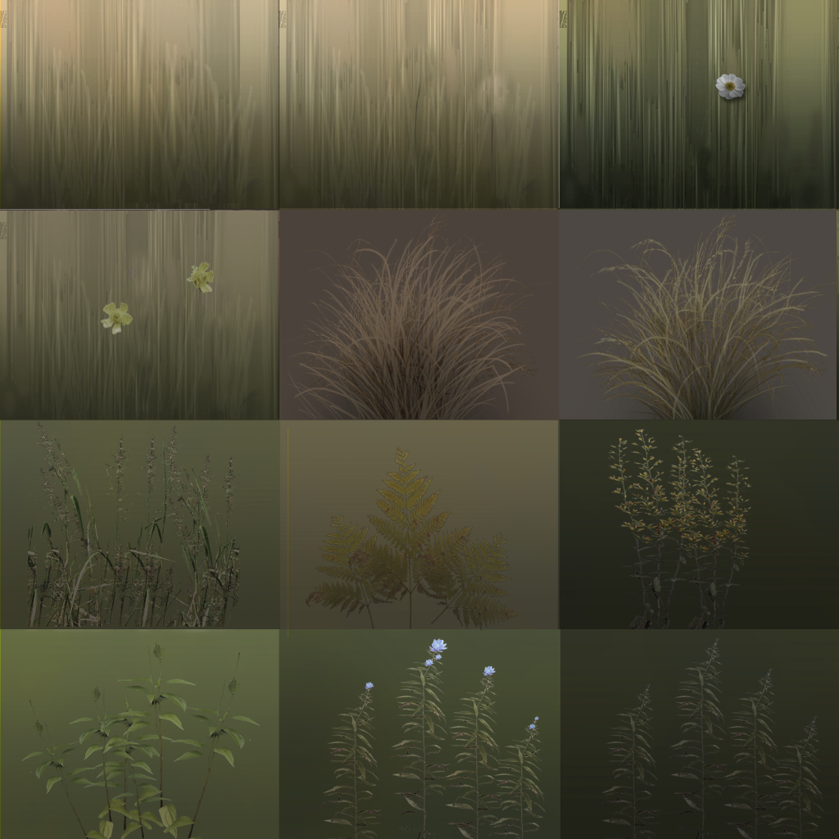
Ground Cover Textures

Slide 19
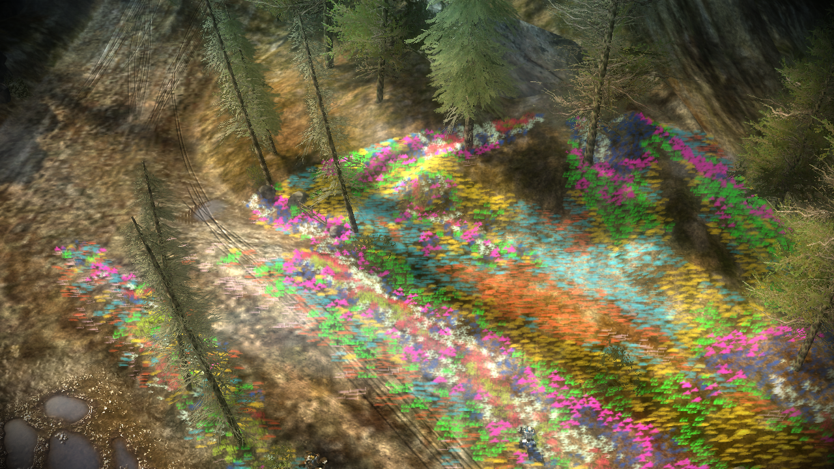
Ground Cover Rendering Area

Slide 20
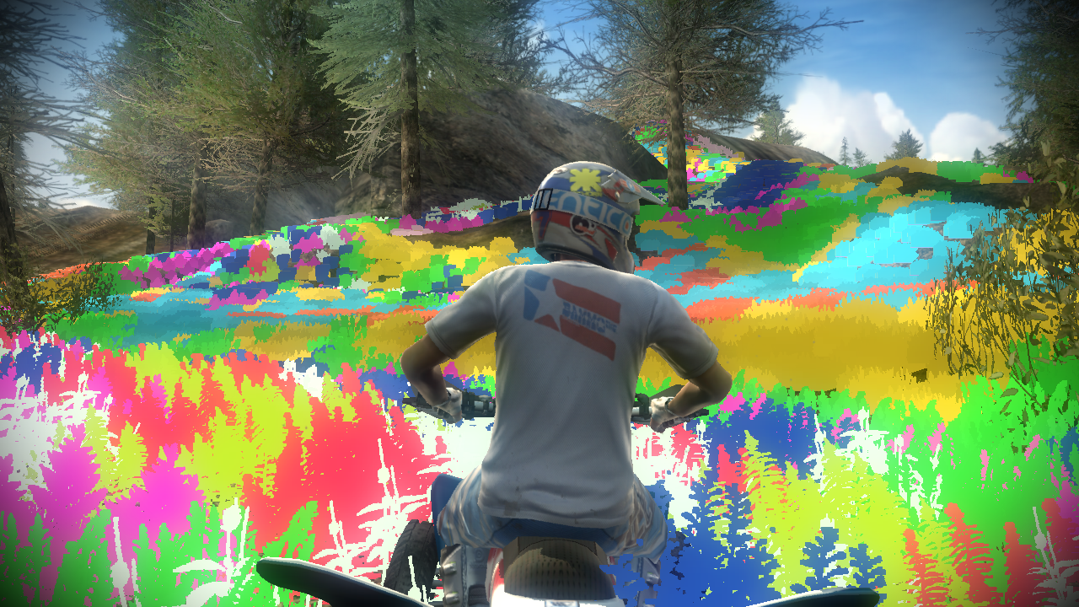
Ground Cover Rendering

Slide 21
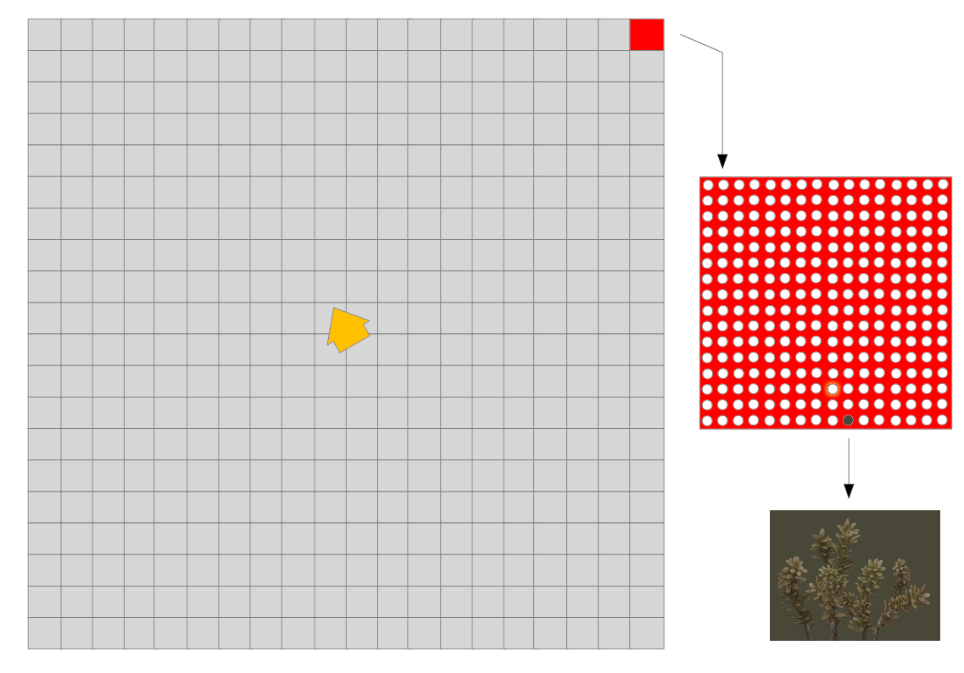
Ground Cover Processing

Slide 22
Ground Cover Tiles
Grass rendered in fixed region around camera
Region divided into 400 tiles of 8 meters square
Each meter square contains 4 screen aligned sprites
So each tile contains 256 sprites
  Each sprite information is encoded as a vector4
Tiles are cached in memory

Slide 23
Ground Cover Vertex Buffers
Vertex buffers are generated per frame
Tile information is copied from the tile cache
16KB needs to be copied by the CPU for each visible tile
Vertex format and shader details in course notes

Slide 24
Ground Cover Vertex Shader
void decode_vertex(INPUT input, out OUTPUT output) { // pos.w integer part contains: // corner = grass_type*4 + vertex_index float corner = floor( input.pos.w ); // corner is used to lookup into preset // array of uv and size information float4 vSpriteInfo = SpriteInfoArray[ corner ]; // pos.w fractional part contains the random size scale // this is halved so that we don't overflow float scale = input.pos.w - corner; float scale *= 2; // fill texture uvs output.uv = vSpriteInfo.xy; // fill position output.pos = float4( input.pos.xyz, 1 ); // get postion offset from sprite centre float2 offset = vSpriteInfo.wz; offset *= scale; // grow face horizontally // up and right are calculated elsewhere in the shader output.pos.xz += input.right.xz * offset.x; // grow face vertically output.pos.xyz += input.up.xyz * offset.y; }

Slide 25
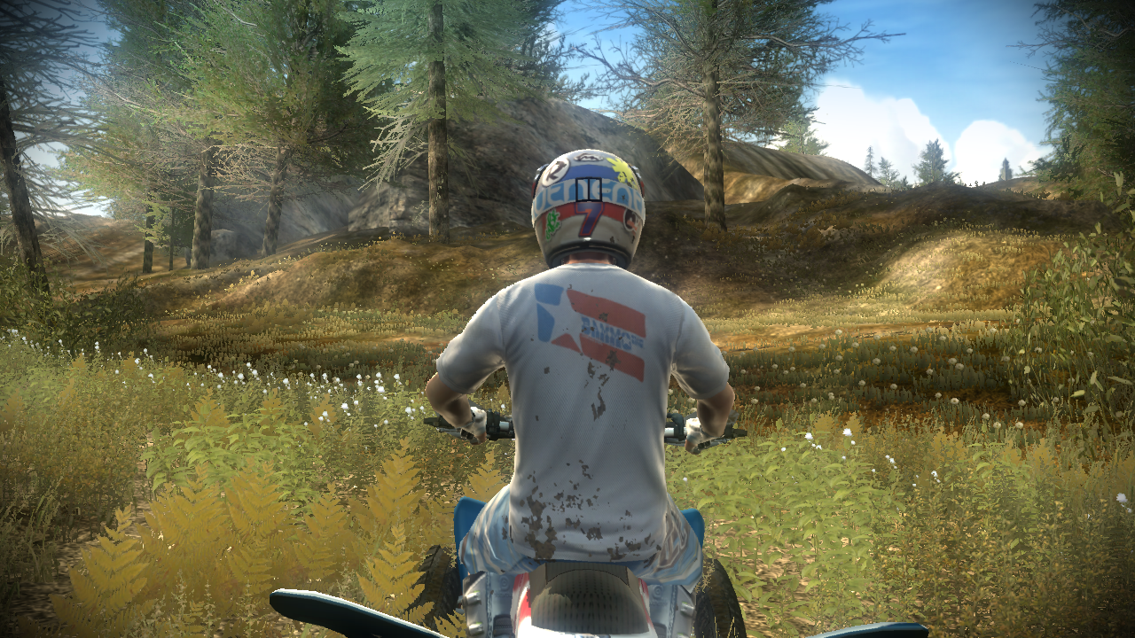
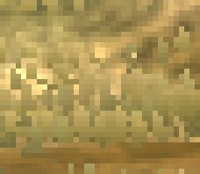
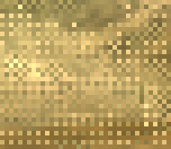

Ground Cover Alpha Compositing
Alpha Mask
Alpha To Coverage
Alpha Blend

Slide 26
Ground Cover Render Order
Alpha blending requires geometry sorting
But regular geometry placement makes sorting easier
Two levels of granularity
  Tiles are rendered from back to front
  Sprites are ordered within each tile

Slide 27
Ground Cover Render Order
Ordering within each tile is pre-calculated
  We pre-calculate render orders for 16 camera directions
  And chose the order for the camera direction that most closely matches the current one
  For performance we group sprites into 32 “cells” of 8 and only sort at the cell level

Slide 28
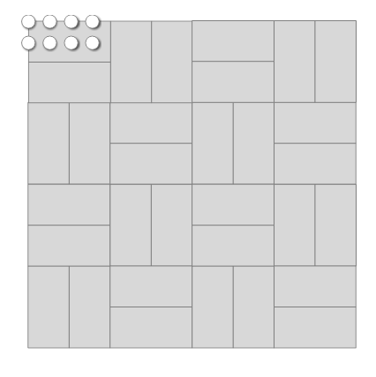
Ground Cover Tile Cell Layout

Slide 29
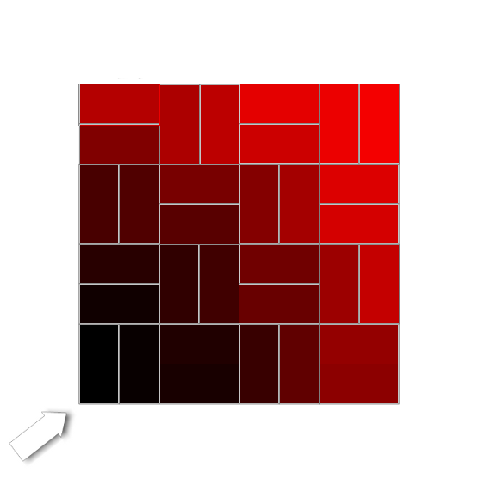
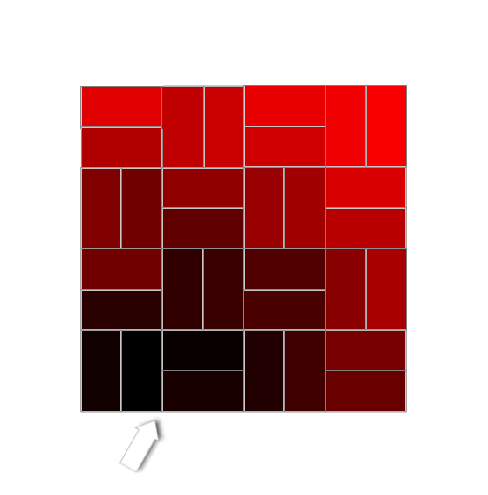
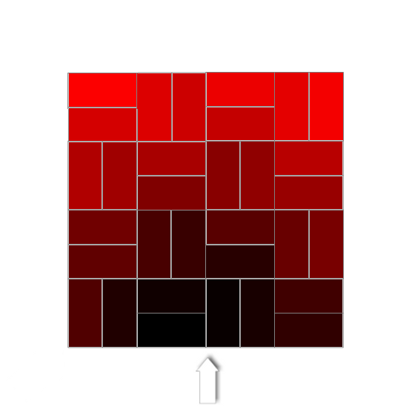
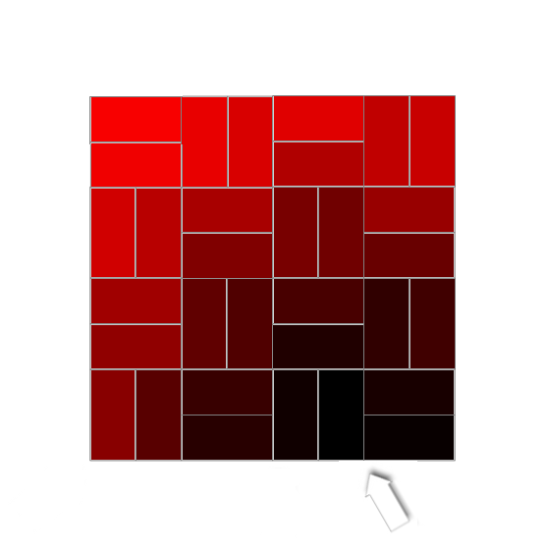
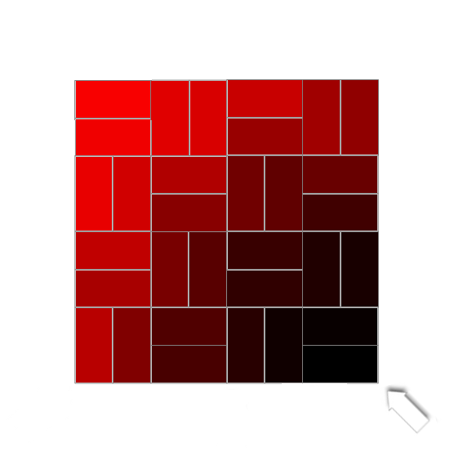
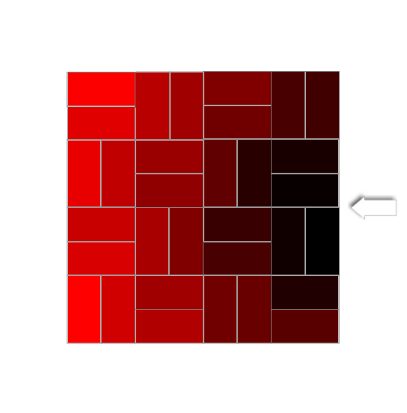
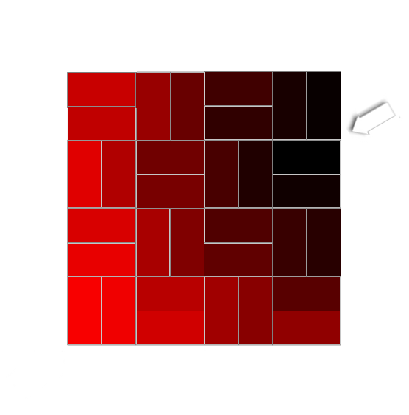
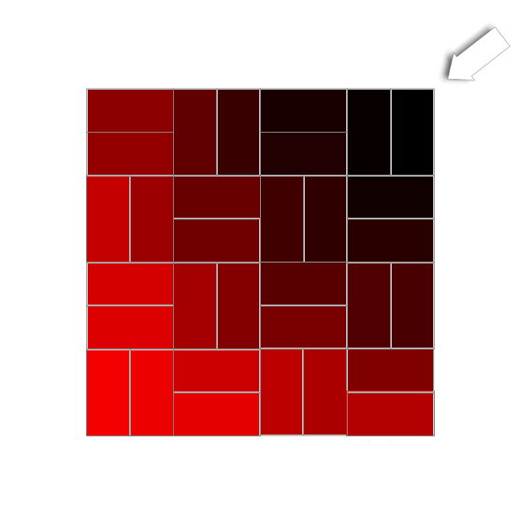
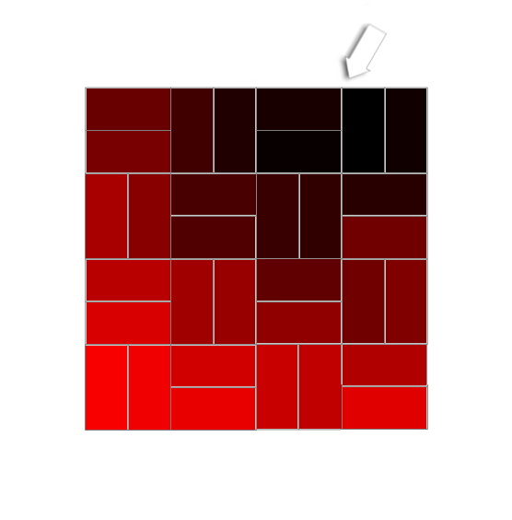
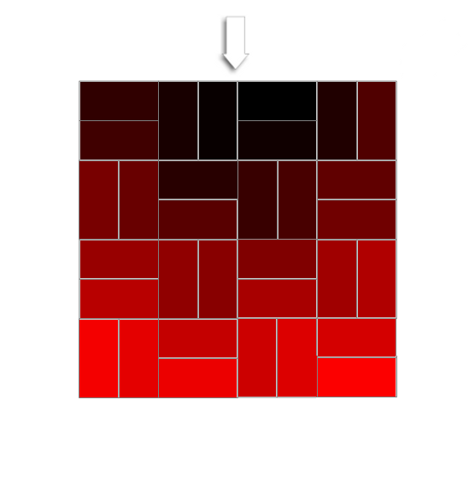
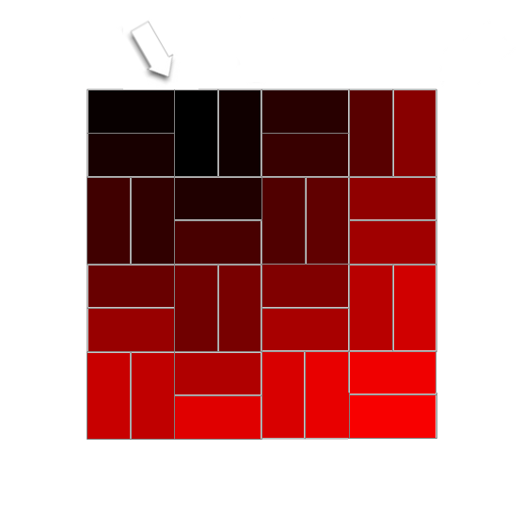
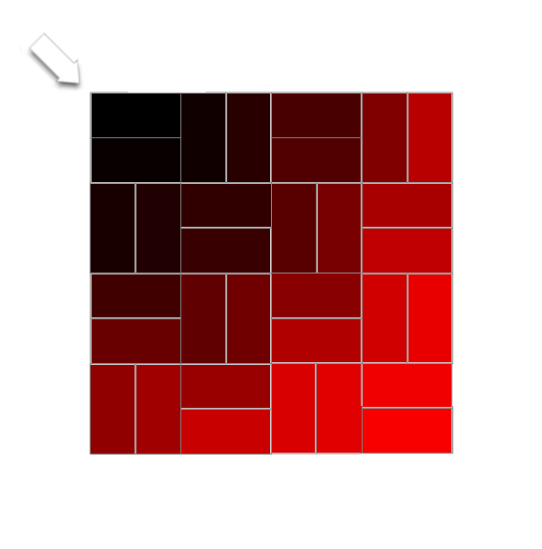
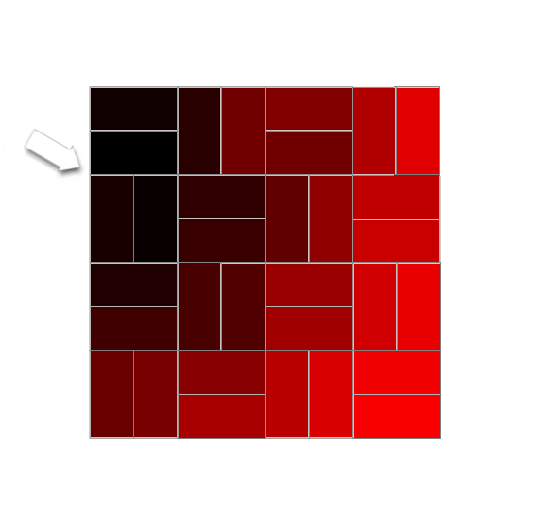
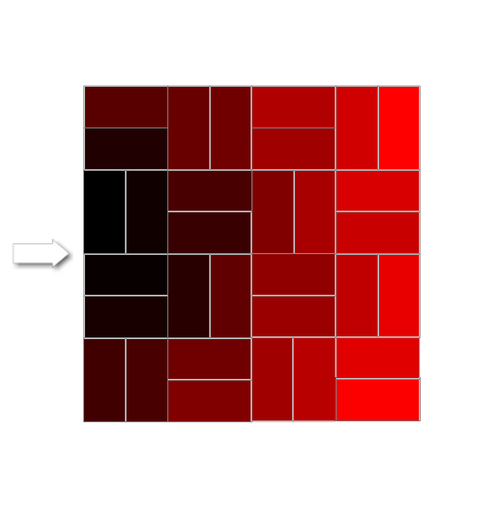
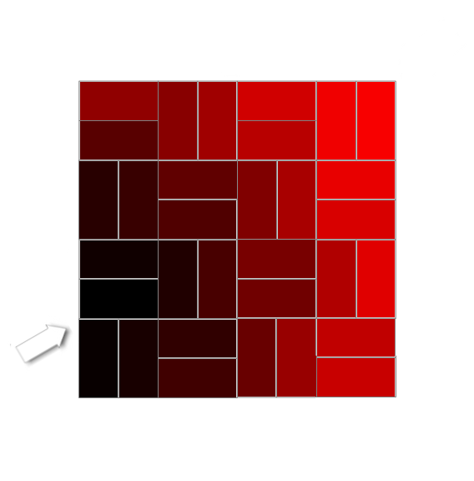
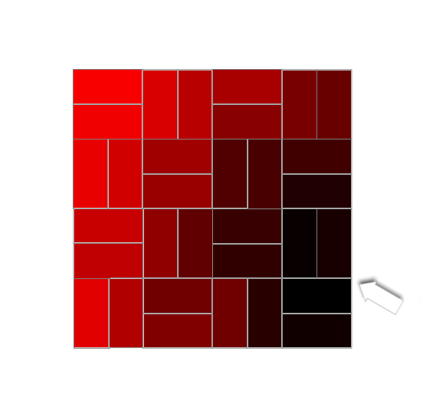
Ground Cover Cell Ordering

Slide 30
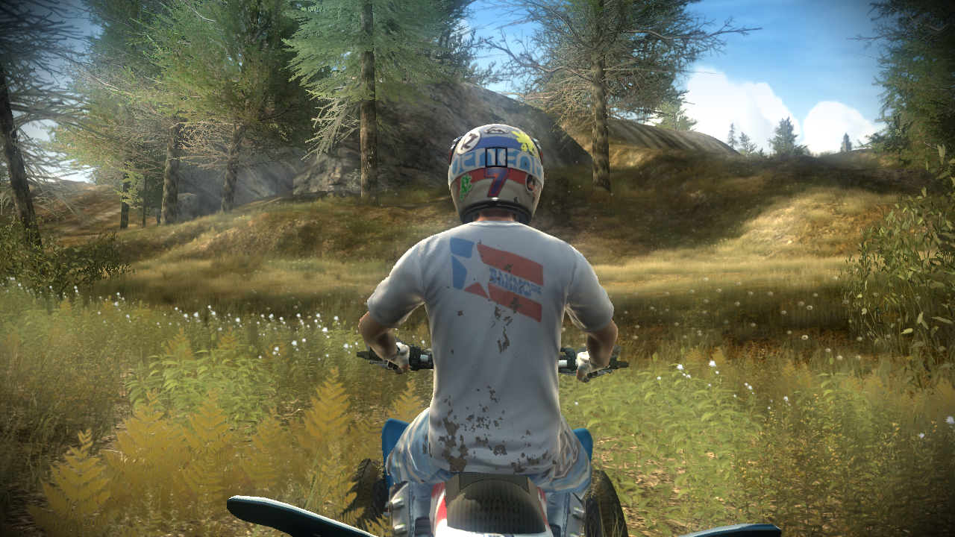
Ground Cover Results

Slide 31
Ground Cover Summary
Advantages
  High quality alpha blended ground cover
  Low cost CPU sorting
  Artist friendly workflow
Disadvantages
  High overdraw isn’t cheap for the GPU

Slide 32
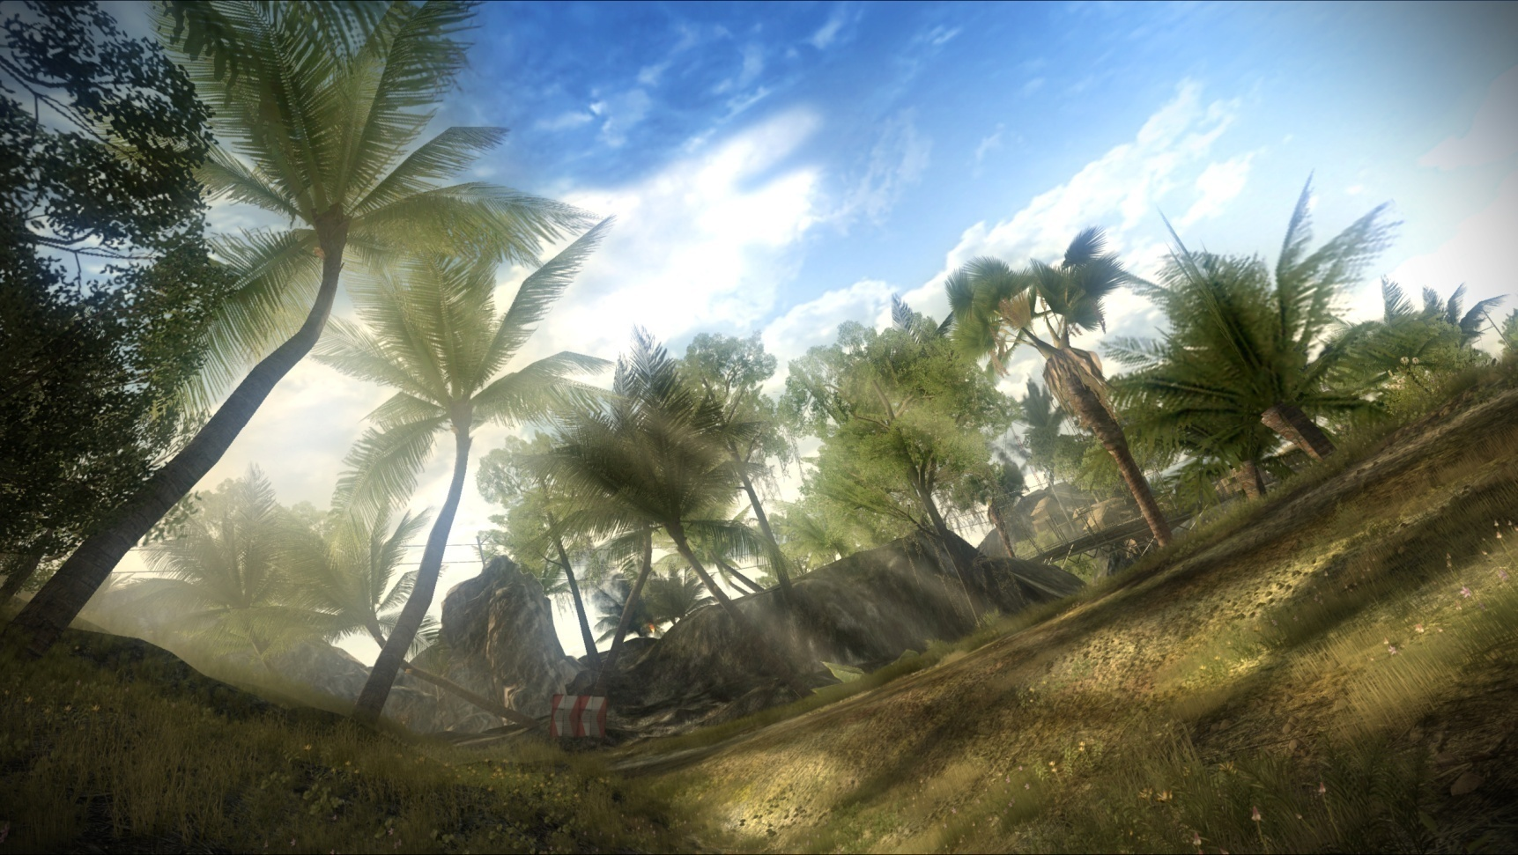
Tree Rendering in Pure

Slide 33
Tree Rendering Challenges
Trees require more detailed geometry
Trees rendered further into the distance
Many trees in the game world, unevenly distributed

Slide 34
Tree Rendering Observations
Using alpha blending will require expensive sorting
Using alpha mask or alpha to coverage doesn’t look good enough on its own
Alpha mask aliasing is only a real problem for the forest silhouette

Slide 35
Screen-Space Alpha Mask Overview
Render Opaque Scene (MSAA)
Resolve Opaque Scene
Render Foliage Alpha Mask
Render Foliage Color
Combine
Final Output

Slide 36
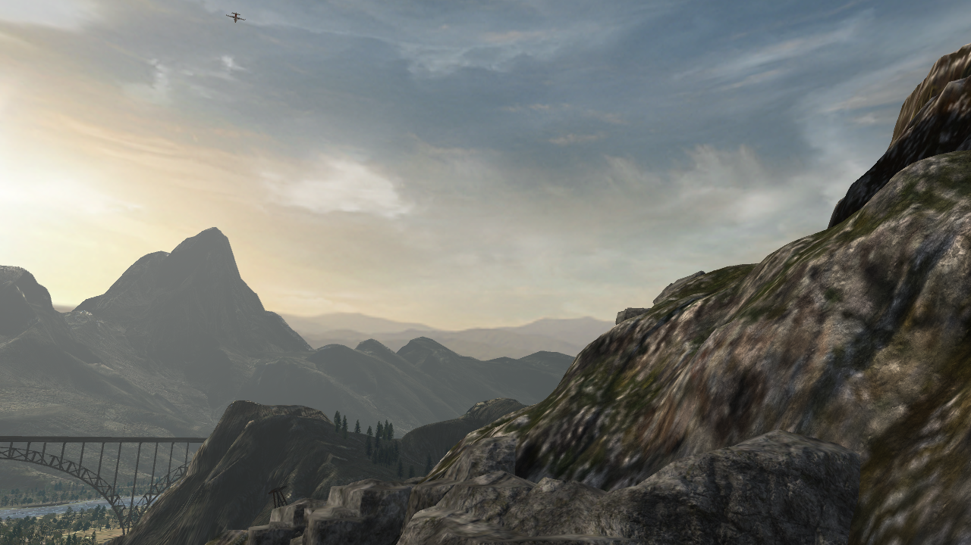
Opaque Scene Pass
Render with MSAA if required
Resolve color and depth

Slide 37
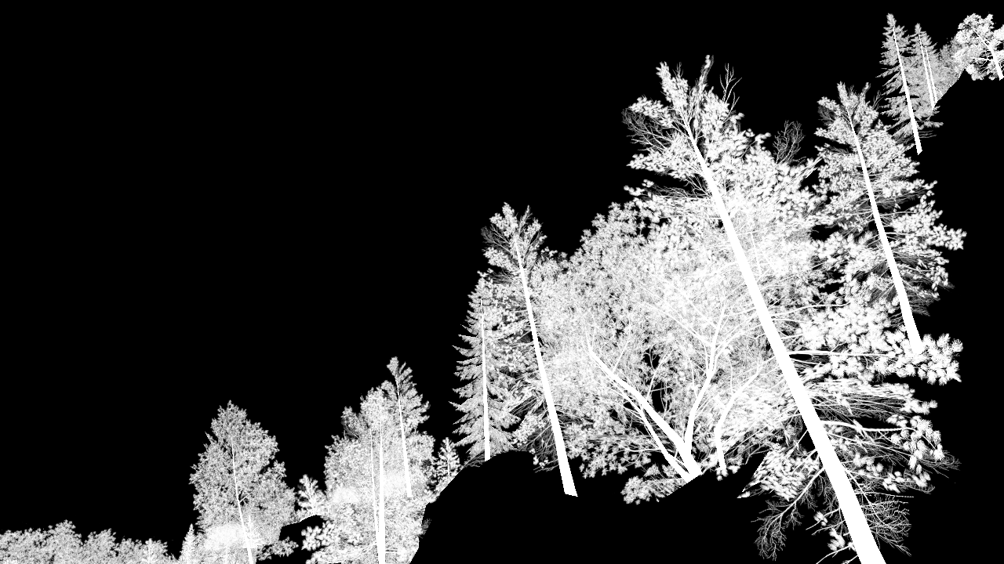
The Alpha Mask
Use resolved depth
z writes disabled
Render out tree alpha values

Slide 38
Alpha Mask Creation Pixel Shader
sampler alphaTexture : register(s0); struct PSInput { float2 vTex : TEXCOORD0; }; float4 main( PSInput In ) : COLOR { return tex2D( alphaTexture , In.vTex ).aaaa; }

Slide 39
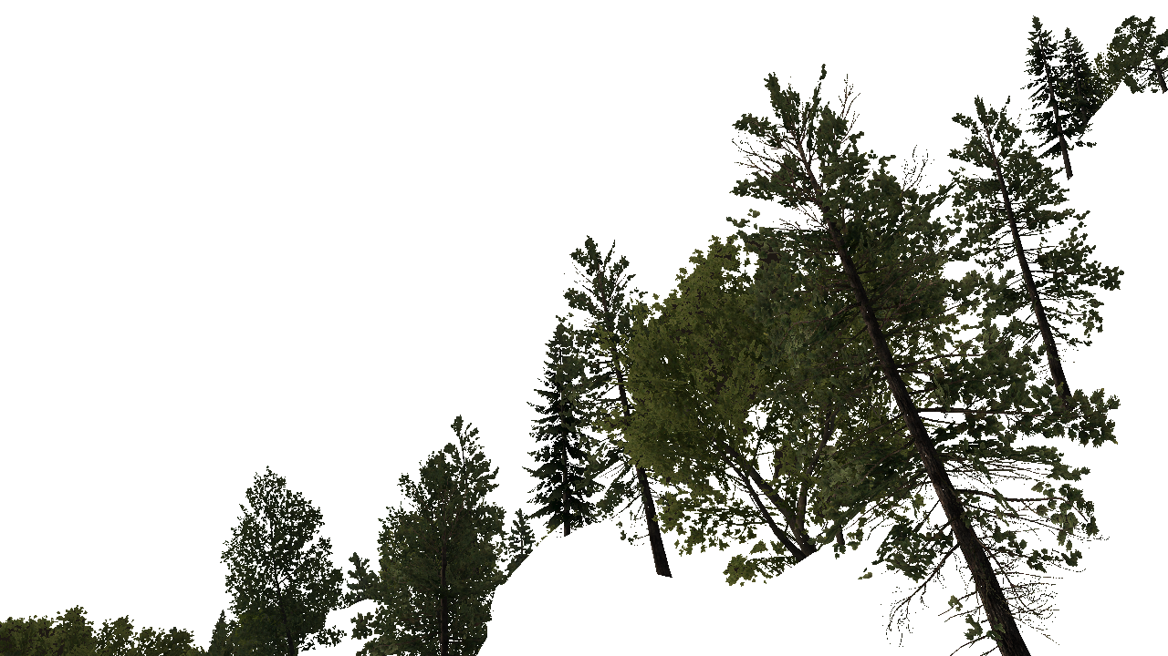
Foliage Color Pass
Use resolved depth
z writes enabled
Alpha test enabled
Render out tree color values

Slide 40
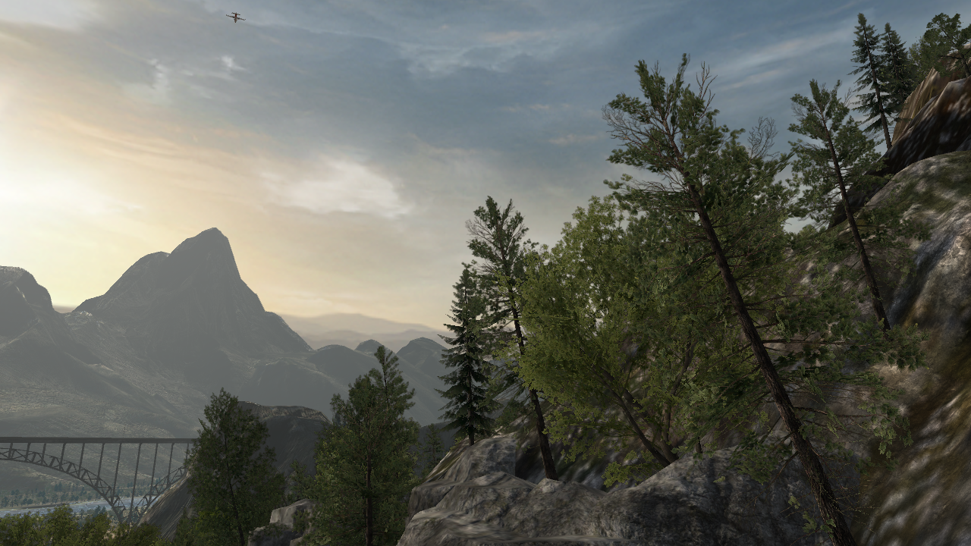
Combine Pass
Combine color passes using the screen space alpha mask

Slide 41

Alpha Mask Creation using ‘ADD’
result = source + destination

Slide 42
Alpha Mask Creation using ‘MAX’
result = Max(source, destination)

Slide 43
Alpha Mask Creation Using Combination
ADD gives opaque results
MAX gives more detail and a softer silhouette
Fortunately we can create both in one pass!
  Different blend modes for writing to color and alpha components of render target
Average the two values during final combine pass
Shader details in course notes

Slide 44
Combine Pixel Shader
sampler maskImage: register(s0); sampler treeImage: register(s1); sampler worldImage: register(s2); float4 main( float2 vTexCoord : TEXCOORD ) : COLOR { float4 vTreeTexel = tex2D( treeImage, vTexCoord.xy ); float4 vWorldTexel = tex2D( worldImage, vTexCoord.xy ); float4 vMaskTexel = tex2D( maskImage, vTexCoord.xy ); float lerpValue = (vMaskTexel.r +vMmaskTexel.a) * 0.5f; return lerp( vWorldTexel, vTreeTexel, lerpValue ); }

Slide 45


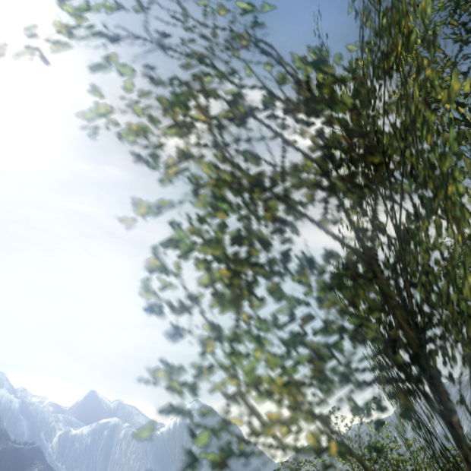

Comparison With Simple Compositing
Alpha Mask
Alpha To Coverage
Our Technique

Slide 46
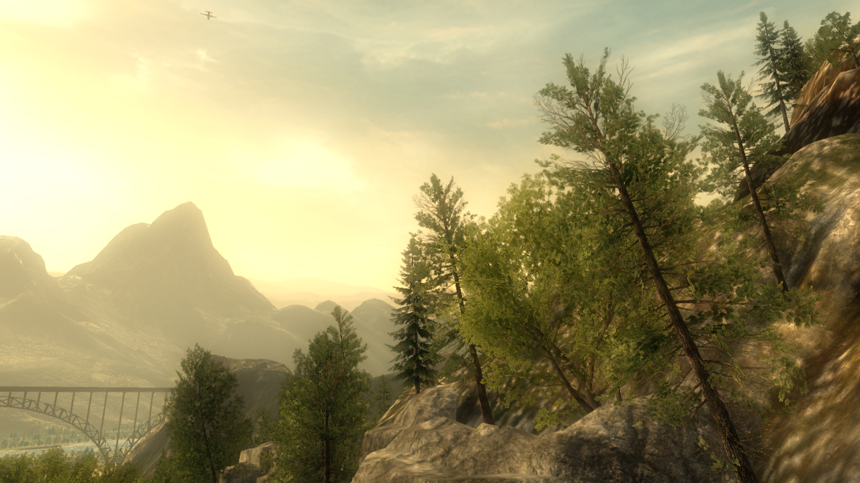
The Final Result

Slide 47
Summary
Advantages
  High quality anti-aliased silhouettes
  No MSAA used for alpha rendering
  No sorting required
Disadvantages
  Cost of additional render passes
  Works best when internal aliasing isn’t a problem

Slide 48
Part 2: Split/Second

Slide 49
Split/Second
Racing game for Xbox360, PlayStation3 and PC
Release Q2 2010
Arcade racing game

Slide 50
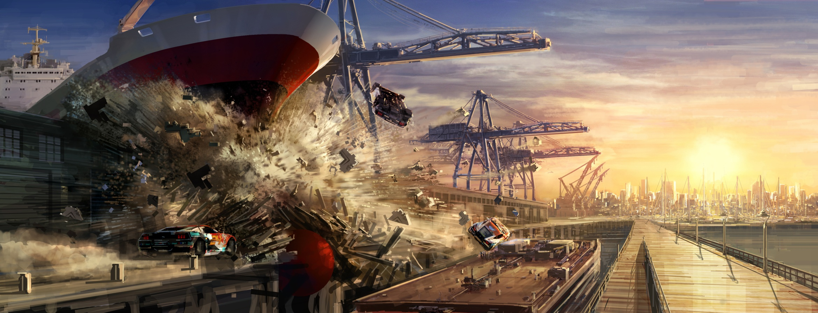
Art Direction

Slide 51
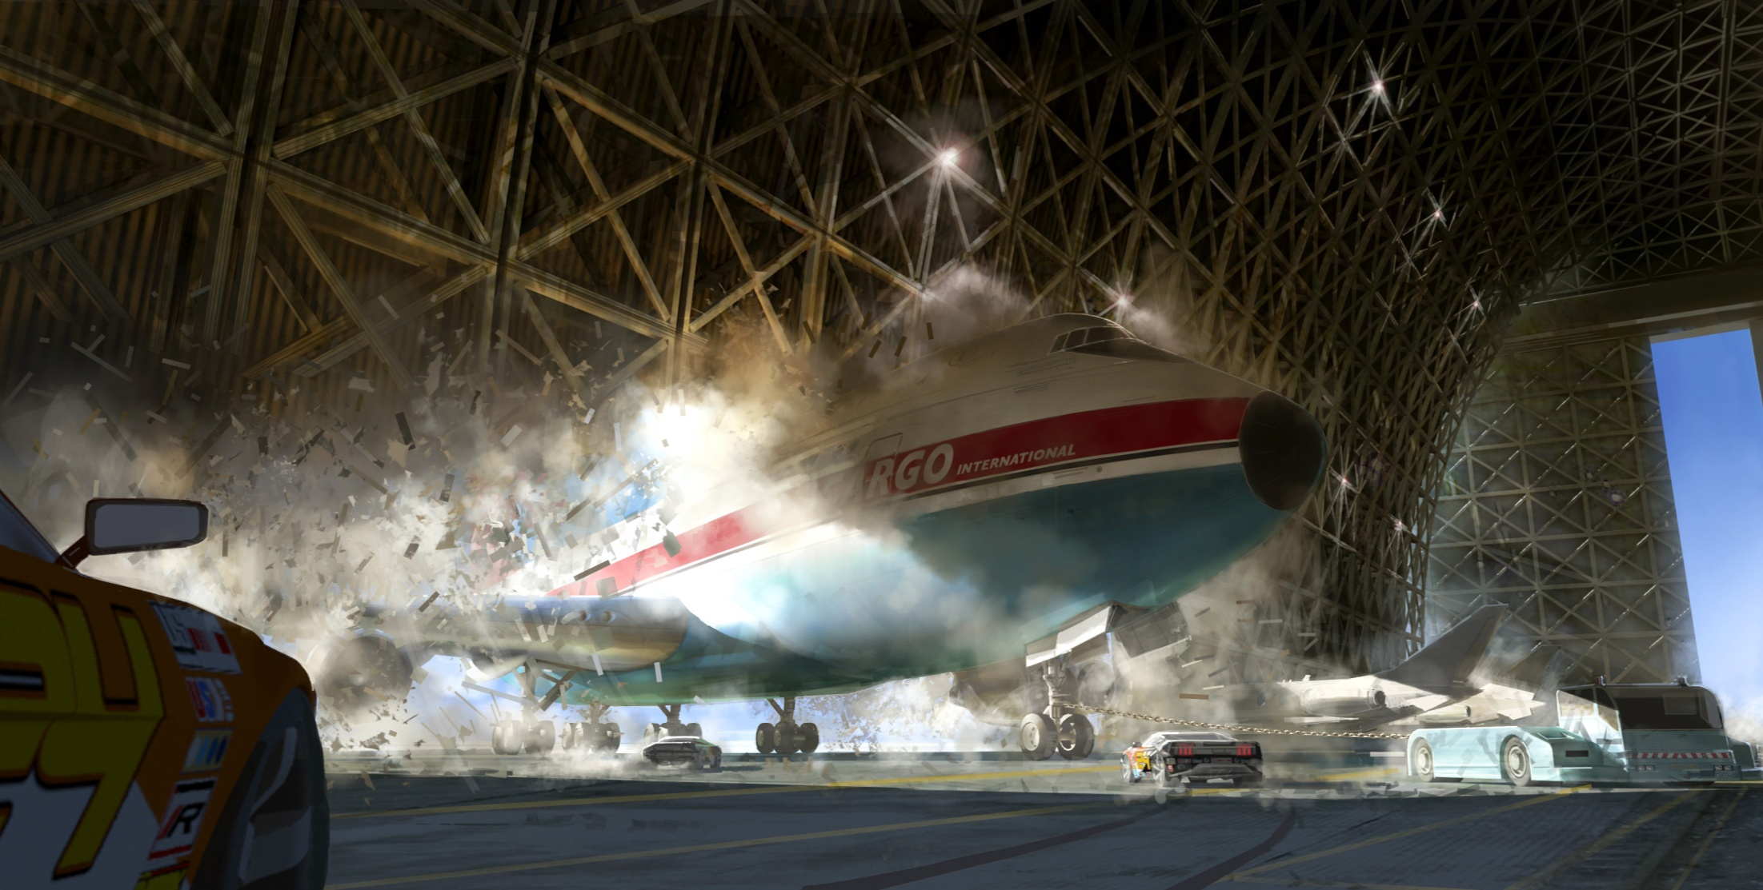
Art Direction

Slide 52
This Talk
Overview of some of the render techniques we use
  Deferred Shading
  Deferred Shadowing
  Irradiance Volumes
Some specific optimizations we’ve employed along the way

Slide 53
Video of Split/Second

Slide 54
Deferred Shading
Split/Second uses a deferred shading renderer

Slide 55
Deferred Shading
Decouples lighting from geometry
Information needed for lighting is written to a Geometric Buffer (G-Buffer) as main scene is rendered
The lighting of the scene is deferred until the lighting pass which happens during the post-processing phase

Slide 56
Deferred Shading
Render Target | Channel 1 | Channel 2 | Channel 3 | Channel 4
1 | Albedo.r | Albedo .b | Albedo.g | Unlit.r
2 | Normal.x | Normal.y | Normal.z | Unlit.b & Edge
3 | Unlit.g | Specular | Motion.x | Motion.y

Slide 57
Optimisation
1st Optimisation is for MSAA

Slide 58
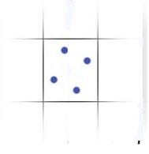
Multi-Sample Anti-Aliasing
Variation of Full Screen Anti Aliasing
FSAA renders scene to a higher resolution than required
The averages down to the desired resolution
This has serious performance implications

Slide 59
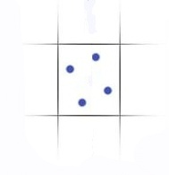
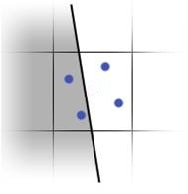
Multi-Sample Anti-Aliasing
MSAA runs the pixel shader only once per pixel
Sets the fragment color for each fragment covered by the polygon

Slide 60
Multi-Sample Anti-Aliasing
Can’t use hardware to average the fragments because the G-Buffer is not suitable for interpolation
This means we have to manually blend every fragment

Slide 61
Multi-Sample Anti-Aliasing

Slide 62
Multi-Sample Anti-Aliasing
We observe that 85% of the pixels are interior to a polygon
This means all their fragments are identical
Can we quickly identify the 15% which are different?

Slide 63
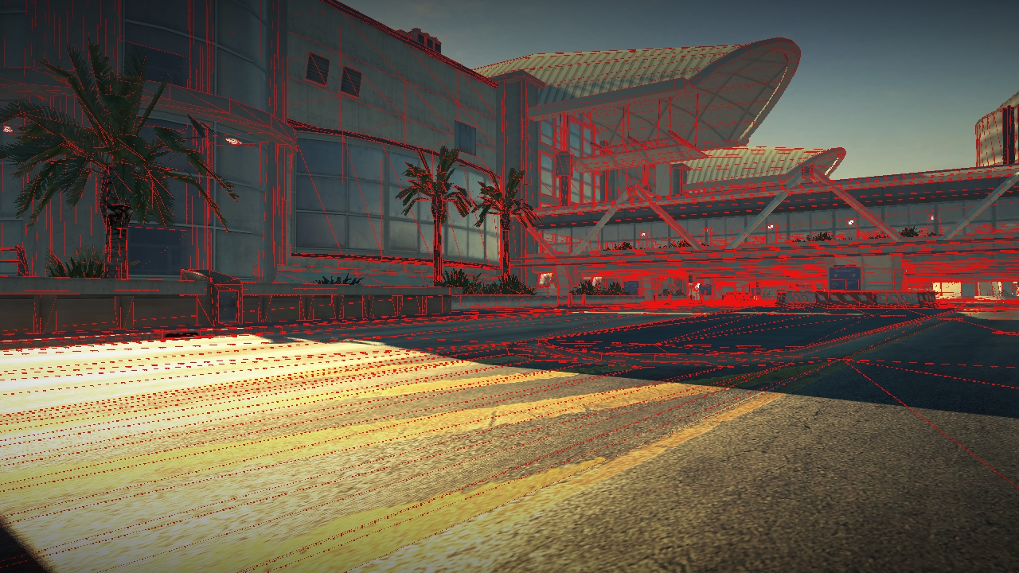
Fragments that need to be identified

Slide 64
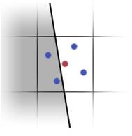
Centroid Sampling
We use a piece of hardware which is also trying to identify polygon edges
Centroid sampling avoids vertex attributes being sampled beyond the polygon’s boundaries

Slide 65

Centroid Sampling
Centroid sampling adjusts the position used for determining colour to be the centre of all the sampling points covered by the polygon
So if the centroid moves then we’re on a polygon edge

Slide 66
Centroid Sampling
Fortunately we interrogate the value of the centroid sample in the pixel shader
If it’s not zero we know the triangle doesn’t cover all of the samples for the pixel

Slide 67
Centroid Sampling
struct PSInput
{
float4 vPos : TEXCOORD0;
float4 vPosCentroid : TEXCOORD1_CENTROID;
};
float4 main( PSInput In ) : COLOR
{
float2 vEdge = In.vPosCentroid.xy - In.vPos.xy;
float fEdge = (vEdge.x + vEdge.y == 0.0f) ? 0.0f : 1.0f;
// For deferred shading we would usually pack this value into
// one bit in the G-Buffer.
return float4( fEdge );
}

Slide 68
Performance Stats (Xbox360)
Light both fragments | 4.5ms
Light fragment 1 | 2.3ms
Light fragment 2 | 0.7ms

Slide 69
Deferred Shadowing
We use parallel split shadow maps for sunlight shadows
Using the shadow maps and depth buffer we create a screen space shadow mask
This is then used in the lighting pass to attenuate the lighting

Slide 70

Shadow Maps

Slide 71

Zoomed In

Slide 72
Shadow Edge Detection
To avoid these artifacts we use percentage closer filtering
PCF takes multiple samples from the shadow map
Performs depth test with each of them against a shadow receiver
Then averages the results.

Slide 73

Shadow Maps with PCF

Slide 74

Zoomed In

Slide 75
Percentage Closer Filtering
PCF is expensive

Slide 76
Optimisation 2
If we can divide the screen into 3 areas
  Areas definitely in shadow
  Areas definitely not in shadow
  Areas that may be in or out of shadow
  We only want to apply PCF to the last of these areas

Slide 77
Areas that may be in or out of shadow
Can we work them out exactly
No. But we can approximate
We want to generate a mask to show where the PCF must be performed

Slide 78

¼ size (cheap)

Slide 79
2nd Pass
We then perform a second pass
This time at 1/16th screen size
During this pass we expand the edges using a conservative algorithm

Slide 80

This is what we end up with

Slide 81
Performance (Xbox360)
Without mask | 6.4ms
With mask | 1.7ms
Calc mask | 0.6ms
This mask is then fed into the shadow renderer
Very efficient because it’s 1/16th screen size so doesn’t use much texture bandwidth

Slide 82
Irradiance Volumes
We want global illumination in a way that integrates well with our deferred shading pipeline
Environment changes dramatically in Split/Second so we needed a solution that can respond to those changes
We thought Irradiance Volumes provided right balance between approximation of GI and ability to update

Slide 83
But…..
Real-time update is not something we currently do
This whole feature is WIP

Slide 84
Irradiance Volumes
IV is a 3D map of diffuse lighting samples
Irradiance environment maps can be compactly represented in terms of Spherical Harmonics

Slide 85

Probe Placement

Slide 86
Irradiance Volumes
With a forward renderer SH coefficients would be uploaded with each render batch
In S/S we apply the irradiance contribution in the deferred lighting pass
Advantage: We only pay the calculation cost once per screen pixel

Slide 87
Irradiance Volumes
We use Volume Textures
These map naturally to the GPU
The GPU carries out tri-linear interpolation of the coefficients to give smooth representation

Slide 88

Direct Lighting

Slide 89

Indirect Lighting

Slide 90

Direct + Indirect Lighting

Slide 91

Constant Ambient

Slide 92
Problems to Solve
Draw Distance
Sampling Cost
Notes:
Problems to solve.

Slide 93
Draw Distance
Can’t cover the whole scene
Only cover the area around the camera
But then what do you do at the border?

Slide 94

Volume Texture

Slide 95

Increased Size

Slide 96

Non-Linear Scale

Slide 97

Fixed Value Interpolation

Slide 98
Shading Cost
Representation | Coefficients per Color Channel | Volume Textures Required | Cost
2nd order spherical harmonics | 9 | 7 | 8.8 ms
1st order spherical harmonics | 4 | 3 | 4.6 ms

Slide 99
Shading Cost
Even 4.6ms would be prohibitively expensive for game
Explored the optimisation of rendering the indirect lighting to a ¼ sized buffer
This reduces 2nd order to acceptable 2.2ms

Slide 100

Quarter Sized Indirect Lighting

Slide 101

Quarter Sized Indirect Lighting

Slide 102
Summary
The deferred shading system has changed the way we optimise. It’s all about screen space now.
We’ve got more work to do to find out how to use irradiance volumes most effectively.

Slide 103
Acknowledgements
The Pure team, especially Ben Hathaway, George Parish, Damyan Pepper and James Callin
The Split/Second team, especially Matt Ritchie and Balor Knight who developed the techniques shown in this presentation

Slide 104
Questions?
Jeremy.Moore@disney.com
David.Jefferies@disney.com

Slide 105
References
[BAVOILMYERS08] BAVOIL, L., AND MYERS, K. 2008. Deferred Rendering using a Stencil Routed K-Buffer, ShaderX⁶, Engel, W. (Editor), Charles River Media.
[Everitt01] Everitt, C. 2001. Interactive Order-Independent Transparency.
[KCS07] KHARLAMOV, A., CANTLAY, I., AND STEPANENKO, Y. 2007. Next-Generation SpeedTree Rendering, GPU Gems 3, Nguyen, H. (Editor), Addison-Wesley.
[PORTERDUFF84] PORTER, T., AND DUFF, T. 1984. Compositing Digital Images. Computer Graphics 18, 3, pp 253-259.

Slide 106
References
[ENGEL09] ENGEL, W. 2009. Designing a Renderer for Multiple Lights: The Light Pre-Pass Renderer, ShaderX⁷, Engel, W. (Editor), Charles River Media.
[GSHG98] GREGER, G., SHIRLEY, P., HUBBARD, P. M., AND GREENBERG, D.P. 1998. The Irradiance Volume, IEEE Computer Graphics & Applications, 18, 2, pp. 32-43.
[HARGREAVES04] HARGREAVES, S. 2004. Deferred Shading, Game Developers Conference, D3D Tutorial Day, March, 2004.
[KOONE07], KOONE, R. 2007. Deferred Shading in Tabula Rasa, GPU Gems 3, Nguyen, H. (Editor), Addison-Wesley.
[MMG06] MITCHELL, J. L., MCTAGGART, G., AND GREEN, C. 2006. Shading in Valve’s Source Engine, Advanced Real-Time Rendering in 3D Graphics and Games - SIGGRAPH 2006, pp. 129-142.
[MITTRING07] MITTRING, M. 2007. Finding Next Gen – CryEngine 2.0, Advanced Real-Time Rendering in 3D Graphics and Games - SIGGRAPH 2007, pp. 97-121.

Slide 107
References
[OAT07] OAT, C. 2007. Irradiance Volumes for Real-Time Rendering, ShaderX⁵, Engel, W. (Editor), Charles River Media.
[RAMAMOORTHIHANRAHAN01] RAMAMOORTHI, R., AND HANRAHAN, P. 2001. An Efficient Representation for Irradiance Environment Maps, Proceedings of ACM SIGGRAPH 2001, pp. 497–500.
[SHISHKOVTSOV05], SHISHKOVTSOV, O. 2005. Deferred Shading in S.T.A.L.K.E.R., GPU Gems 2, Pharr, M., Fernando, R. (Editors), Addison-Wesley.
[SLOAN04] SLOAN, P.-P. 2004. Efficient Evaluation of Irradiance Environment Maps, ShaderX², Engel, W. (Editor), Charles River Media.
[ZSXL06] ZHANG, F., SUN, H., XU, L., AND LUN, L. K. 2006. Parallel‐Split Shadow Maps for Large‐Scale Virtual Environments, Proceedings of ACM International Conference on Virtual Reality Continuum and Its Applications 2006, pp. 311–318.

