Slide 1
Adaptive Volumetric Shadow Maps
Marco Salvi, Kiril Vidimce, Andrew Lauritzen, Aaron Lefohn Intel Corporation

Slide 2
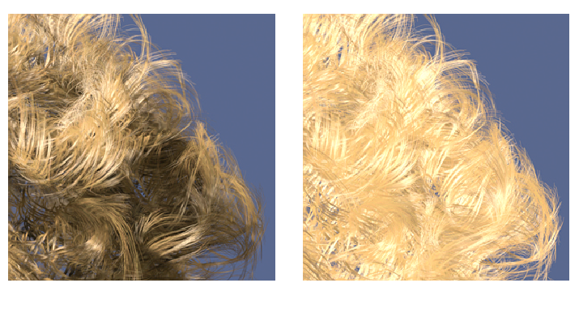
Problem Background
Realistic lighting of volumetric media
Hair, smoke, fog, etc..
Compute visibility curve
Transmittance: Fraction of light that passes through a material
LOKOVIC T., VEACH E. “Deep shadow maps”, SIGGRAPH 2000
1
1
Transmittance
0
Depth
0
Notes:
Transmittance maps to the [0,1] interval.
In this work we don’t take in consideration light scattering, transmittance can only change (decrease) via absorption. Emissive materials are technically possible as our work doesn’t make any assumption on the monotonicity of the visibility curve.

Slide 3
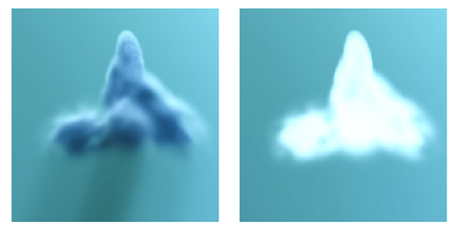
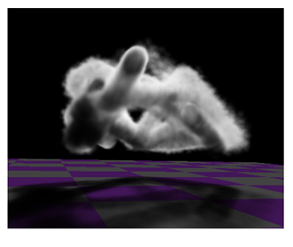
Previous Methods
Deep Shadow Maps [Lokovic et al. 2000]
Capture visibility curve & compress
Used defined error threshold
Variable number of nodes
Designed for off-line rendering, easy to implement on DX11 but slow
Opacity shadow Maps [Kim et al. 2001]
Sample visibility at regular intervals
Numerous variants optimized to handle special case (i.e. hair)
Depth range dependent
Fourier Opacity Mapping [Jansen et al. 2010]
Visibility function expansion via trigonometric series
Converge slowly, especially around sharp features
Ringing
Depth range dependent
LOKOVIC T., VEACH E. “Deep shadow maps”, SIGGRAPH 2000
JANSEN J., BAVOIL L. Fourier opacity mapping. I3D 2010

Slide 4
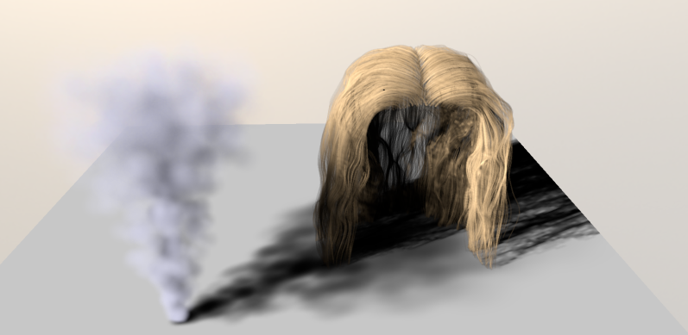
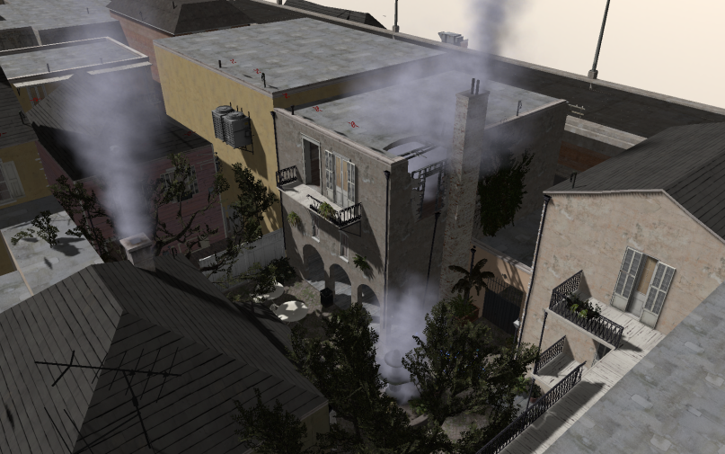
AVSM
Streaming simplification algorithm
Generates an adaptive volumetric light attenuation function using a small fixed memory footprint
Fixed number of nodes. Variable and unbounded error
Easy to use method that does not make any assumption about light blockers type and/or their spatial distribution
Scene courtesy of Valve Corporation

Slide 5
AVSM Insertion
depth | trans
1 | 1
10 | 1
15
0.65
1
30
0.9
1
15
0.9
50
0.6
25
0.4
25
0.8
30
0.3
50
0.2
Transmittance
0.6
0
Depth
Notes:
- An individual AVSM texel encodes N nodes, each node is represented by a depth and a transmittance value. Nodes are always stored as sorted (front-to-back) sequence.
The AVSM is cleared by initializing all nodes within a texel to the same value. We set depth to the far plane and transmittance to 1 (no occlusion)
Incoming light blockers are represented by light-view vector aligned segments. A segment is defined by two points (entry and exit points) and transmittance at the exit point (transmittance at the entry point is implicitly set to 1).
We assume that the space between the entry and the exit points is filled by an uniformly dense media. This would typically generate transmittance curves shaped as piece-wise exponential curves, we use lines instead to simplify the problem (not much visual difference in most cases)

Slide 6
AVSM Streaming Compression
depth | trans
1 | 1
ΔA
10
1
3
15
0.9
7
1
25
0.4
5
30
0.3
10
50
0.2
Transmittance
ΔA
max nodes: 5
current nodes:
6
5
0
Depth
Notes:
The first and last node are never compressed/removed as the provide very important visual cues. The last node is extremely important as it encodes information on the shadow that is cast on any receiver which is located behind the volumetric blockers. For instance the shadow cast by some cigarette smoke over a table will always be correct (no compression artifacts)
After a node is removed we don’t update the remaining nodes location in order to better fit the original curve (ala deep shadow maps). In fact updating nodes location over dozen of insertion-compression iterations can generate some unpredictable results as the nodes perform random walks over the compression plane.

Slide 7
Implementation Details (DX11)
Algorithm designed for streaming simplification but..
In-flight fragments that map to the same pixel cause data races
Atomic RMW operations on structures not currently available from pixel shaders
A tale of two implementations:
Compute shader based, slower but fixed memory
Software pipeline prototype for particles has received little optimization work
~2x slower than variable memory implementation
Pixel shader based, faster but variable memory
Notes:
- The variable memory (pixel shader based) implementation avoid data races by reading back per pixel linked lists and building an AVSM via a full screen pass. A full screen pass avoids data races by guaranteeing that only one fragment that maps to a specific pixels in shaded in flight at any given time (no overlapping primitives)

Slide 8
Variable Memory Implementation
Light blockers AVSM insertion in two steps
Render blockers in light space and capture them in a per pixel linked list [Yang et al. 2010]
Traverse per pixel lists and build AVSM entirely on-chip
Optionally sort blockers to remove temporal artifacts due to out of order fragments shading
AVSM sampling and filtering
Evaluate transmittance at receiver depth via linear (or exponential) interpolation
Filtering implemented in software (bi-linear, tri-linear, Gaussian, etc..)
Notes:
AVSM sampling is implemented via a 2-level search performed over a sorted (front-to-back) array of nodes. The first step is a linear search performed with a 4-node stride, while the second level search within 4 nodes. Since we always work with a pre-determined number of nodes it is possible to generate some very efficient search code that doesn’t employ any dynamic control flow statement or dynamic access to arrays of temporary values.
It is possible to generate mip-maps for an AVSM texture, which are mostly useful to improve data locality and to improve IQ for volumetric shadows generated by sharp and thin light blockers.

Slide 9
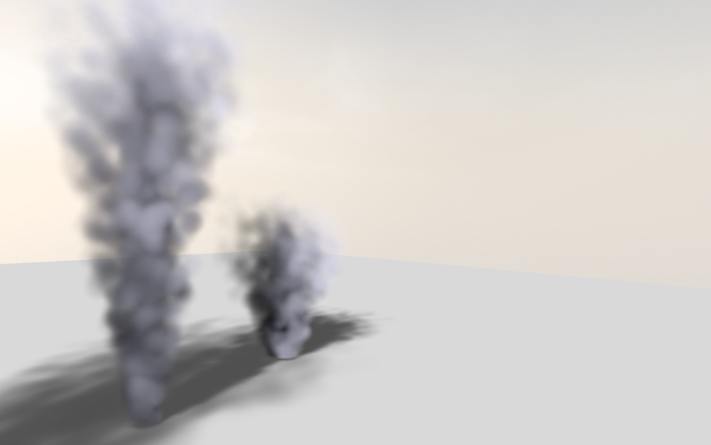
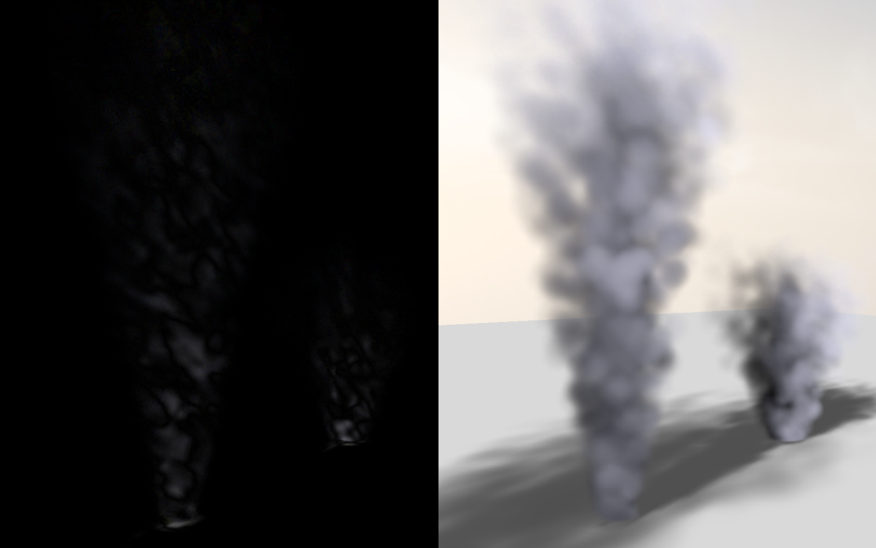
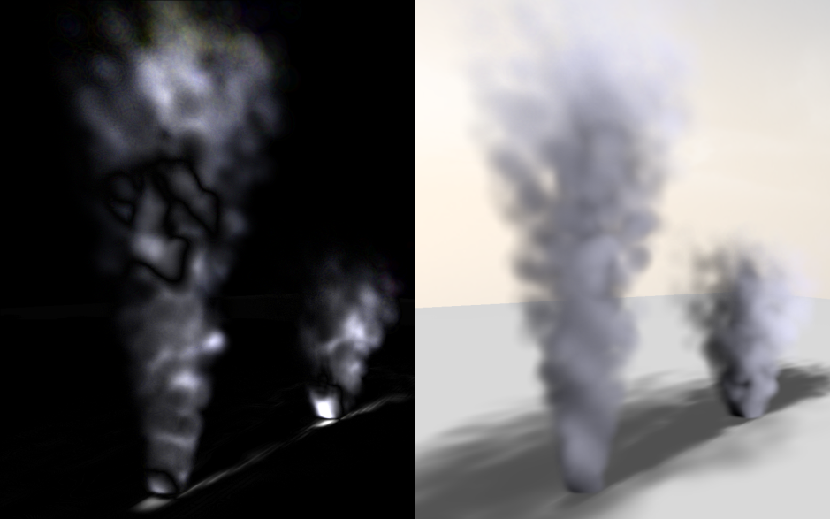
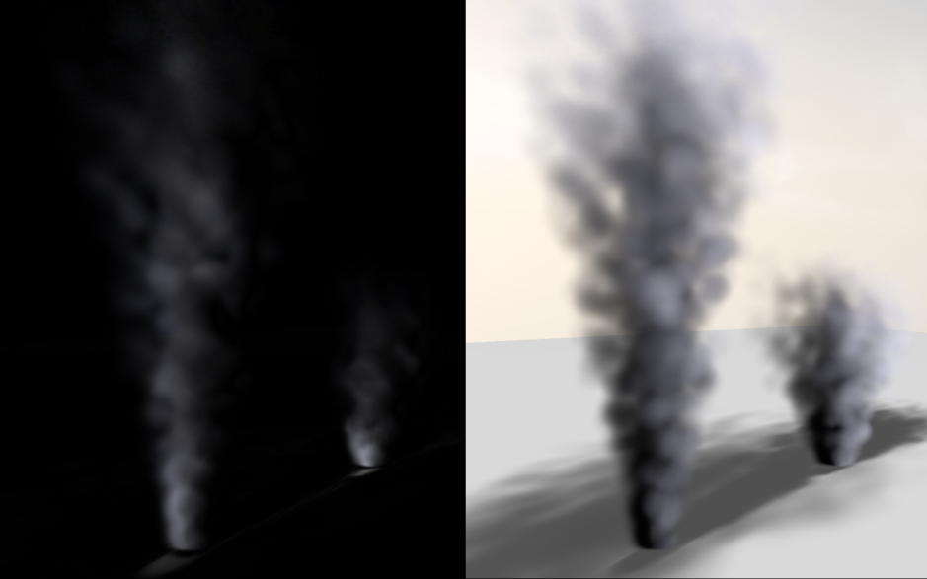
Results (1/3)
uncompressed
avsm (new) - 8 nodes
osm - 32 slices
fom - 16 terms
4x enhanced diff images
Notes:
- Diff images have been enhanced by 4X

Slide 10
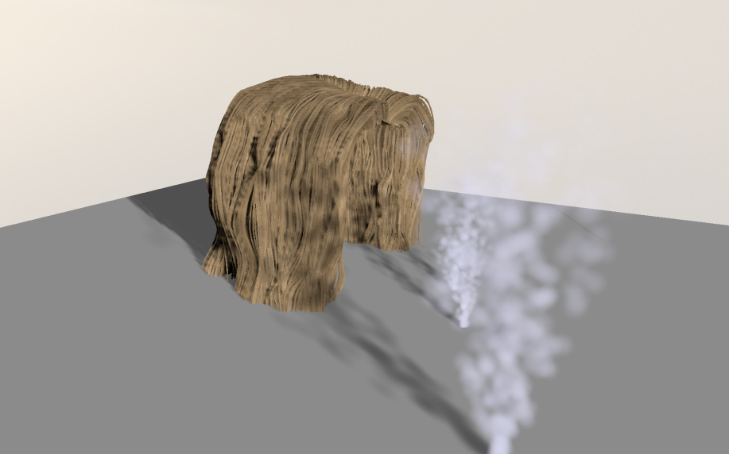
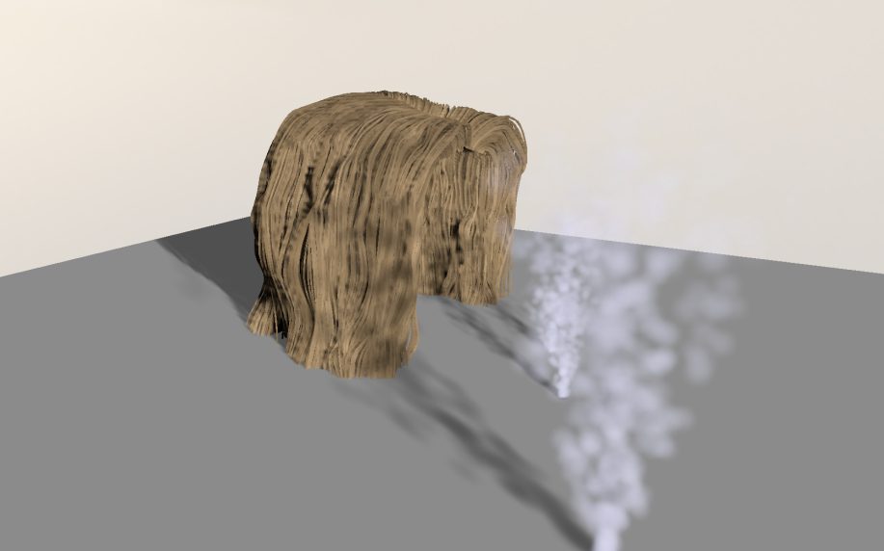
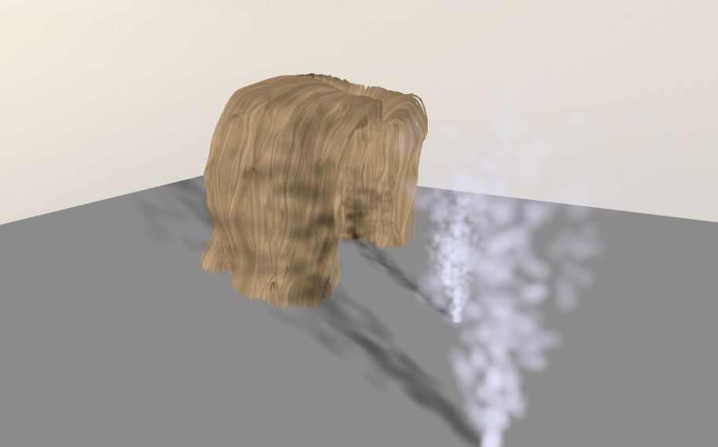
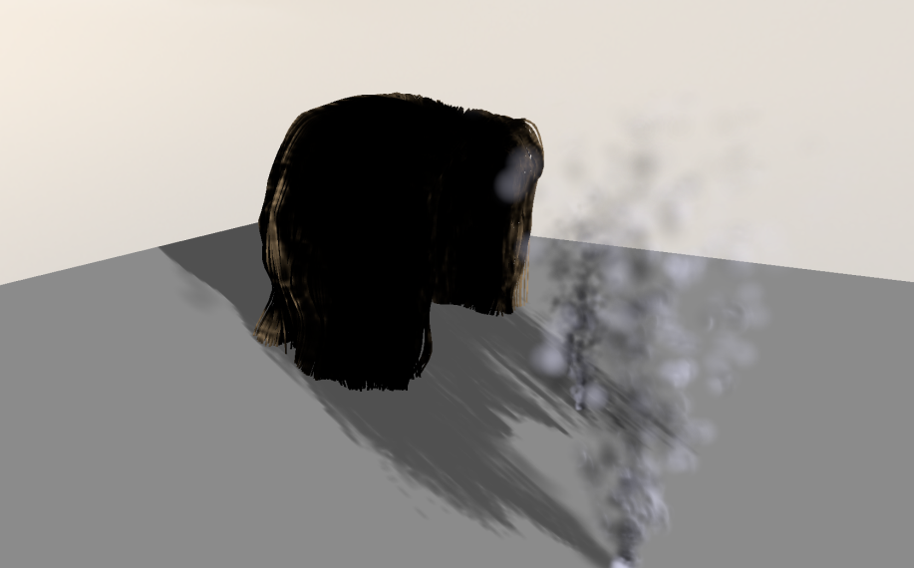
Results (2/3)
uncompressed
avsm (new) – 8 nodes
osm -32 slices
fom – 16 terms
Notes:
- FOM has significant issues with very sharp transmittance function transitions generated by hair-like geometry

Slide 11
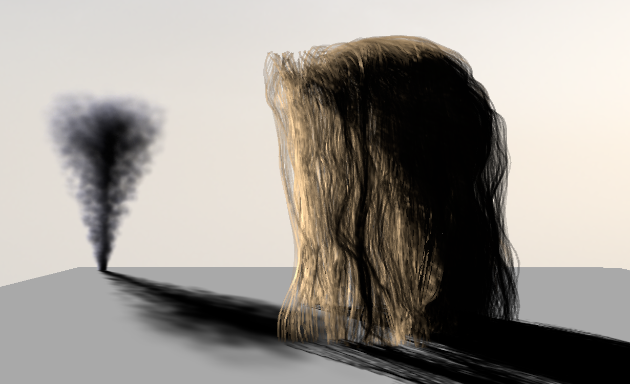
Results (3/3)
1
Transmittance
0
Depth
Notes:
- In this particular case AVSM generates slightly better results than Deep Shadow Maps. The latter performs a local analysis of the visibility curve. AVSM, while working on an incomplete data set, always try solve a global (within a texel) optimization problem.

Slide 12
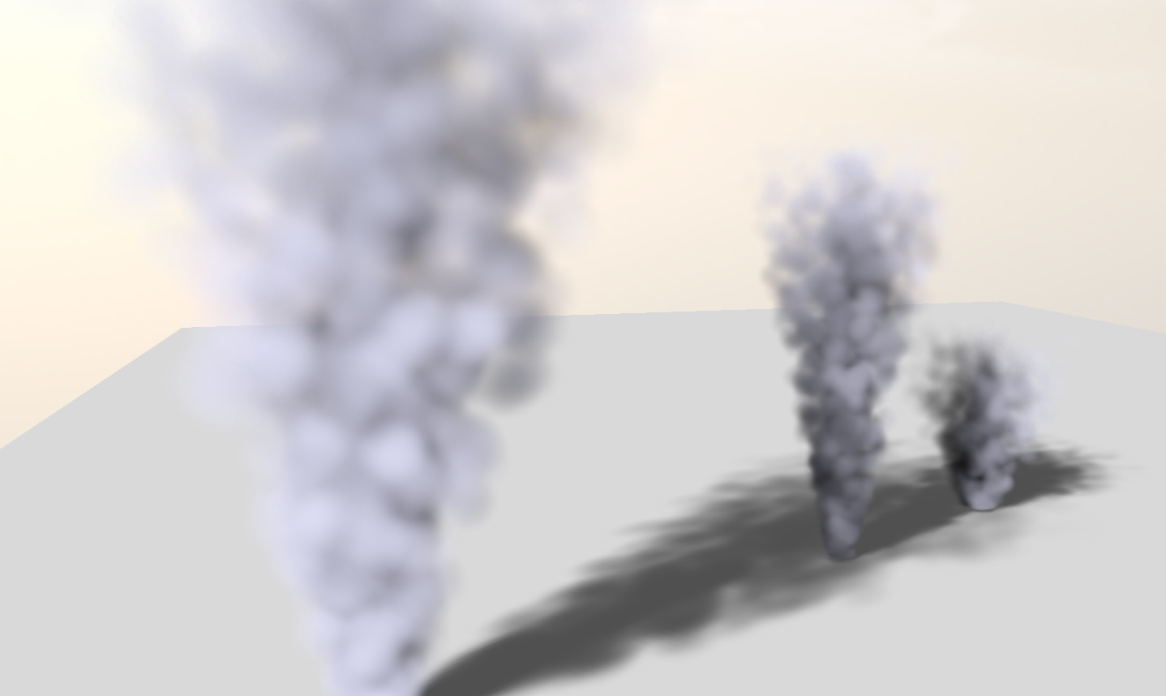
AVSM Performance
Competitive performance
Higher image quality
Shadow look-up dominates
Often < 30% of AVSM related rendering time is spent in the insertion code
DSM is 20x-40x slower than AVSM
Notes:
- The per-pixel-list and AVSM rendering (compress) time is often negligible compared to the AVSM sampling/filtering time.

Slide 13
Conclusions
The Good:
Higher image quality via adaptive sampling
Avoid common pitfalls of methods based on regular sampling or series expansion of the visibility function
Robust and easy to use
Doesn’t require any a priori knowledge of light blockers type and spatial distribution
Easy to trade-off image quality for speed and storage
The Bad:
A fast fixed-memory implementation requires graphics hardware to add support for read-modify-write operations on the frame-buffer
Notes:
- Pixel shader based implementation is fast but uses unbounded memory

Slide 14
What’s Next?
Improve AVSM filtering performance
Find bottleneck(s)
Not an external memory bandwidth issue
Re-encode AVSM data?
Fixed memory implementation with pixel shaders
Avoid RMW hazards (per pixel mutex?)
Lossy Order Independent Transparency via AVSM streaming compression

Slide 15
Acknowledgements
Jason Mitchell and Wade Schin (Valve)
Natasha Tatarchuk and Hao Chen (Bungie)
Johan Andersson (DICE)
Matt Pharr, Craig Kolb and the rest of the Advanced Rendering Technology team at Intel
Nico Galoppo, Greg Johnson, Doug McNabb, Jeffery Williams and Mike Burrows from Intel
Hair model courtesy of Cem Yuksel

Slide 16
Questions?
Paper*:
Salvi M., Vidimce K., Lauritzen A., Lefohn A., Adaptive Volumetric Shadow Maps Computer Graphics Forum - Volume 29, Number 4, pp. 1289-1296 http://www.eg.org/EG/DL/CGF/volume29/issue4
Source code and binaries:
http://visual-computing.intel-research.net/art/publications/avsm/
To contact the authors:
firstname.lastname@intel.com
*contact us to get a copy of the paper

Slide 17
References
AGARWAL P. K., VARADARAJAN K. R.: Efficient algorithms for approximating polygonal chains. Discrete and Computational Geometry 23, 2 (2000), 273–291
BOSEA P., CABELLOB S., CHEONGC O., GUDMUNDSSOND J., VAN KREVELDE M., SPECKMANN B.: Areapreserving approximations of polygonal paths. Journal of Discrete Algorithms 4, 4 (2006), 554–566.
JANSEN J., BAVOIL L.: Fourier opacity mapping. In I3D ’10: Proceedings of the 2010 Symposium on Interactive 3D Graphics and Games (Feb. 2010), pp. 165–172.
KIM T.-Y., NEUMANN U.: Opacity shadow maps. In Rendering Techniques 2001: 12th Eurographics Workshop on Rendering (June 2001),
LOKOVIC T., VEACH E.: Deep shadow maps. In Proceedings of ACM SIGGRAPH 2000 (July 2000), Computer Graphics Proceedings, ACS, pp. 385–392.
SINTORN E., ASSARSON U.: Hair self shadowing and transparency depth ordering using occupancy maps. In I3D ’09: Proceedings of the 2009 Symposium on Interactive 3D Graphics and Games (Feb./Mar. 2009), pp. 67–74
YANG J., HENSLEY J., GRÜN H., THIBIEROZ N.: Real-time concurrent linked list construction on the gpu. In Rendering Techniques 2010: Eurographics Symposium on Rendering (2010), vol. 29, Eurographics

Slide 18
Backup

Slide 19
Fixed Memory Implementation
ComputeShader threadgroups mapped to screen tiles
First step: parallelize over particles
Each threadgroup builds on chip a list of particles that overlap their tile ordered by primitive ID
Second step: parallelize over pixels
Run AVSM insertion code for each pixel inside a particle
Enforce the correct frame buffer ordering update by mapping each pixel to a single ComputeShader thread (i.e., SIMD lane)
Loop until all particles have been processed

