Slide 1
Adaptive Tessellation and Subdivision
John Hable
Notes:
Hey. Welcome to this talk. I’m John, and I’ve been around for a while.

Slide 2
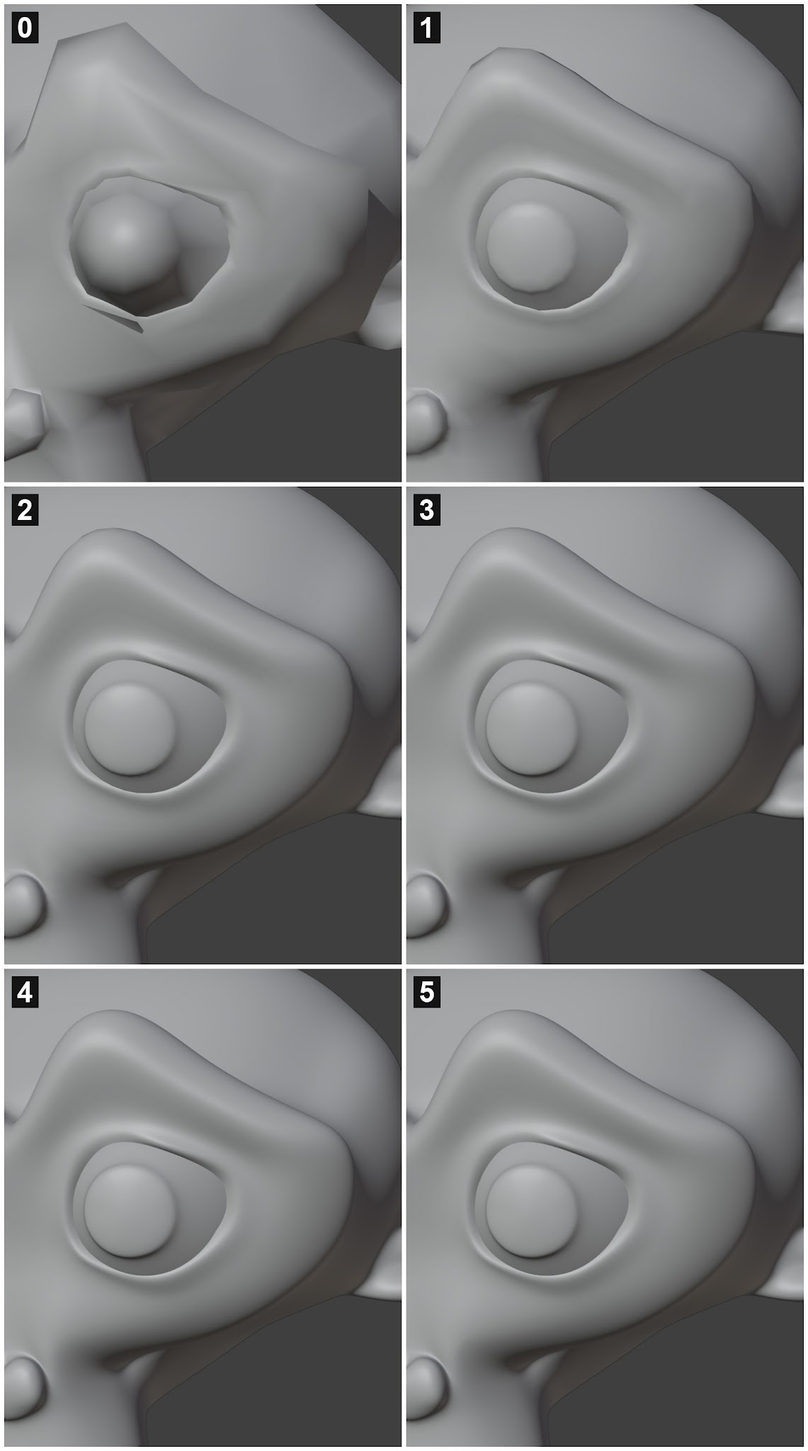
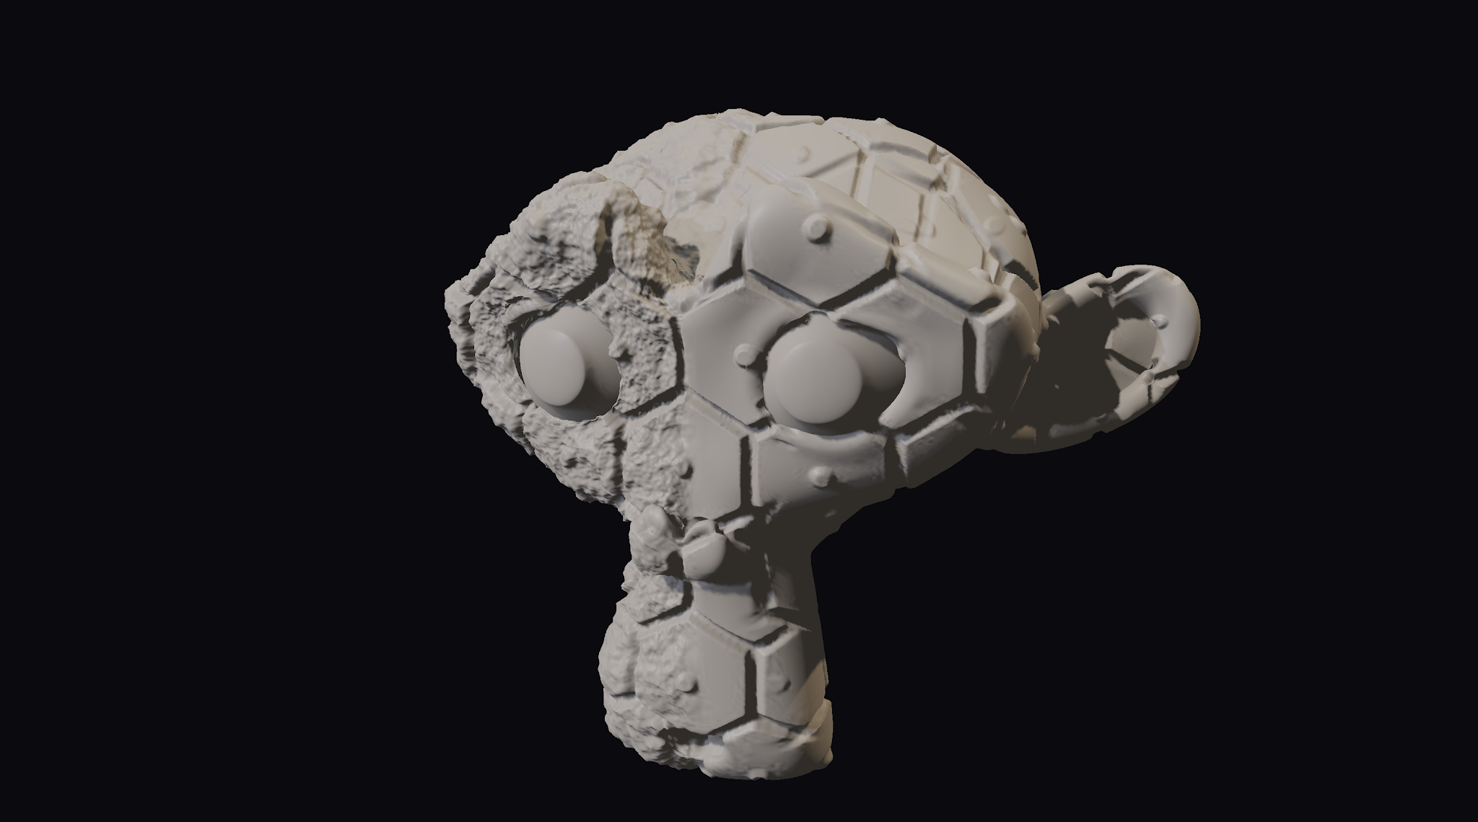
Subdivision Surfaces
Catmull-Clark Subdivision [Catmull & Clark]
Geris’s Game - 1997
From low poly mesh to high poly smooth surface
  Displacement
Clean LOD transition
Notes:
Catmull-Clark Subdivision surfaces have been the standard in film for years, as popularized by Geri’s Game in 1997. The basic idea is to start with a low-res mesh, as in the screenshot of Suzanne, the blender monkey on the upper left. Each iteration of the catmull clark subdivision algorithm smooths the surface, turning any faceted mesh into a smooth surface. It allows us to have a clean lod transition from low to high, as well as apply displacement mapping for fine details.

Slide 3
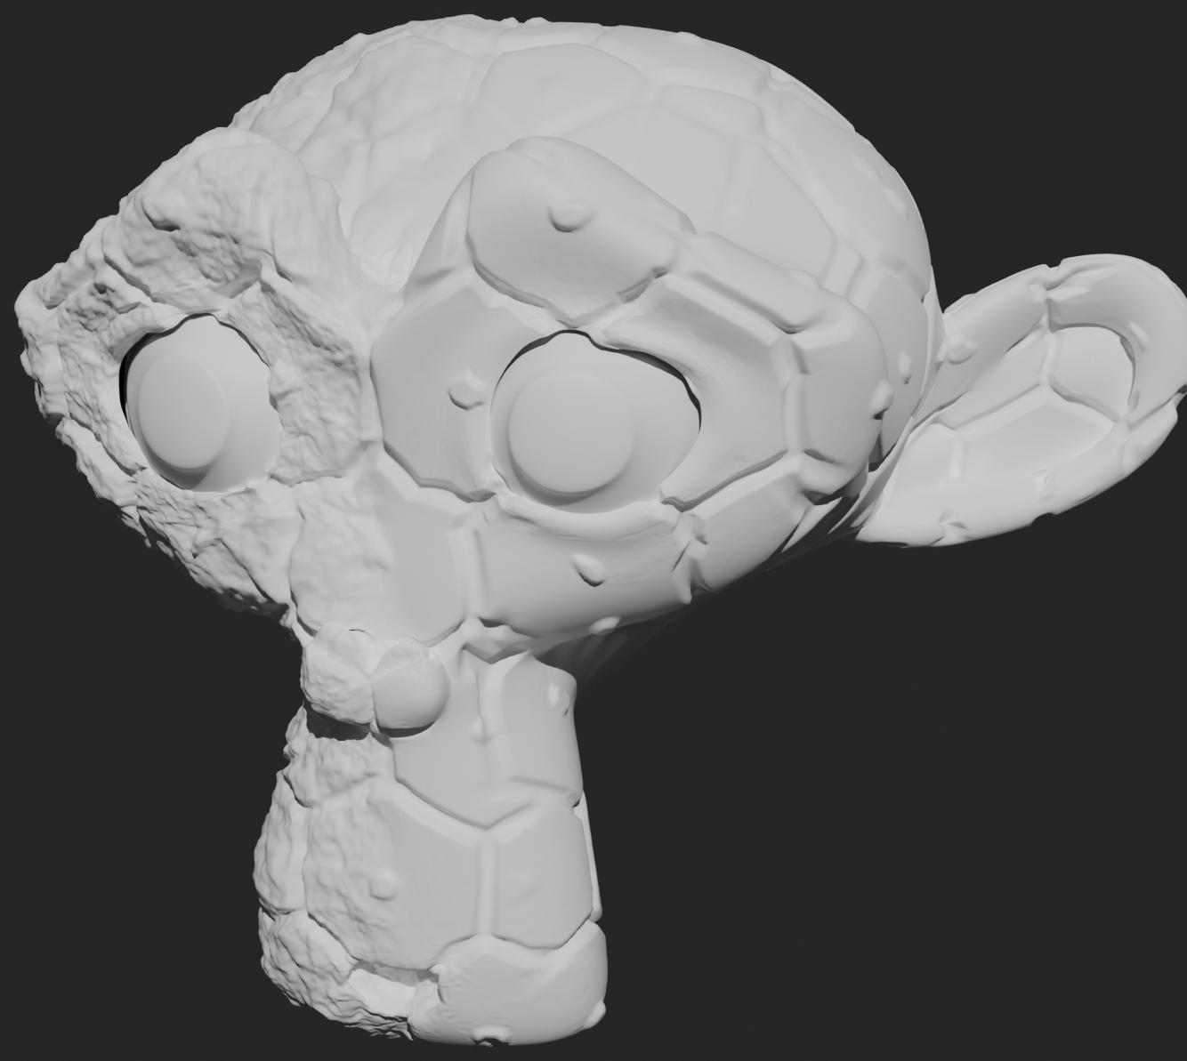
Triangle Meshes
High-res triangle meshes
Topology: 12 bytes per triangle
  3 indices (4 bytes each)
Vertices: ~64 bytes per Vertex
  Position (3 floats, 12 bytes)
  Normal (3 floats, 12 bytes)
  Tangent/Flip (4 floats, 16 bytes)
  UV (2 floats, 8 bytes)
  Color (4 floats, 16 bytes)
Raw Data: ~44 bytes per triangle
  12 bytes for connectivity
  32 bytes for vertices (1 vert = 2 tris)
Notes:
Now, there are plenty of different ways that we can represent a detailed surface, the most common being a triangle mesh. If you want a high poly mesh, all you have to do is export it from your DCC of choice, and you have a detailed model just waiting for you. The catch is the data size. If you are rendering a typical model, you need some combination of topology, positions, normals, a tangent frame, uvs, color, and possibly deformation data like skinning and morph targets. In games today, we are essentially out of disk space, and this has become one of our hardest bottlenecks. For the hypothetical example here, a dense mesh will require about 44 bytes per triangle.

Slide 4
Compression
Virtualized geometry (Nanite): [Karis et al. 2021]
  5.6 bytes per Nanite triangle on disk
DGF: Block-based Geometry Supercompression [Barczak 2026]
  Built for hardware ray tracing
  2.3 bytes per triangle
    Extra cost for extra attributes
Draco (GLTF) - [Draco] [Rossignac]
  Quality depends heavily on settings.
Arbitrary Baseline: 5 bytes/tri
Notes:
There are numerous techniques, both in research and in shipped products to compress triangle meshes to significantly better data sizes than 40 or so bytes per triangle. The last published numbers I’ve seen from Nanite were at 5.6 bytes on disk per output triangle. Those numbers have surely improved since then. DGF is a recent technique designed for raytracing, so it can get to 2.3 bytes per triangle, but the cost will increase when you need extra attributes. Another option is Draco, which is included as a GLTF extension. The quality depends heavily on what settings you use, and the most advanced compression settings will have side effects like reordering your vertices.
So, to keep life simple, I’ll be comparing to an arbitrary baseline of 5 bytes/triangle for triangle meshes.

Slide 5
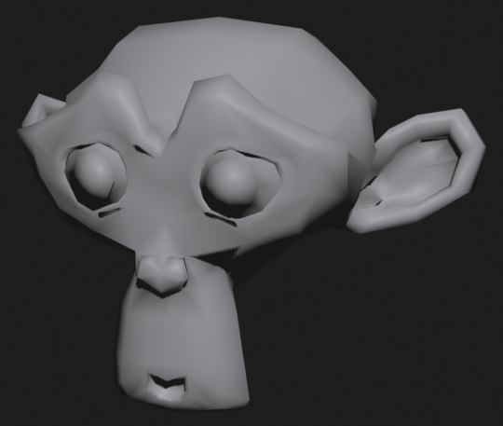
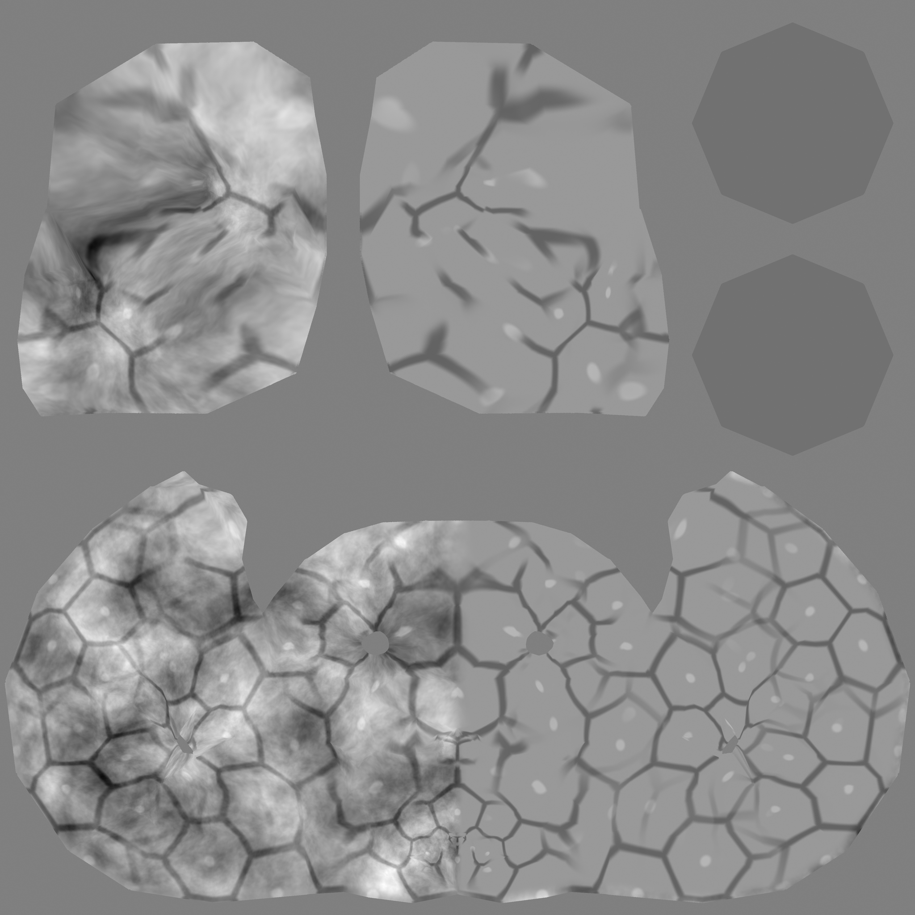
Subdivision Displacement
Subdivision surface + offset displacement
  Infinite smoothness is "free" - in terms of disk space
    Memory and performance is not!
  8-bit displacement is often enough for real surfaces
Suzanne (Blender Monkey)
  Modeled as multiresolution displacement
Notes:
The cool thing about subdivision is how well it helps us with the disk space problem. After encoding the base mesh on disk (as well as helper data), the cost of encoding an infinitely smooth surface is free. Obviously we have to pay in memory and performance at runtime, but the smooth surface is free on disk. Additionally, the details of hard modeled surfaces can often be well-encoded into an 8bit texture map. In this case, I did some programmer art…or should I say Claude art…where I stamped some hexagons onto this multiresolution model and exported it to the displacement map you see here.

Slide 6
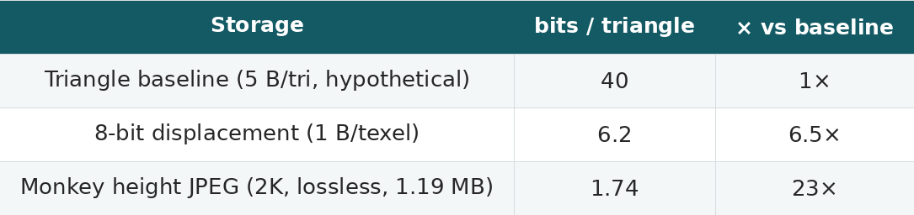
Fixed disk cost
Subdivision data is a fixed cost
Baseline Estimate: Store triangles at 5 byte/tri.
  Actual number will be higher or lower depending on technique
Monkey (Blender's Suzanne)
  2K height map, lossless JPEG
    64.9% UV coverage
  1.19 MB for ~5.45M triangles (1 texel = 2 triangles)
Notes:
Storing the raw data including colors and uvs per vertex would be about 44 bytes per triangle. Of course, that’s not a fair comparison, as everyone is doing some kind of compression, so we’ll compare against a hypothetical baseline of 5 bytes, or 40 bits per triangle. While it’s 8 bits for a single texel, we can get lossless compression with a solution as simple as jpeg. On top of that, each texel corresponds to two triangles. So then when we account for the roughly 65% uv coverage here, we end up with about 1.74 bits per triangle, which is roughly 23x smaller than our 5 byte per triangle baseline.

Slide 7
Caveats
Loss when using displacement.
  Resampling
  8-bit quantization
Shader Techniques
  Standard Tiling, Triplanar mapping, Hex tiling, Detail Textures
  Layering / Blending
  Fully procedural shaders
Limitation: No Topology Changes
  Overhangs, Folds
Notes:
Of course there are a million caveats here. We have to be careful with resampling to the uv map, as well as quantization. And there are many things displacement can’t do like overhangs or folds. But this approach also opens up a whole bag of shader tricks, like tiling and blending. There are many times where you can’t use subdivision and displacement, but the times when you CAN do it, the compression is amazing.

Slide 8
Agenda
Tessellating a triangle
  Including a deep dive into DX11 hardware tessellation
  Then clamped parallelogram tessellation
Tessellating a Mesh
  Adaptively
  With Compute
Subdividing a Surface
  Also with compute
Full explanations, animated diagrams, and MIT licensed WebGPU examples. (filmicworlds.com)
Notes:
So for this talk, we’re going to go over three sections. First, how should we actually tessellate a triangle? We’ll take a trip down memory lane with Hardware Tessellation, and then describe a novel algorithm I call clamped parallelogram tessellation. Second, we’ll discuss tessellating a mesh adaptively in compute. And finally, we’ll use that tessellation scheme to run Catmull Clark subdivision, also with compute.
For a more thorough explanation of the algorithm, you can get the full details from the blog posts, as well as source if you want to dive into the code. The three blog posts roughly correspond to the three sections of this talk.
https://filmicworlds.com/blog/compute-tessellation-with-clamped-parallelograms/
https://filmicworlds.com/blog/adaptive-compute-tessellation/
https://filmicworlds.com/blog/adaptive-catmull-clark-subdivision-with-compute-tessellation/

Slide 9
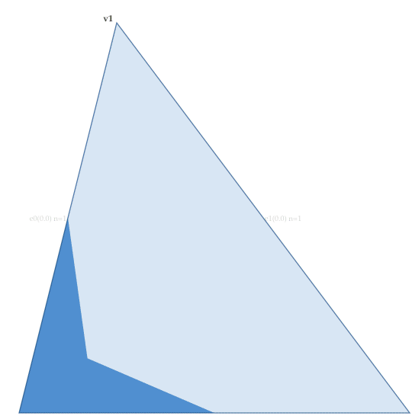
Part 1: The Triangle
Notes:
(6) Before we can tessellate a mesh, we first have to tessellate a triangle. Here is the tessellation algorithm that I landed on, and in the next few slides, we’ll derive it.

Slide 10
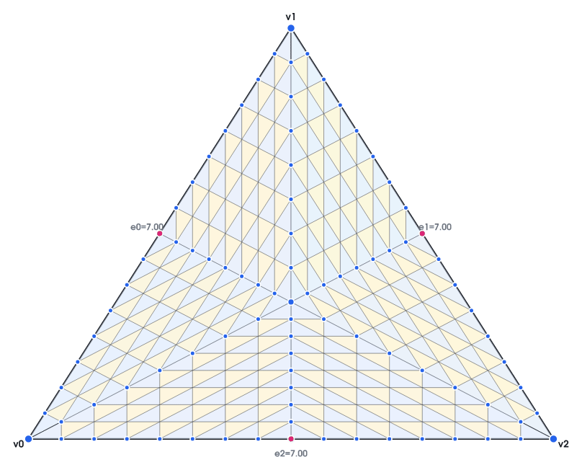
20 years of hardware tessellation
DX11-style tessellation traces to Xbox 360 (2005) [Microsoft]
Rooted in Pixar's Reyes: dice primitives into micro-tris [Cook et al. 1987]
Games shipped with Tessellation. (Gears of War 2, Halo: Reach).
Activision's Call of Duty: Ghosts used Tessellation and Catmull-Clark Subdivision [Brainerd 2014]
Notes:
But first, we need to know where we came from. What we know as DX11 tessellation first shipped as hardware tessellation on the Xbox 360, used in games like Gears of War 2 and Halo: Reach. A few years later, Call of Duty: Ghosts used a hybrid of compute with tessellation hardware for Catmull-Clark.

Slide 11
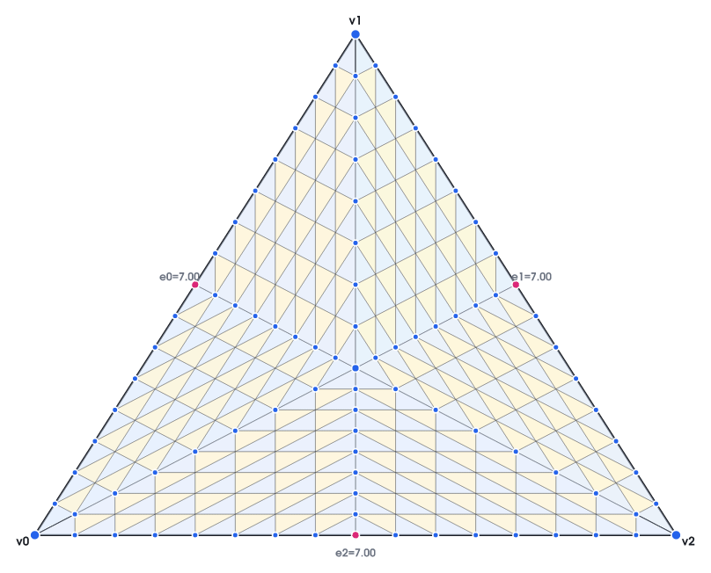
Key tessellation requirements
Fractional tessellation factors: No popping!
All three edges independent of each other
Several differences with DX11 tessellation:
  DX11 tessellation is symmetric, but we are going to break this constraint.
  DX11 has an interior tess factor, but our interior pattern is implicitly defined by the edge tess factors.
Notes:
There are a few key ideas from DX11 tessellation that I want to preserve. First, all of the edge tessellation factors are fractional. The tessellation factors describe how much we want to tessellate each side, and by fractional, that means we can blend between any tess factors without a visible pop. Second, all three edges are independent of each other. However, one aspect of DX11 tessellation that we will NOT preserve is rotational symmetry. DX11 will give you the same pattern regardless of how you order the vertices, whereas we are going to treat the 3 vertices differently.

Slide 12
Tessellating a line
Before we can tessellate a triangle, we need to understand how to tessellate a line.
Each edge has a float tess factor (DX11: [1,64])
No popping!
This is what the final pattern will be. So let's derive it.
Notes:
Before we can tessellate a mesh, we need to tessellate a triangle. And before we can tessellate a triangle, we first need to tessellate a line segment. This is the line tessellation that we are going to use, so let's derive the algorithm for it.

Slide 13
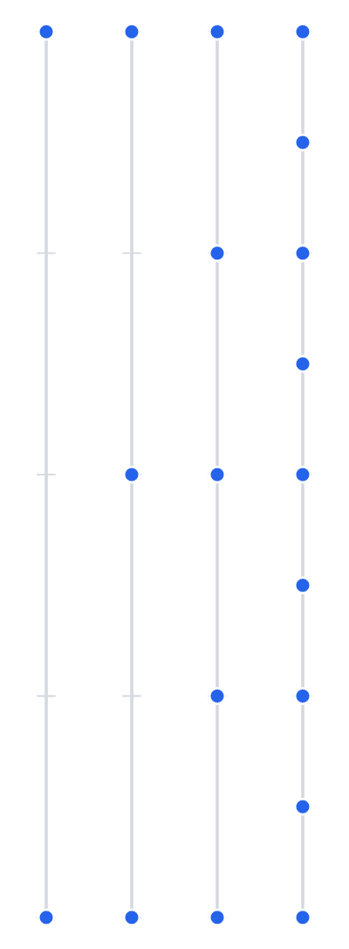
Tessellating a line: Powers of Two
What is the simplest solution?
Just subdivide at each power of two.
  1 -> 2 -> 4 -> 8 -> 16 -> 32 -> 64
Results in a very strong pop.
  But how can we make it transition between levels?
Notes:
So, we have a line segment, what’s the best way to tessellate it? The first, most obvious idea would be to subdivide it at each power of two, doubling each time. It’s simple, trivial, and it would pop every time. How could we modify this algorithm so that it is smoother, leading towards that fractional algorithm that we are looking for?

Slide 14
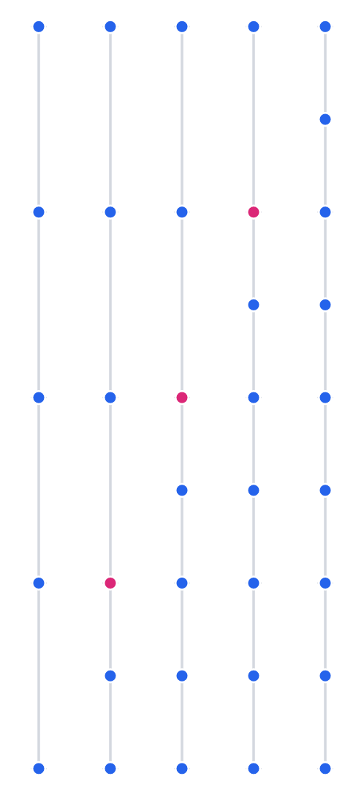
Tessellating a line: One at a time
Add one new point at a time.
When going from 4 -> 8
  Add points 5, 6, 7, 8 one at a time.
Exact same pattern as before
Notes:
When we are splitting from, say, 4 to 8, there is no rule saying that we have to split all 4 segments at once. Instead, we can add segments one at a time. On the left, you can see points behind added just below the pivot point in red. The points are still popping, but at least we have 4 small pops instead of one big pop.

Slide 15
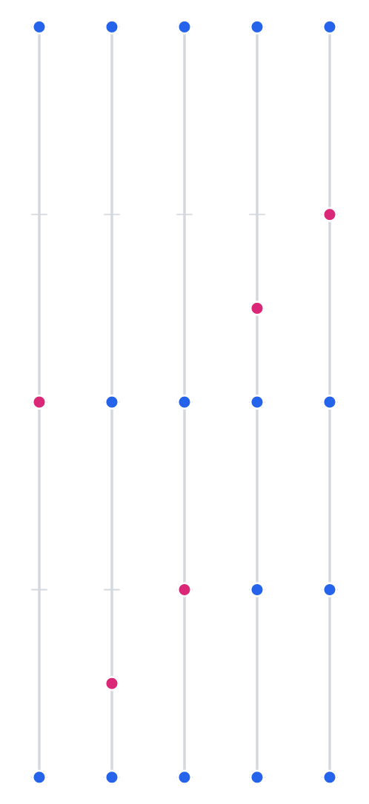
Tessellating a line: Distribution
When adding a point, have it "slide" in from the previous point
  Added point is in red
All other points stay locked
  Only the pivot moves
Resolves to the same position as before
Results in lopsided distribution.
Notes:
Next up, instead of popping in points, we can slide them in from the point below. This operation is analogous to the edge collapse when making LODs from triangle meshes. On the left, we start with a tessellation of two, and then we can gradually slide in one point for the tess factor of 3, and then slide in another for a tess factor of 4. And we now have a simple, fractional tessellation. But there is a catch.

Slide 16
Tessellating a line: Distribution
When adding a point, have it "slide" in from the previous point
  Added point is in red
All other points stay locked
  Only the pivot moves
Resolves to the same position as before
Results in lopsided distribution.
Tess factor of 3
  Two small green segment.
  One big red segment.
Notes:
The catch is, our distribution is lopsided. At a tess factor of three, we have two short gaps, in green, and one large gap in red.

Slide 17
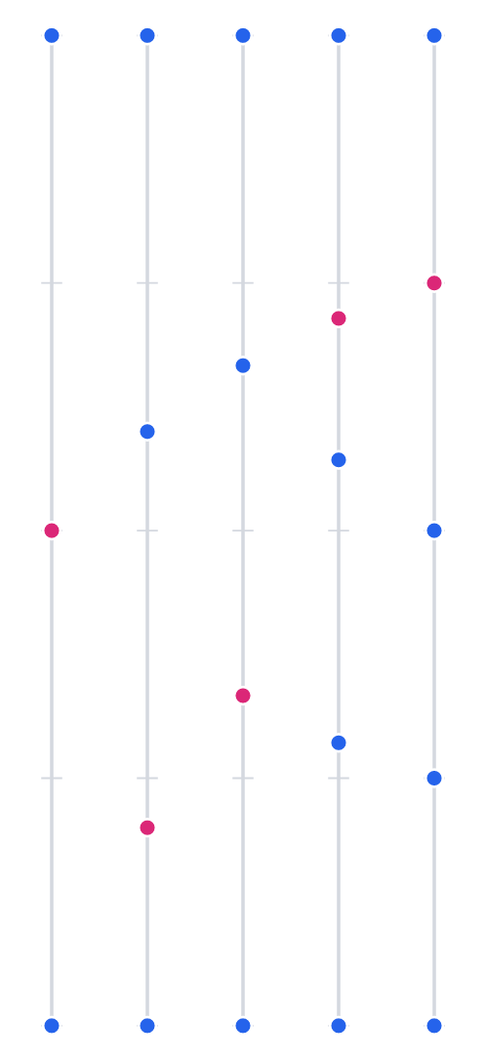
Tessellating a line: One at a time
Adjust the distribution based on new points.
Example: Tess factor 10.3
  11 segments.
  10 segments at 1.0, sliding segment at 0.3
Lands at exact same position at powers of two
Keeps a more even distribution
Notes:
We can fix this. The trick is that when we slide in a new point, our new point should have a fractional length, but all other line segments should stay the same. So for example, at a tessellation factor of 10.3, we would have 11 segments. 10 of them would be the exact same size, and the 11th would be 30% of the size of the others.

Slide 18
Tessellating a line: One at a time
Adjust the distribution based on new points.
Example: Tess factor 10.3
  11 segments.
  10 segments at 1.0, sliding segment at 0.3
Lands at exact same position at powers of two
Keeps a more even distribution
Notes:
Then when we do this, all segments stay about the same size, and we solve this problem of a lopsided distribution of points.

Slide 19
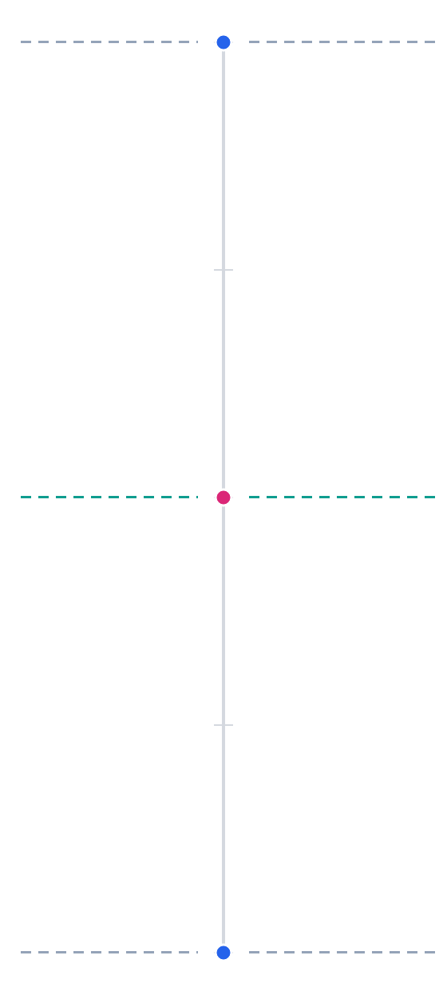
Tessellating a line: One at a time
Take the previous pattern and mirror it.
Minimum tess factor is 2.
  Midpoint always enabled
This is DX11, Fractional-Even Tessellation
Notes:
The next problem is symmetry. If we have two triangles next to each other, the points along their edges need to be consistent. Across a single edge, we can’t have the points slide one way on a triangle and the opposite way on the other. But this is easy to fix. We can simply take the entire pattern from before, and mirror it. Now our segments split at 2,4,6 instead of 1,2,3, but we still have a fractional tessellation. This approach is, AFAICT, fractional-even tessellation in DX11.

Slide 20
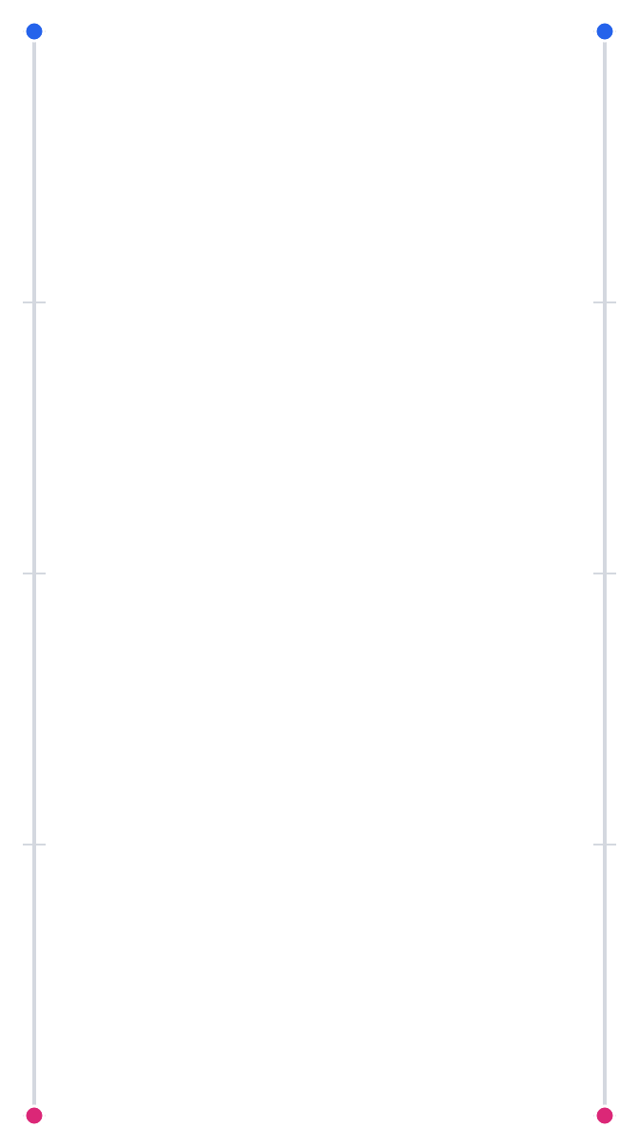
DX11 Line Segments
The distribution is very even
  ..but at the cost of very low stability
The simpler algorithm has a lopsided distribution.
  But the points are stable.
  Less aliasing with displacement
Notes:
However, we have a problem: Stability. On the left we have the DX11 fractional even tessellation, and on the right we have the algorithm before we evened out the spacing. While the algorithm on the left has a much better distribution of points, it also has a lot more movement. If we are going to be displacing these points, if there is any aliasing in our displacement, the points are going to slide back and forth over it, causing a “wobbling” effect.

Slide 21
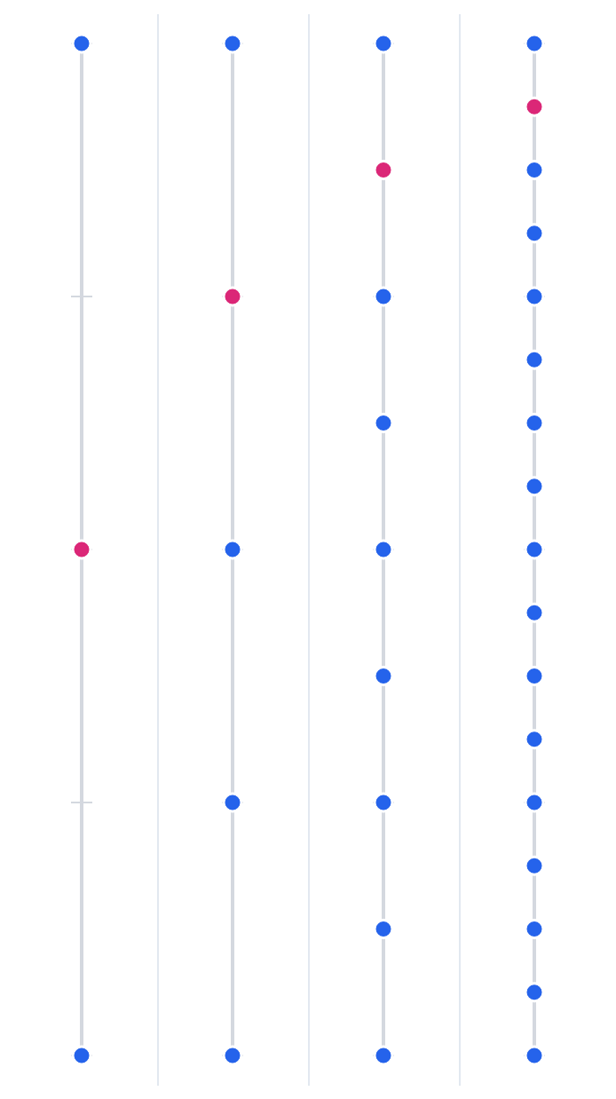
Why DX11 does not converge
As each point is added (in red)
  Points above are pushed UP
  Points below are pushed DOWN
During each octave, the middle point: 0.5 -> 2/3 -> 0.5.
The figure on the left is the first octave.
The animated mesh shows the 4 octaves.
  2->4, 4->8, 8->16, 16->32.
Notes:
Here we see it more clearly. The figure on the left shows the first octave. As we start sliding in the next point, the middle point is pushed up. But then we slide in the next point, it pushes the middle point back down. This same operation happens at each octave, where the first half of the points push the middle up and the second half points push it back down. In effect, every point is moving all the time. DX11 maxes at a tess factor of 64, but if it were to continue to higher tess factors like 128 or 256, the pattern would still be moving.

Slide 22
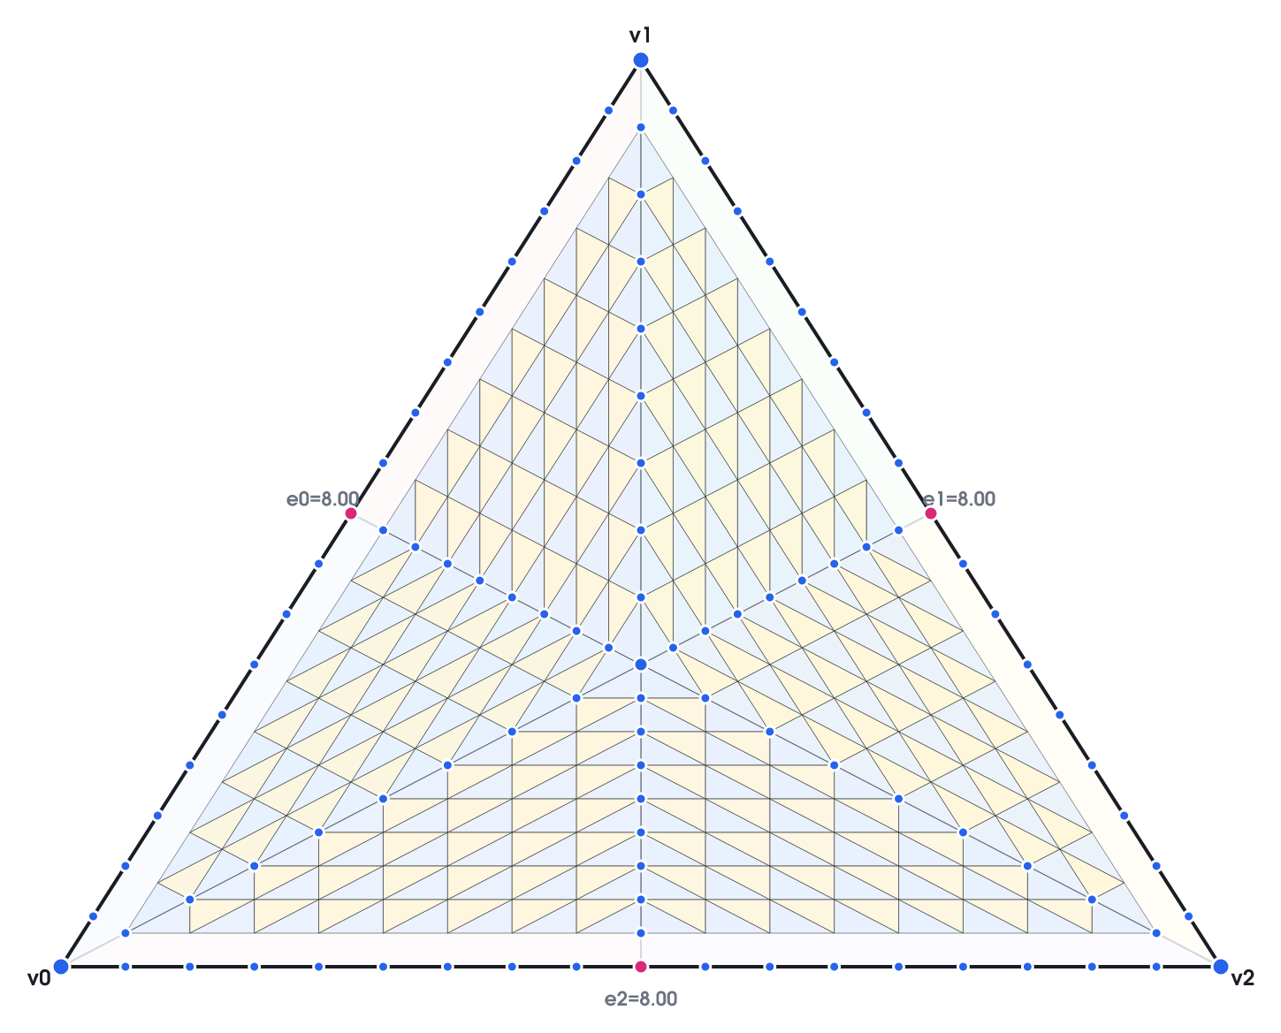
DX11 Triangles Tessellation
How does DX11 Tessellation actually create a triangle?
Split the triangle into 6 regions, triforce-tessellation
[Microsoft], [Giesen 2011]
  Discard the outer strip so each edge can differ
Notes:
Now that we finally have figured out the DX11 algorithm for tessellating a line, we can build that into tessellating a triangle. The general scheme is to split the original triangle into 6 regions, each with regular (or Triforce) tessellation. Then these 6 regular triangles fill in the original triangle. However, it skips the row of triangles connecting to the edge, leaving a gap.

Slide 23
Each edge moves on its own
Edge tess factors are separate from internal tess factors
Drop one edge at a time to 0, then bring it back
The gap-matching strip absorbs the difference; the interior never re-flows
Notes:
Then the DX11 algorithm fills the gap, connecting the interior tess region to the edges. It’s a little hard to see, but in the animated gif, the edge tess factors are changing. Since the edges do not connect to the other edges, each edge is independent of the others.

Slide 24
DX11 interior: the internal tess factor
The internal factor drives the inner tessellation density
Edges fixed here; only the interior grows
Notes:
Additionally, we can change the internal tess factor without affecting the edges. In this animation, the internal tess factor is changing, but the edge tess factors stay the same. Note that the internal tess factor is a single control.

Slide 25
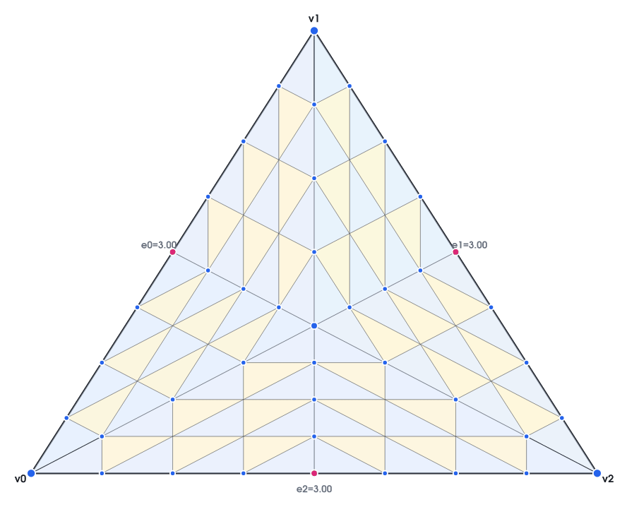
DX11 Tessellation
And that is fractional even.
Each edge can carry a different factor
Interior can change as well.
Ideas for improvement?
Notes:
And that in a nutshell is fractional even triangle tessellation. All three edges and the interior can have different tess factors. And all three are fractional, so we can lerp between and combination of values and never have a pop. So, how would we improve this?

Slide 26
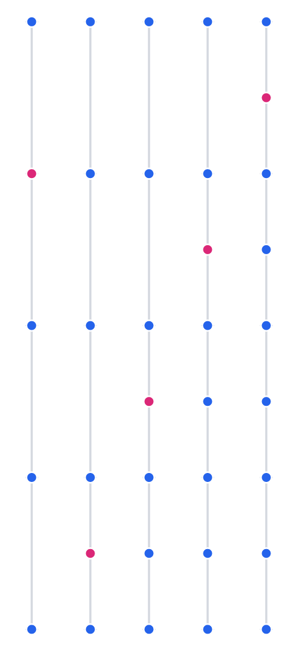
Fixing the line first
Revert to stable "add one at a time" spacing
Improve stability.
…which means regressing the distribution.
Notes:
(13) The first thing that I want to do is improve the stability, so I’m going to revert back to the line algorithm that makes all edges the same size. This is a regression in terms of the distribution, as now we are lopsided again. But now we have much more stable points.

Slide 27
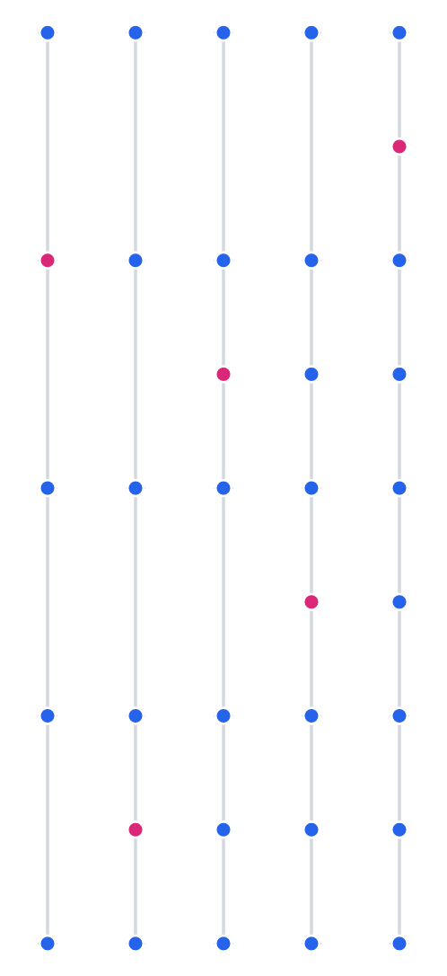
Fixing the line first
Insert odd points before even for better balance
  Same segments, but less lopsided
Note the 3rd column
Notes:
The first thing that we can do is change the order of adding points. Instead of adding all points from bottom to top, we can add all odd points in the first half of the octave and even points in the second half of the octave. This doesn’t change the actual sizes of our line segments, which are still the same. But by splitting them we avoid this lopsided distribution where we have a universally better distribution on the bottom half of the segment. If I flip back and forth, we can see how this one point changes.

Slide 28
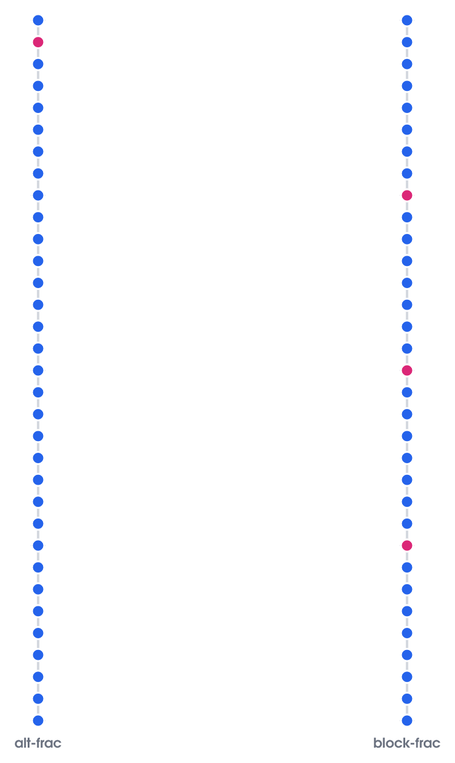
Fixing the line first
Previous algorithm (left)
  Note how red points seem like they pop in.
  Technically it’s continuous
Instead of quickly sliding in one point at a time, slowly slide in multiple points
  Note the points in red moving together (right).
Notes:
Next up, this is a subtle one. Our distribution is continuous, without pops. But when you have 32 points quickly sliding in one after the other, if each one is taking a fraction of a second, then it looks like a pop to the eye even if it isn’t technically popping. So instead, as tess factors get high, we can slide in multiple points together. Notice how on the right, there are multiple points in red sliding in simultaneously.

Slide 29
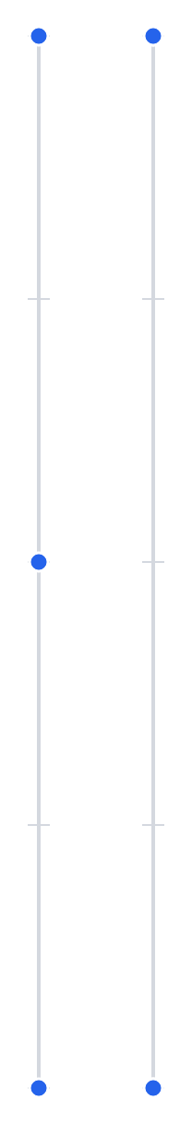
Fixing the line first
Clean 1->2 transition: slide in from both ends
DX11 fraction even has a range of [2,64]
  Technically, you can pass in 1, but it gets clamped to 2.
Instead, allow a transition from 1->2
Notes:
The last change to the line segment algorithm is to allow a transition from 1 to 2. DX11 fractional even clamps all lines at a value of 2, but in my case, I’ll allow transitioning from 1 to 2 by sliding both points in and welding them.

Slide 30
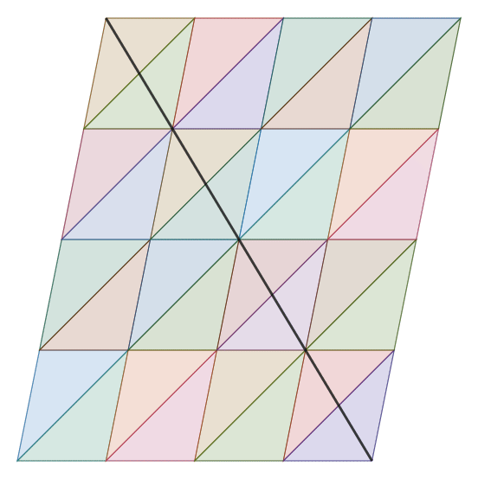
The clamped parallelogram
Start with a parallelogram from two edge factors
Use the 1D point algorithm
  In both U and V
Then create a parallelogram.
Pros: Straight!
Cons: Not a triangle.
Notes:
Now that we have the finalized algorithm for a line, how do we apply it to a triangle? I tried a bunch of ideas, but the one that worked the best was a parallelogram. The core algorithm is trivial: simply use our line tessellation vertically, and then at each of those points, apply the line algorithm horizontally. These points form a parallelogram. And there aren’t many geometric primitives that are straighter than a parallelogram. The downside is that a parallelogram is, you know, not a triangle. So how can we make this fit?

Slide 31
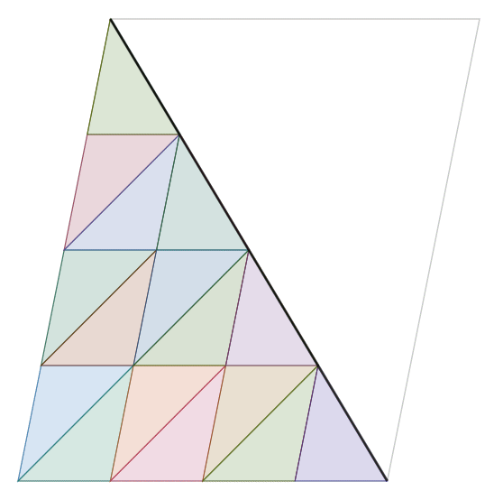
The clamped parallelogram
Start with a parallelogram from two edge factors
Clamp it into a triangle: u = min(u, 1 − v)
Add a gap term for differing L/R edges
Creates degenerate points
  Solvable problem
Problem: Left and right forced into same tess factors.
Notes:
Turning a parallelogram into a triangle is surprisingly easy. For each vertex, we can get our u value from the horizontal line formula, and the v value from the vertical line formula. Then all we have to do is clamp it by 1-v, and poof, we have a triangle. It retains the straightness from the parallelogram. But we have another problem, the left and right edges are forced into the same tess factors. But we need all three tess factors to be independent.

Slide 32
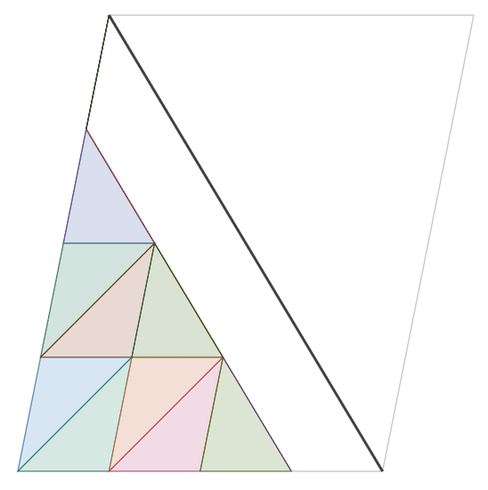
The clamped parallelogram
Mind the gap.
  Both the horizontal and vertical 1d points have a gap from the last point.
  Use the max of both as the gap
Clamp it into a triangle:
  u = min(u, (1 - gap) − v)
This constraint leaves an open area.
Notes:
The solution is to add a gap. We get the gap of the last two points from both the vertical and horizontal lines, and take the maximum. That value is the gap size. Then clamp all of these points to be at least that far away from the right edge horizontally. That gives us space to fill them in.

Slide 33
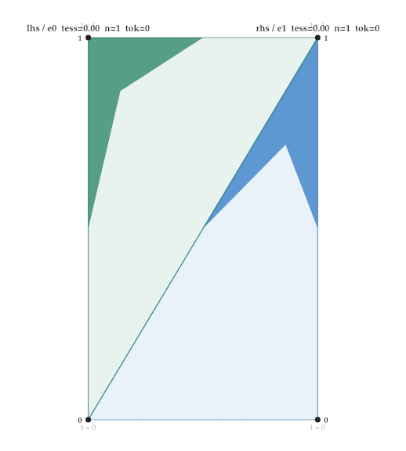
Matching the gap
Matching algorithm to fill the gap.
Built offline as a table with a fast lookup.
Algorithm:
  Round up to the nearest power of two
  Then match across
  Details are a bit finicky. See sample code for details.
Notes:
The actual algorithm to fill the gap is a little finicky. It essentially involves rounding up the left and right side to a shared power of two. Then figuring out which points on the right match up with the same points on the left, using that shared power of two. But it can be calculated offline and stored in a table. So for any combination of left and right tess factors, we can look up the pattern.

Slide 34
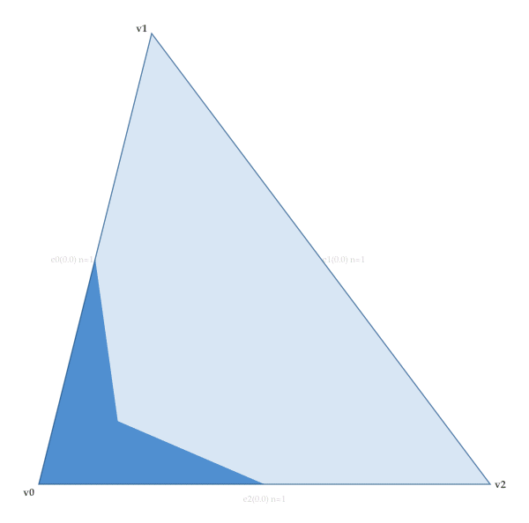
The full tess pattern
For low tess patterns, we need an extra point in the middle.
The clamped parallelogram only kicks in when the tess factor of the left edge is at least 2.
  It doesn’t work when the points on the left edge are sliding from 1->2
Otherwise, a center points is added.
Notes:
We have one extra case to consider, and that is when the tess pattern is at low values. The clamped parallelogram pattern is only valid if the tess factor of the left edge is at least two. It doesn’t really work while those two points are sliding into each other. So the best solution I was able to find is to have a single point sliding in from the opposite vertex, towards the edge on the left. Then when the left edge is 2, the centroid point merges with the two points sliding along the left edge, and we can switch to the clamped parallelogram pattern the rest of the way.

Slide 35
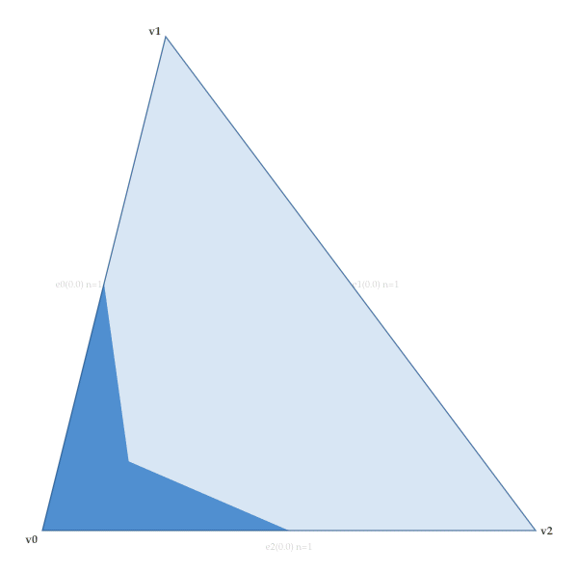

Full pattern
Notes:
And finally, for reference, here are two animations of the pattern. The left side shows the equilateral pattern, when all three edges are the same tess factor. And the right shows the more extreme pattern, when all three values are quite different from each other. But regardless of the values, it still lerps without a pop.

Slide 36
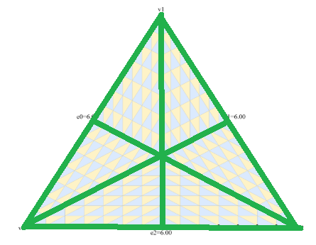
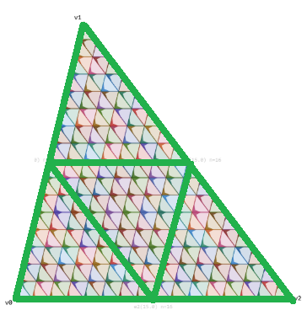
DX11 vs. clamped: inefficient patterns
DX11: 6 regular regions - more triangles than needed
  Clamped Parallelogram is 4
  1/3 less triangles at equal power of 2 tessellation.
  In this case, Interior and Exterior tess factors are 16.
Notes:
In comparing to DX11 tessellation, the first major difference to note is the raw number of triangles during regular tessellation. In the case when all tess factors are the same at a power of two (such as all exterior and interior tess factors at 16). The DX11 algorithm will split into 6 different regions of a regular triforce pattern, but the clamped parallelogram algorithm will result in 4 regular regions. At regular powers of two, this algorithm exactly matches a fully regular tessellation, at only 2/3 number of triangles.

Slide 37
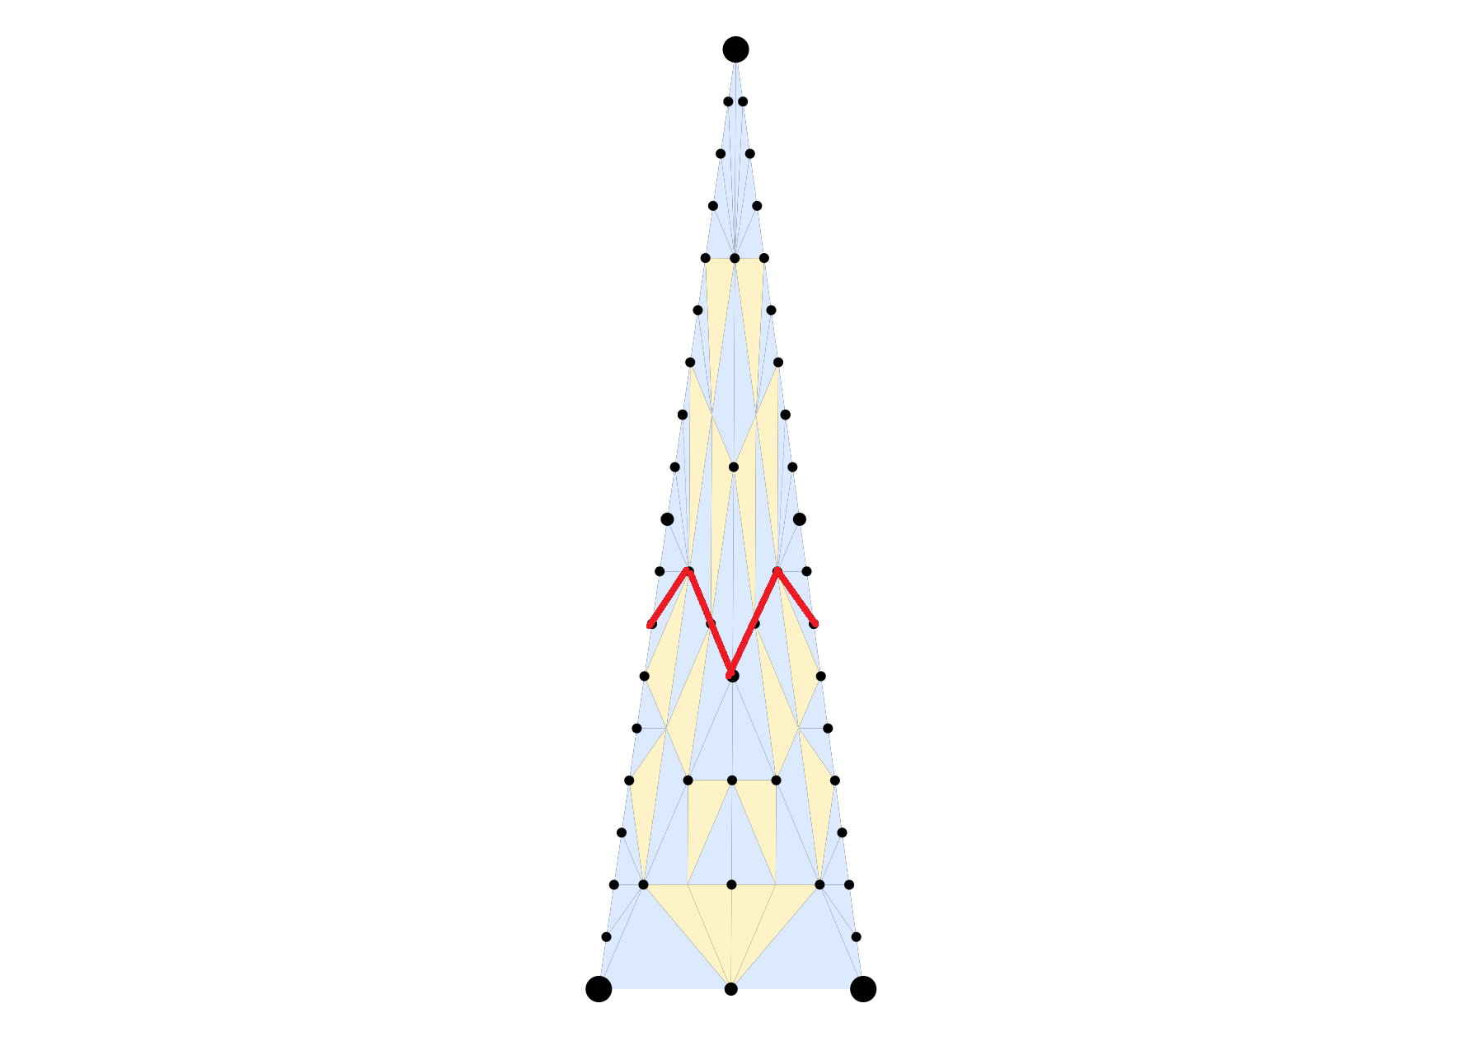
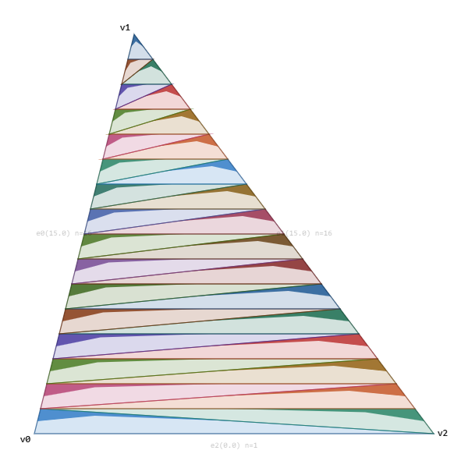
DX11 vs. clamped: varied factors
Thin triangle
DX11: single internal tess factor
  Impossible to have more internal points vertically than horizontally
  Either rows are under-tessellated or columns are over-tessellated
Clamped Parallelogram: Gracefully handle long, thin triangles.
Notes:
Second, and this matters more than you might think, is thin triangles. DX11 has a single interior tess factor. We generally want to maintain a consistent distribution inside our triangles so if we have a tall/thin triangle, we would want that triangle to have multiple rows of interior tess factors but very few columns. However, that is impossible as DX11 only provides a single tess factor to control the entire internal pattern. However, because of the nature of the parallelogram, for thin triangles, we can have edges cross from one side of the triangle to the other.

Slide 38
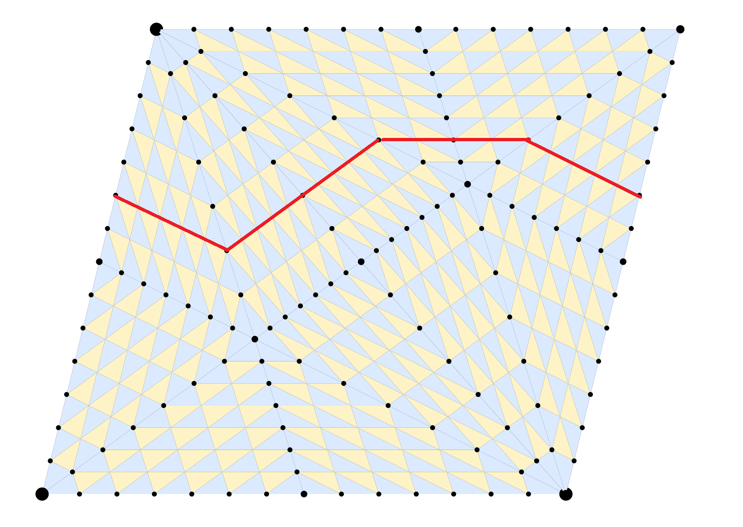
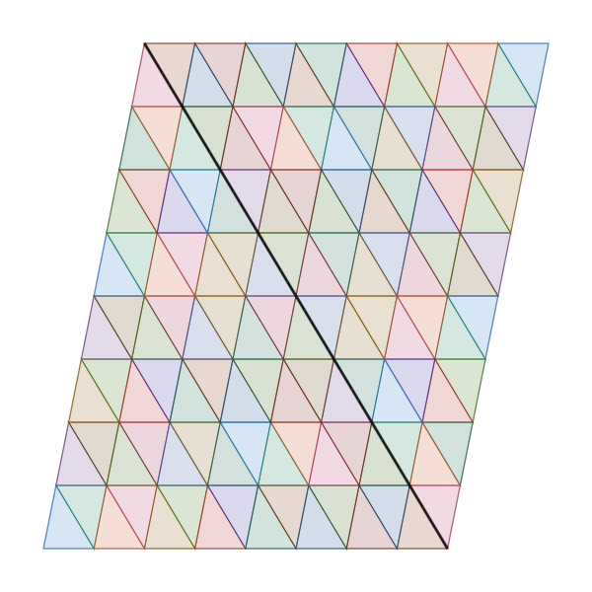
DX11 vs. clamped: bending & edge loops
Deformation wants straight edge loops - no sharp bends
DX11: no clean loops (quad primitive - mixed tri/quad
Clamped: regular quads, loops that degrade gracefully
  This is why we explicitly reject rotational symmetry
Notes:
The third issue is general straightness. This is particularly important since most real meshes are a hybrid of triangles and quads. Then those quads get split into triangles for the runtime. With the DX11 tessellation pattern, even with a simple quad split into two triangles, look at the path the loop has to take to get from one edge to the other. However with this algorithm, it naturally preserves straight edge loops in that case.

Slide 39
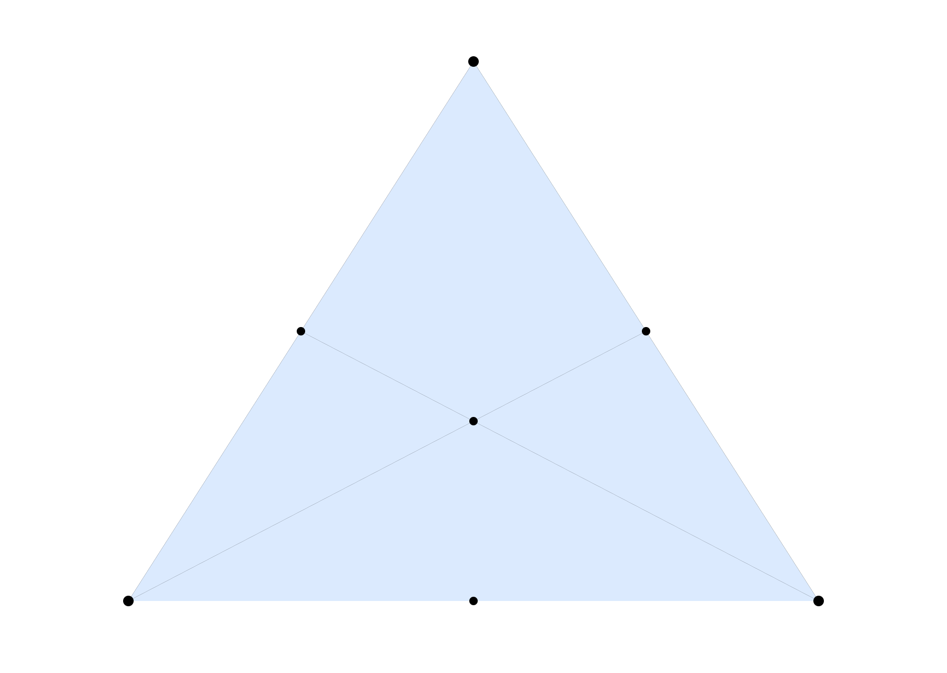
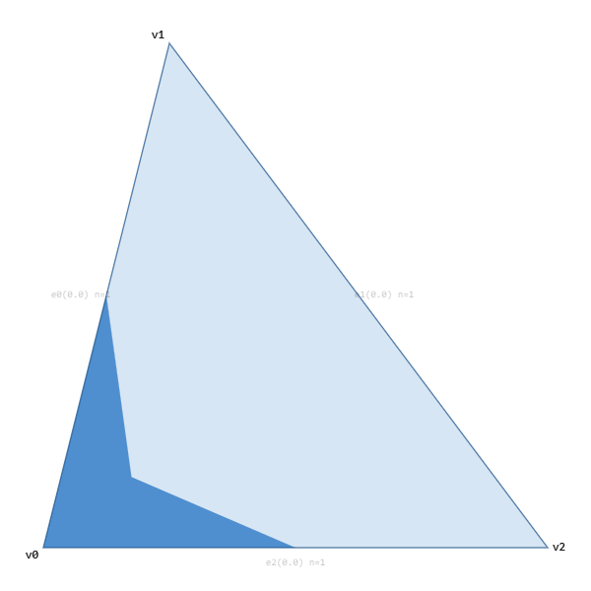
DX11 vs. clamped: minimum triangles
DX11 fractional even: minimum 6 triangles.
  Simply “turning it on” causes a hefty increase in triangles.
  Fractional odd can go from a single triangle.
    At the expense of even more instability.
Clamped Parallelogram
  Transitions all the way from a single triangle
Notes:
And finally, since fractional even clamps tess factors to a minimum of 2, each triangle must get split into a minimum of 6 triangles. So simply turning on DX11 tessellation already causes a 6x jump in triangle count even if you want to just begin the process of transitioning in more detail. The clamped parallelogram pattern easily handles the single triangle case.

Slide 40
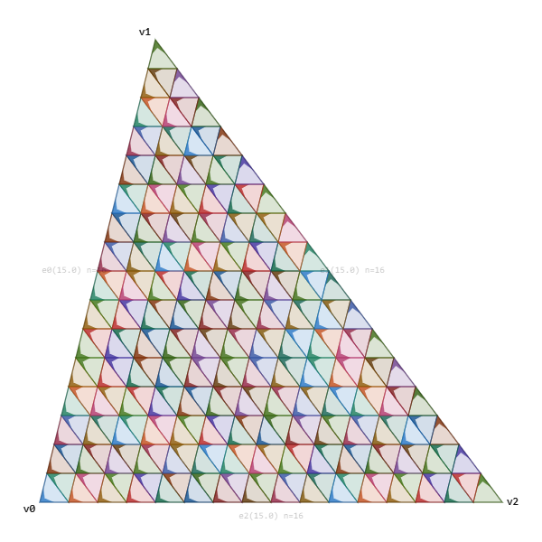
Implementation Details
Store everything as tables.
  25 unique 1D lines
  Each line has a start and end t for each position
Clamped Parallelogram Tables
  Based on left edge and bottom edge
    25*25 tables.
Gap Table
  Based on left edge and right edge
    25*25 tables
Total tables size: 1.6MB
Notes:
For evaluation, I found it’s best to just throw everything into tables. For each 1d table, I store both a start and end position for each tess factor range. Since each position starts and ends exactly on the 256 segment grid, each position conveniently fits into one byte. Also, even though we have a max tess factor of 256, we only have 25 unique transitions. For full details, look at the blog post or source code.

Slide 41
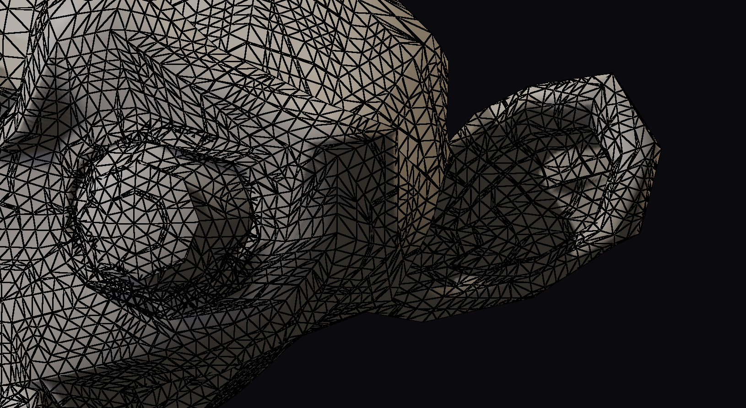
Part 2: The Mesh
Full Compute Adaptive Tessellation
  Choose tess factors for edges.
  Tessellate into large, flat buffers.
A reference baseline:
  Vanilla WebGPU, no extensions
Algorithm options?
Notes:
(21) Now that we are able to tessellate a triangle, it’s time to focus on the next step, which is tessellating a mesh. The implementation is fully adaptive, meaning any edge can have any tess factor. The mesh will be tessellated into big flat buffers. And as a restriction, this runs on vanilla WebGPU with no extensions.

Slide 42
Recent Compute Tessellation Algorithms
Nanite Tessellation [Karis 2026]
  Integer tess factors, nested splits
  Pattern pops when tess factors change
    Not visible with sub-pixel triangle error, similar to Reyes (Reyes)
Concurrent Binary Trees / Longest-edge bisection [Dupuy 2020], [Deliot et al. 2021]
  Recursive cascading splits
  Dependencies between edges
Goal: Fractional tessellation
  Independent edges
  No pops
Notes:
There are several other recent approaches which are adaptive in various ways. Nanite tessellation uses a raw table for each triplet of three integral tess factors. Any change in any tess factor will cause a pop, but this is mitigated if you can guarantee subpixel error in your triangles, which is a key design pillar of nanite. Another option is concurrent binary trees. It uses a recursive splitting algorithm with some dependencies among adjacent edges. Neither one fulfills the goal of this talk, which is a full, fractional tessellation without pops.

Slide 43
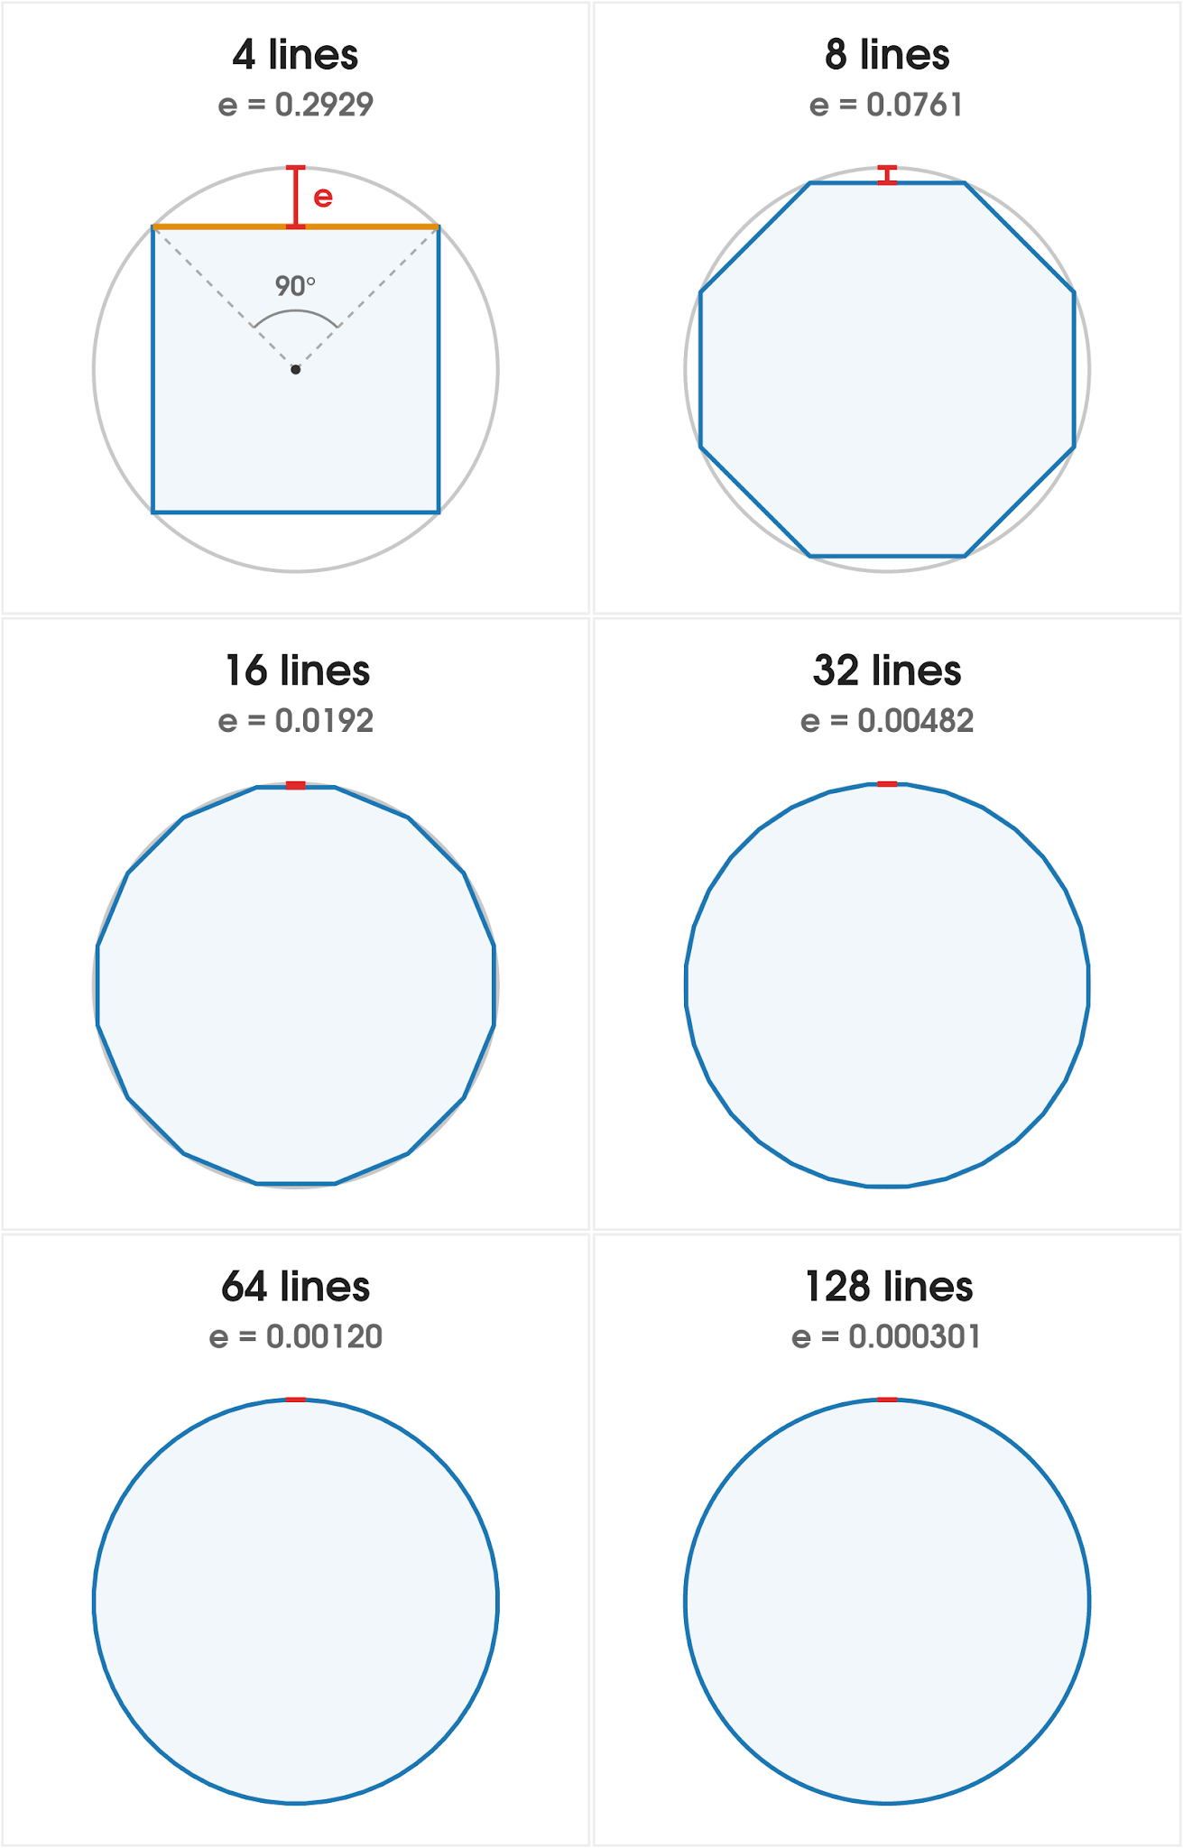
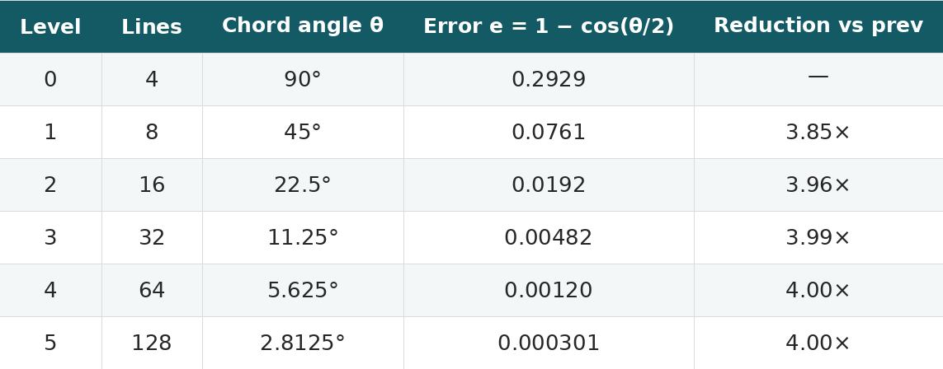
The 2D Rule: 1/8th
In 2D, each level gives 2× more line segments for a 1/4 reduction in error
2× the cost for 1/4 the error means each level is 1/8th as efficient as the last
Huge early gains, rapidly diminishing returns
Notes:
Going back to line segments again, suppose we are trying to tessellate a circle. We could start with a box, with four points. Then each time we subdivide, we decrease the error. Initially, a small number of edges leads to a very good decrease in error. But we quickly get close to convergence, where a huge number of triangles has a negligible impact. In particular, each 2D subdivision requires 2X the number of points. But the actual amount of error reduces by 4x. So, in my mental model, each subdivision level is about 1/8th as efficient as the previous one. Even at a glance, the top two levels show a huge improvement by just adding 4 points. But at the bottom, adding 64 points looks virtually identical.

Slide 44
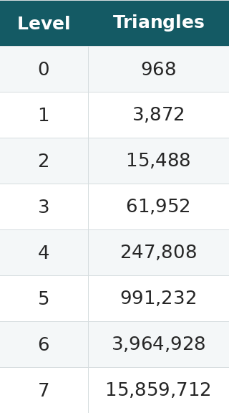
The 3D Rule: 1/16th
Same error reduction per level (1/4)
Each level is 4× the triangles
  As opposed to 2x for 2D.
1/4 the error for 4× the cost for each level is 1/16th as efficient as the last
Gains diminish even faster than 2x.
Notes:
The result is more dramatic in 3D. With Catmull-Clark subdivision, the error still converges at about the same rate, being 1/4 the error for each level. But each level costs 4x as many points as opposed to 2x. So in total, each level of subdivision is about 1/16 as efficient as the previous level.

Slide 45
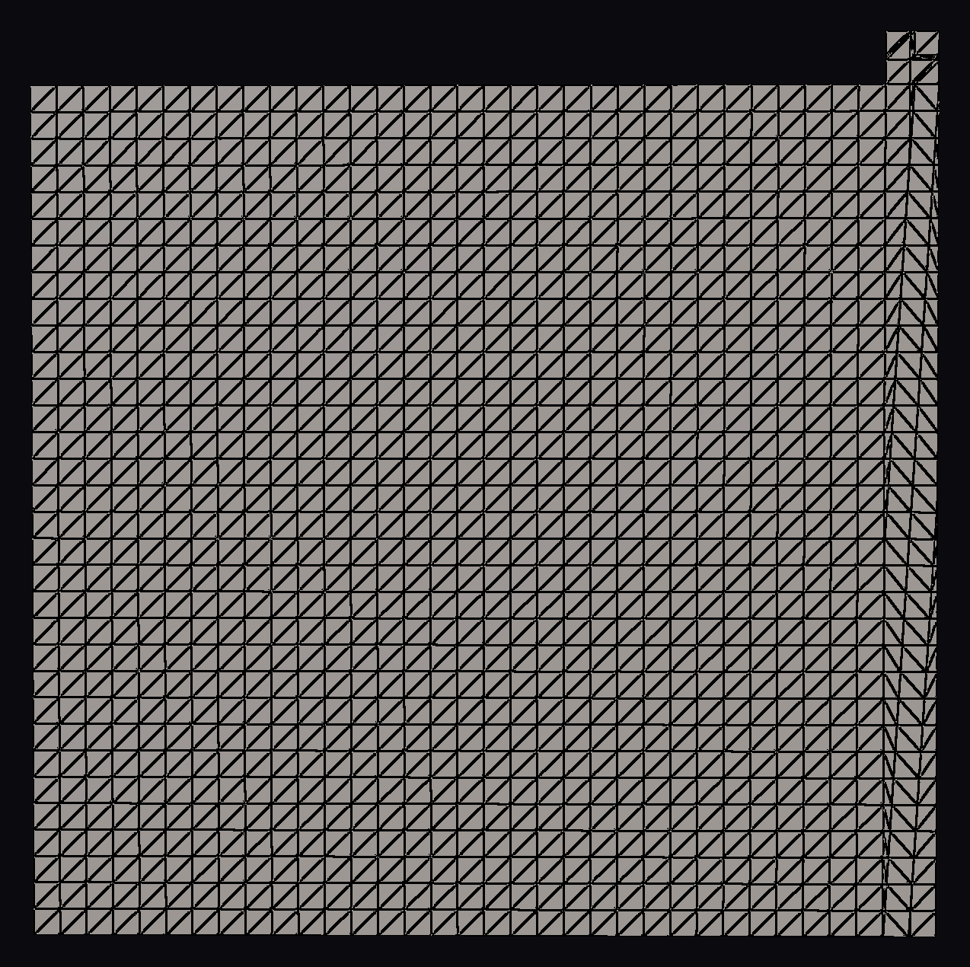
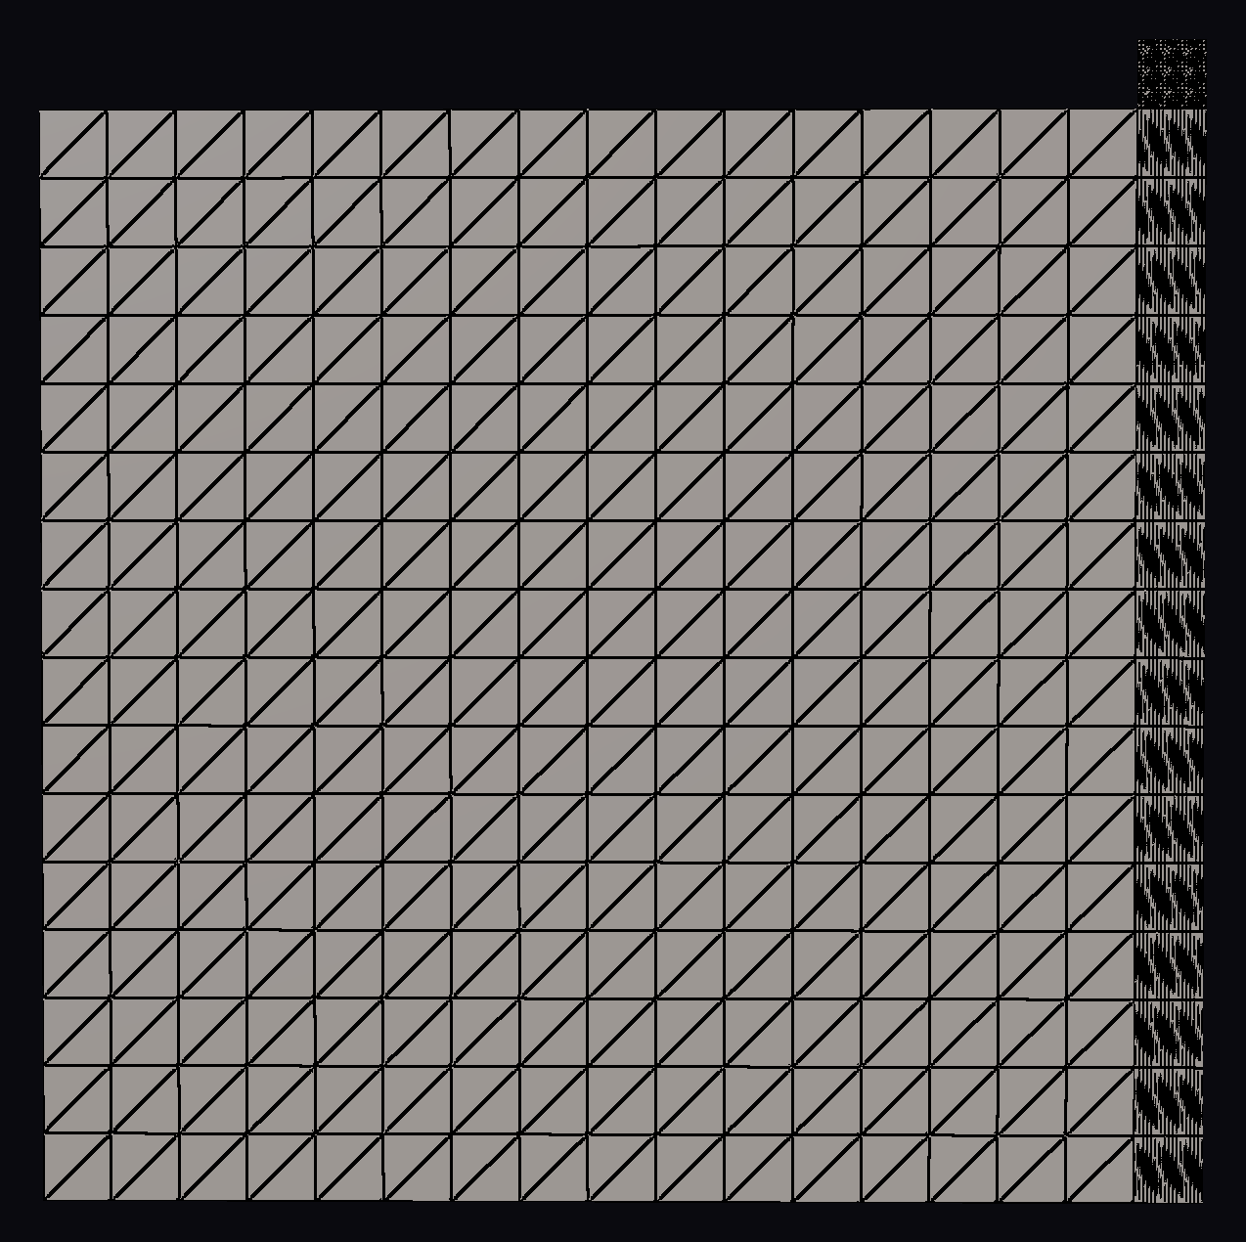
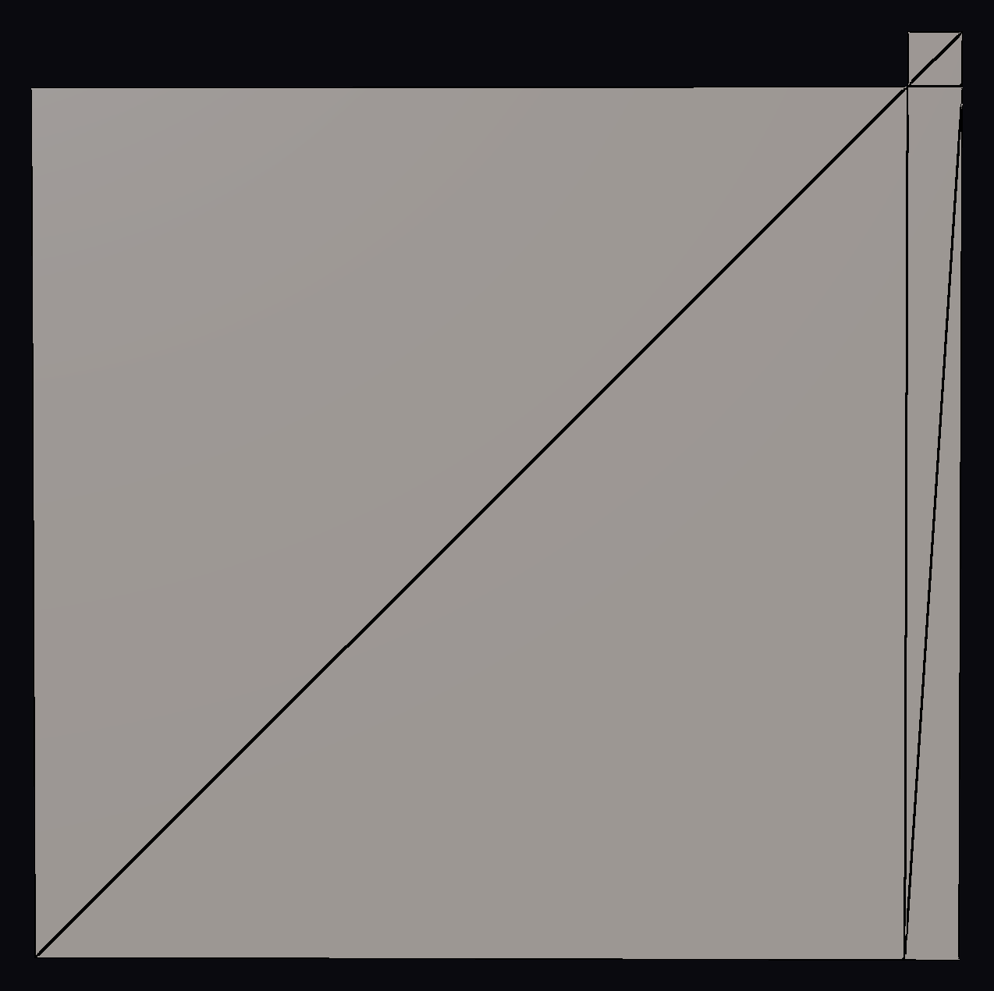
Real meshes have unevenly sized polys
Simple case, with three initial quads.
Fixed tessellation:
  Over-tessellate the thin and/or small quads
  Under-tessellate the large quads.
Left: Adaptive tessellation
Right: Fixed tessellation
Notes:
Where this effect really becomes pronounced is in uneven meshes. In general, most meshes have uneven density, especially manufactured objects like lamps, cars, and buildings. To demonstrate, here is a hypothetical object on the bottom, with a big quad, a thin quad on the right, and a tiny quad up top. With adaptive tessellation, we can maintain an even distribution across all three source quads after they were turned into triangles. However, with fixed tessellation, the thin quad on the right is over tessellated horizontally. And then the small quad on the upper right is nearly black. With a fixed tessellation, we naturally end up over-tessellating the small and thin polys which forces us to under-tessellate the big polys that need it the most. Every over-tessellated triangle we waste is one that we can't use more effectively elsewhere.

Slide 46
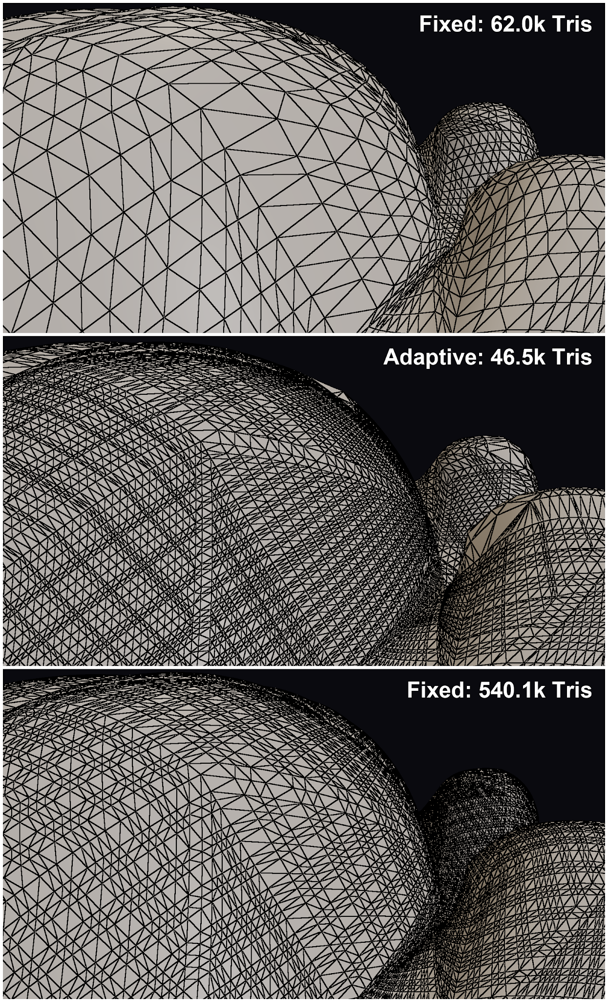
The payoff: adaptive vs fixed
Top image is fixed, at 62.6k triangles
The middle image is adaptive. It provides a vastly finer tessellation despite fewer triangles (46.5k)
  More aggressive tessellation of larger triangles.
  Less aggressive tessellation of smaller and offscreen triangles.
To achieve similar tessellation size, we need about 560.1k tris
Notes:
Here is another example of the monkey mesh. The monkey’s scalp has a lower tessellation than the brows. The image on the top shows a fixed tessellation with 62.2k polys. But with adaptive tessellation, we can get vastly more detail with even fewer triangles. As a test I tried to bump up fixed tessellation to get a similar result, but even at 560k triangles, it still has a sparser tessellation than the adaptive mesh (more than 10x the adaptive size).

Slide 47
Big buffers
Store buffers for 16M tris and 16M verts
  Indices (3 u32 per tri): 192 MB
  Positions (3 f32 per vert): 192 MB
  Normals (3 f32 per vert): 192 MB
  Barycentrics (1 u32 per vert, packed 2x16): 64 MB
  Src Tri Index (1 1u32 pververt)
~704 MB at the 16M-vert / 16M-tri cap
  Lots of room for improvement (mesh shaders!)
Interpolate attributes in VS
Notes:
In order to tessellate this mesh, we are going to need big buffers. In this demo, I chose a buffer large enough for 16M tris and 16M verts. There are no mesh shaders in vanilla WebGPU, so I have to store a fat index list. But still, even with those limitations, we can make this work.
Finally, the interpolation of all other attributes happens in the vertex shader. The only information we really need from the compute tessellation pass is the indices, positions, normals, and barycentrics. From the barycentric we can calculate everything else.

Slide 48
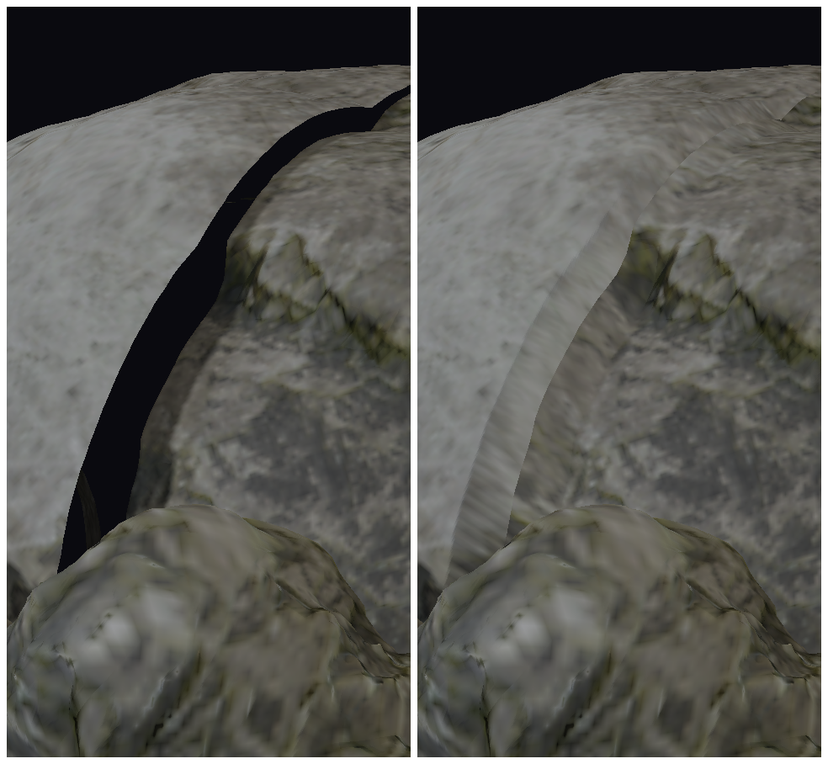
Welding
UV seams
Texture partial derivatives
Roundoff error
Material seams
  Brick wall to a concrete wall
Weld positions in a post-pass
  Separate pass for corners vs edges
Fundamental limitation with hardware tessellation.
Notes:
One of the subtle issues with hardware tessellation is that you need to find some way to weld your edges together. Gaps can form at edges for many reasons. We have the obvious ones like UV seams, as well as the subtle ones like matching up the partial derivatives of mipmapped texture samples. And the big one is material edges: For example, if you have a brick wall connected to a concrete wall, you have to do…something! With storing the vertex data in a giant buffer, we can just weld them together as a post pass and ship it.

Slide 49
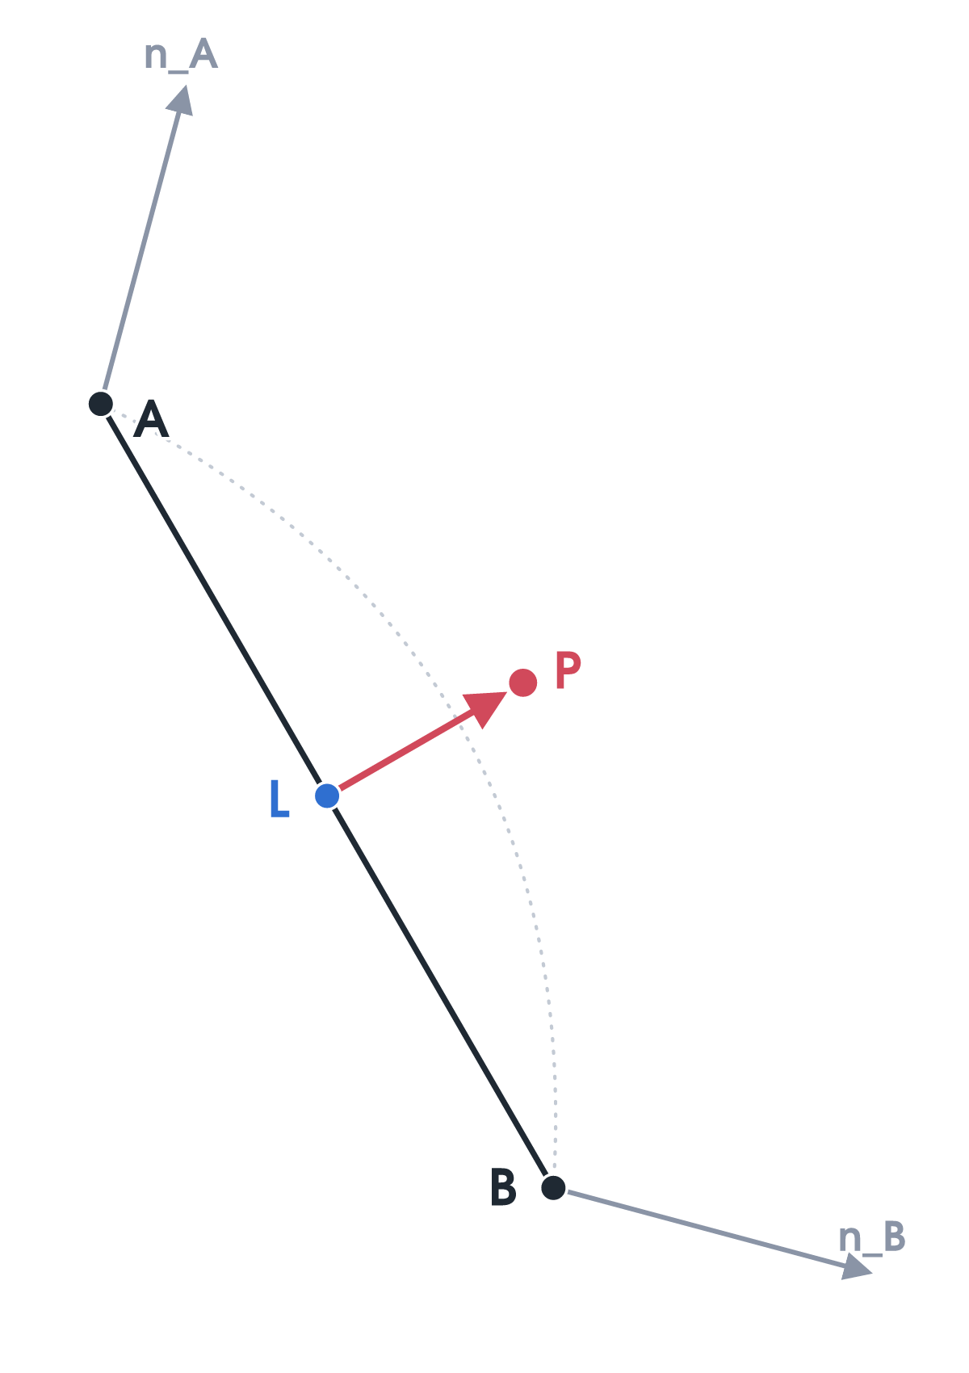
Choosing the tess factors
Inspirations: [Brainerd 2014], [Karis 2026]
[Brainerd 2014] uses the distance from the linearly evaluated point to the midpoint.
Instead, use the Phong approximation with the limit position and normal from both vertices.
  Error is the offset from the Phong midpoint to the linear midpoint
Using arc angle instead of screen projection
Notes:
In choosing the tess factor, there are several options, most recently being nanite. But the algorithm I went with is closest to Wade Brainerd’s presentation. In it, he evaluated the silhouette edge analytically using a cubic B-Spline, and used the distance from the linear midpoint to estimate curvature. I went with a similar approach. Given the position and normal of both vertices on the edge, you can calculate the approximate curved midpoint using phong interpolation. And the distance from that point and the linear midpoint gives you a good estimate of curvature.

Slide 50
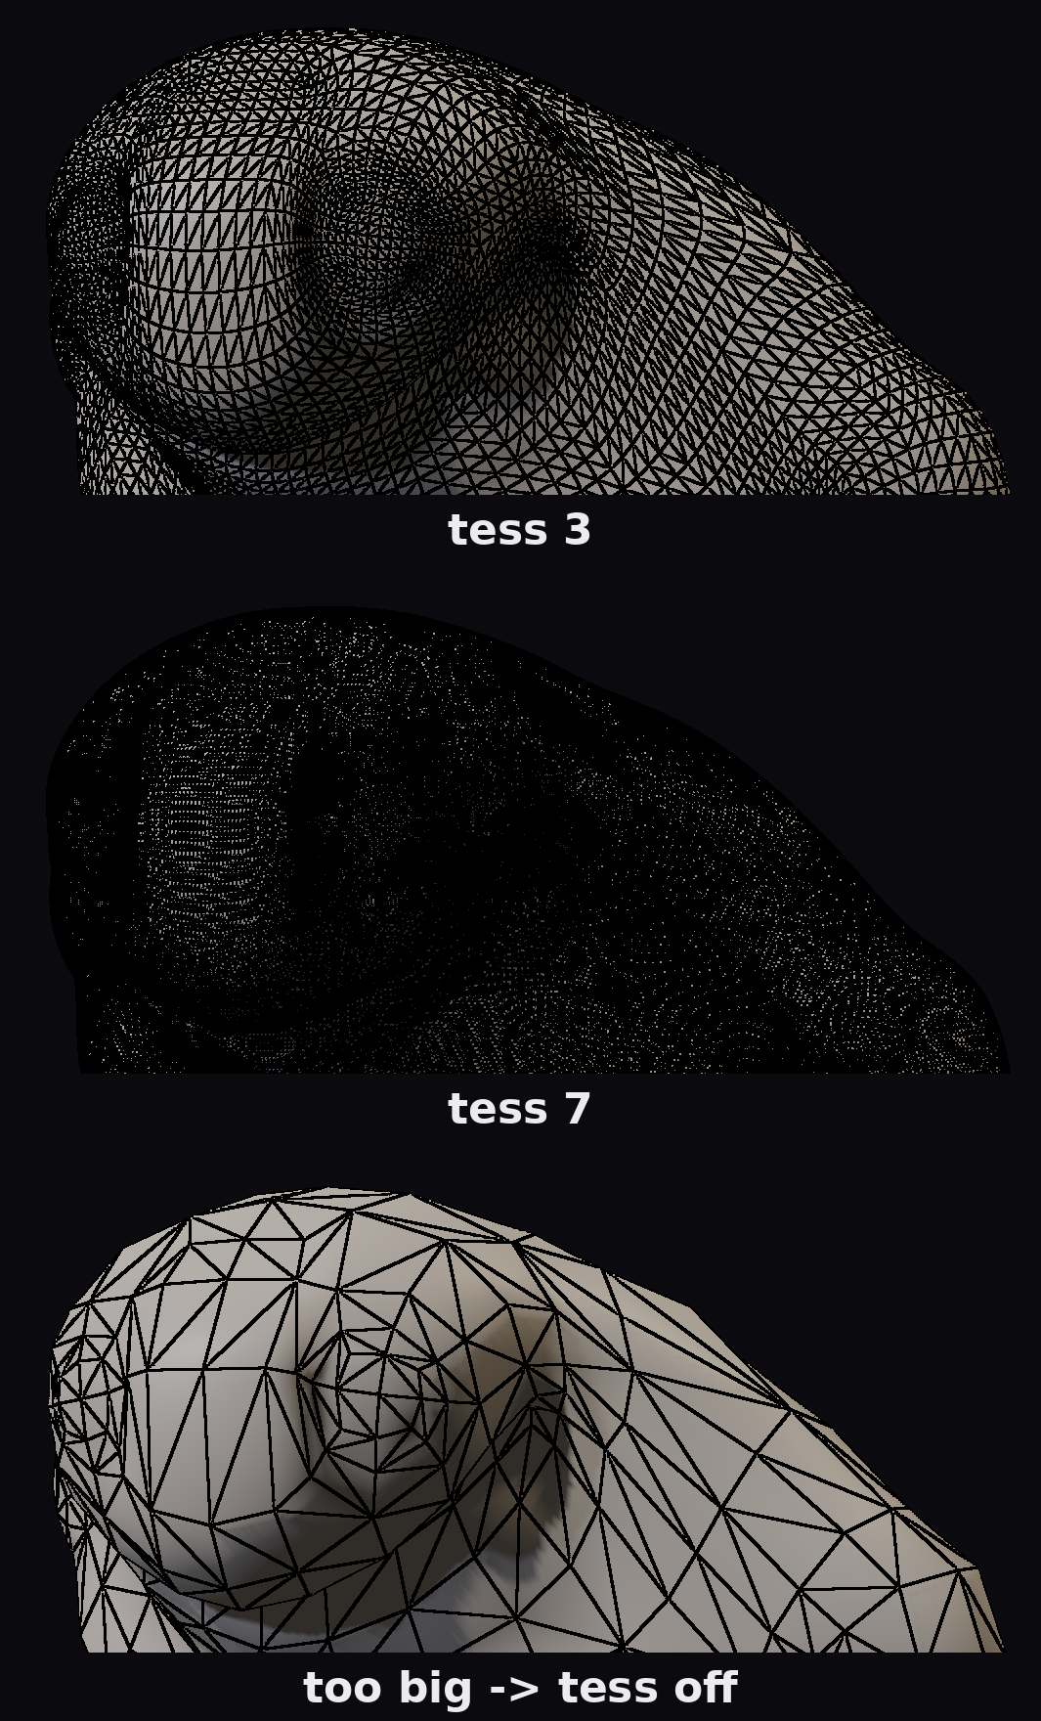
Too much data?
What if we have too much data?
  And it would overflow the buffer?
Goal: Not crash
  Good enough
Tess factors first
  Drop tess factors if we know we would go over
Significant room for improvement
  Half or quarter size
Notes:
DX11 hardware tessellation has the elegant property that data is consumed as it is produced, so you can theoretically tessellate to any size you desire and will never run out of memory. However we have to store all data in large buffers. In practice this should be rare, since we would adjust to keep the adaptive size within budget. But spikes will happen. Our solution doesn’t need to be perfect, but we do need to at least “not crash”.
The trick is that the edge tess factors are calculated in the very first step of the algorithm. If we detect that the triangle sizes would exceed the budget, then we can clamp down the tess factors before anything bad happens. We could do a more graceful solution, like falling back to half or quarter edge size, but for the purposes of this demo, not crashing was good enough.

Slide 51
Multiple Render Passes
DX11 tessellation both produces and consumes in the same pass.
  Elegant: constant memory regardless of tessellation size.
  Multiple Passes: Full calculation every pass.
Most engines require multiple passes per frame:
  Pre-Pass, GBuffer, Motion Vectors, Shadow Depth
Store the tessellated verts once, weld
  Reuse for each pass
Notes:
This single big buffer approach has a very important real benefit: Multiple passes. In most engines you are going to render your dynamic objects multiple times. You’ll have a primary pass like, GBuffer or Forward, then likely a prepass, motion vector pass, and shadow depth. DX11 is elegant in that data is consumed as it is produced, but what if you have to render the same geometry 5 times in a frame? In that case, the data must be produced 5 times to be consumed 5 times. Whereas with the big buffer compute approach, we only have to produce it once in order to consume it 5 times.

Slide 52
Implementation: Big Tables
For each combination of clamped parallelogram (25x25)
  Precalculate a full table.
  Size depends on max tess facto
    64: 2.5MB
    128: 8.6MB
    256: 30.2MB
Also implemented with analytic, but table was faster
  TODO: precalculate meshlets
Notes:
The initial version I implemented as an analytic solution for tessellation on the fly. However, it was slightly faster to simply precalculate every triangle pattern combination. For a maximum tessellation factor of 64, that size is 2.5MB. It expands to 30.2MB if you want full 256 tess factors. Precalculating a list of meshlets for each triangle pattern seems like it would be viable, but that item is lingering on my very large todo list.

Slide 53
Part 3: Catmull-Clark
Film standard since Geri's Game (1997)
Artists author low-poly, subdivide at render
Hierarchical displacement
  Delta vs. the subdivision surface
  ZBrush/Mudbox/Blender
Notes:
(26) So now we can actually start talking about subdivision surfaces. As mentioned, it’s been the standard in film VFX since the late 90s. It gives you a clean way to author a low poly mesh and generate infinite levels of smoothness. But what often gets under-appreciated is that catmull-clark with hierarchical displacement is the underlying representation for most solid modeling, in particular ZBrush. Under the hood, ZBrush stores your sculpt as a low poly, catmull clark surface with hierarchical levels of edits.

Slide 54
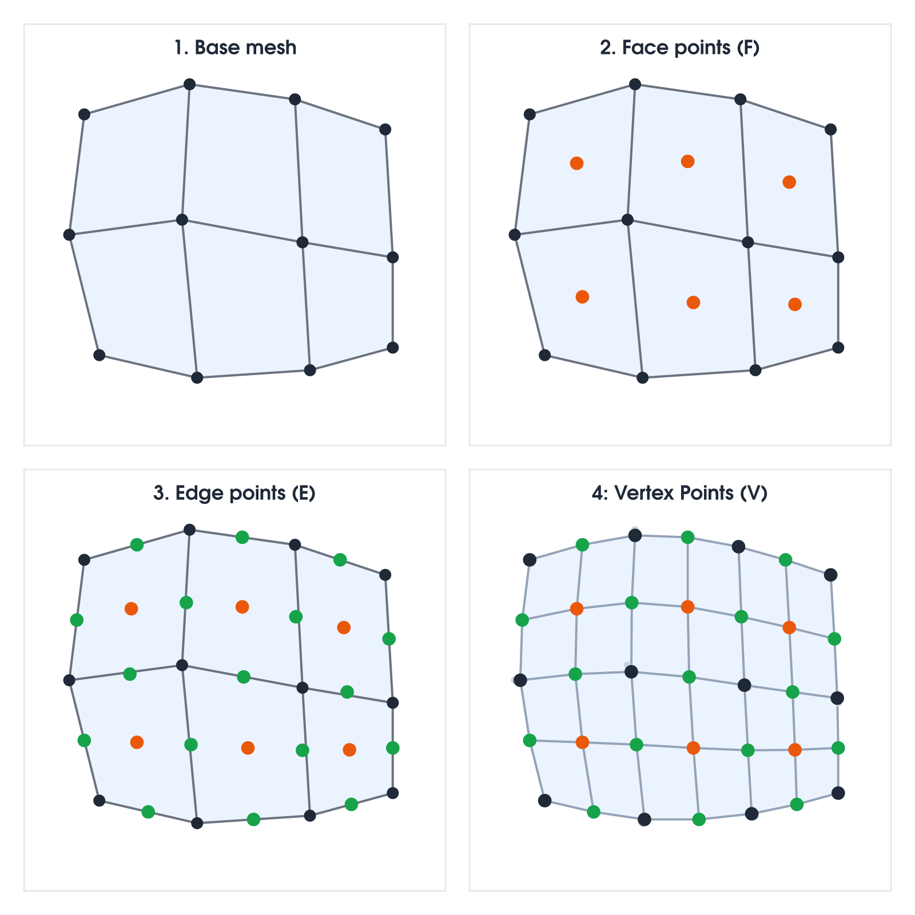
Catmull-Clark
For each level:
  Calculate Face Points
  Calculate Edge Points
  Calculate Vertex points
It’s stable and well-behaved
It’s linear
  Each subdivided point is a linear combination of points within the 2 poly ring.
  I.e. current poly and one ring around it.
Notes:
The actual idea of catmull-clark is very simple. Essentially, you start with a coarse mesh. Then you calculate the face points. From those face points you calculate the edge points. And from the edge points you calculate the new vertex points. These three steps give you the next subdivision level. Then you can continue this sequence until you are done. Additionally, each calculated point can be defined as a linear combination of nearby points. Spoiler: This will be important later.

Slide 55
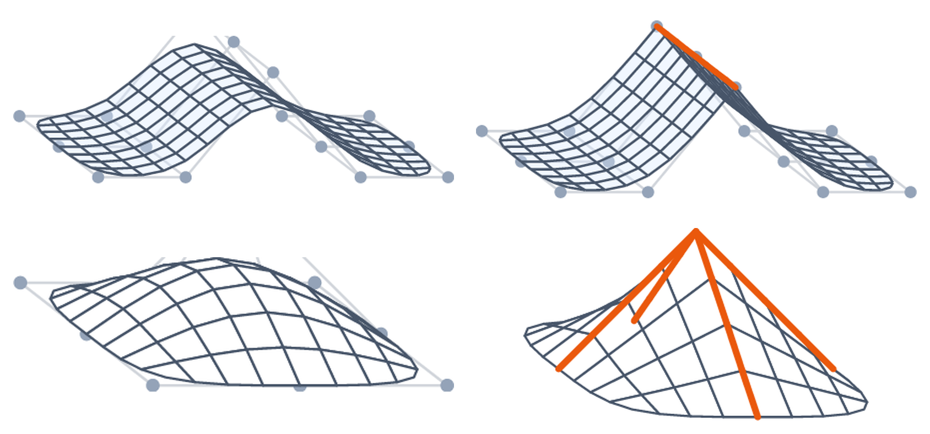
Semisharp creases
Vanilla Catmull-Clark struggles with sharp bevels
Semisharp weights: sharp rule for N levels, then blend to smooth
Widely adopted - [DeRose et al. 1998]
Notes:
The advantage of Catmull-Clark subdivision is that you can take a low poly mesh and make it smooth. However, there are times where you want to preserve sharp edges, or at least a bevel. This can be done by hand, by manually placing extra edge loops to adjust the curvature, but it’s just as much of a pain as it sounds like. Instead, the DeRose semi-sharp creases and vertices extension has been widely adopted. This allows you to set a semi-sharp value for your edges and vertices, giving artists easy control of creases and bevels.

Slide 56

Regular quads = bicubic B-splines
A regular 4×4 control mesh
  Evaluate the surface analytically at any (u,v)
  Both position and normal
The 2D bicubic basis is separable
  The 1D cubic basis applied twice
Evaluate the 4 columns in v, then a single curve in u through the results
No recursion needed!
Only works at regular polys
Notes:
By design, Catmull-Clark has a very helpful property. If a quad is in the middle of a 3x3 block of quads, then the limit surface is a bicubic B-spline. Instead of iterating through subdivision levels one at a time, we can simply plug in the uv value and calculate the limit point analytically. The bicubic B-spline evaluation is separable, meaning we can calculate a 1d cubic B-spline for each of the columns, and then use those 4 points across the row. This gives us the limit position after an infinite number of subdivision levels. We can use this analytic formula for both the position and normal. However, this rule only works if none of your edges or vertices are semisharp.

Slide 57

Semisharp creases stay analytic
Take that same 1D cubic basis
  A crease just changes the basis [Nießner et al. 2012b]
One 4×4 matrix on the control points, derived from semisharp weight
Multiple sharp edges, or a sharp corner?
  Treat that neighbourhood as irregular
Notes:
However, a very interesting trick was found in 2012. In the 2d case, you can analytically evaluate semisharp creases. If you have a single cubic spline, you can convert between a smooth and sharp edge by simply changing the basis that you use for the 4 points of your cubic spline. Given an edge sharpness value, you can calculate a 4x4 change of basis matrix (or store them in a table). Then if you apply that change of basis to your cubic control points, you can exactly match the behavior of recursive semisharp catmull-clark.

Slide 58
Creases live on the x = 0 line
Same separable evaluation: 4 splines in v, then a single spline in u
The x=0 line is the one place we allow a semisharp crease
A crease there is just a change of basis on the 1D cubic [Nießner et al. 2012b]
Everywhere else stays a plain bicubic
Notes:
That trick allows us to extend the usefulness of regular polygons. If one of the edges is semisharp, then we can treat it as a bicubic b-spline with the additional change of basis step. First, let's assume that the semisharp crease is only along the u=0 line. We can calculate the 4 vertical cubic b-splines the standard way. But when applying the horizontal b-spline, we can apply a change of basis to the coefficients. This allows us to analytically calculate the position and normal as a closed form function.

Slide 59
Regular with 1 optional semisharp crease
This is the primary building block of this algorithm.
Problem:
  Decompose the full subdivision surfaces into regular grids (with up to 1 semisharp crease)
  Special handling for rare cases where we are off a regular grid.
Notes:
This combined regular grid with at most one semisharp crease is the backbone of the algorithm. The plan is that we are going to take an arbitrary mesh and decompose it into regular pieces that we can evaluate with this closed form. Then for the rare cases where we can’t evaluate in this kind of grid, we simply make sure that it’s flat “enough” that we can get away with linear interpolation.

Slide 60


Feature-adaptive subdivision
Only quads touching an irregular vertex stay irregular - [Nießner et al. 2012a]
  2012 was a pretty good year for Catmull-Clark subdivision
New quads are regular by construction
Irregular count grows linearly per level (much better than 4× expansion)
Notes:
So how do we do that? The algorithm is from another paper called Feature Adaptive Subdivision, also in 2012. Take a look at the upper-left mesh. That little red vertex touches 5 quads, and it is called an extraordinary vertex. We can’t use the bicubic trick because it is not regular. However, what happens if we subdivide it once? The polygons next to the extraordinary vertex stay irregular, but all of the new ones are actually regular by construction. As we subdivide over and over, the number of irregular polys stays the same, but the area becomes exponentially smaller.
However, we don’t need to subdivide all the points. Instead, we only need to subdivide the points right around the extraordinary vertex. This means that instead of subdividing exponentially more points per level, we actually subdivide the exact same number of points each level.

Slide 61

Feature-adaptive subdivision with DX11 Tessellation
Store the patches as a quadtree [Brainerd et al. 2016]
  Deformation via stencil tables [OpenSubdiv]
Decompose problem into two steps:
  1. Tessellate (DX11 Hardware)
  2. Evaluate tessellated points (Domain Shader)
Use compute to generate patch data after deformation.
Evaluate position/normal in the Domain Shader
Large tables
Notes:
Feature adaptive subdivision with tessellation was first introduced in the Activision NVIDIA paper, where they used a hybrid with compute shaders and hardware tessellation. For each patch, they stored a quadtree storing the recursive regular tables. Then you could simply pick a uv point on a patch, traverse down the quadtree until you find a leaf, and then evaluate using a bicubic b-spline.
With this approach, you can think of catmull clark as two sub-problems. First you need an algorithm to tessellate a surface, which in this case is hardware tessellation. And second, you need a formula to convert those barycentric values into an actual position and normal. And then you’re essentially done.
The only catch is that you need some pretty hefty tables. The actual points in these subdivision tables are linear combinations of nearby points. So you have to store these tables on disk, and then you have to update them every frame after deformation.

Slide 62

Catmull-Clark: the original cage
Start with the control cage
  An irregular vertex with five quads around it
Everything that follows is one subdivision step, in four stages
Notes:
(31) But there is another way to address this problem. Let’s start with a standard 5 poly control cage. Then let’s go through the process of subdivision.

Slide 63

Catmull-Clark: face points
One new face point per face
  The average of its corners
Notes:
The first step is to calculate the face points. This is done trivially by averaging the four neighbors.

Slide 64

Catmull-Clark: edge points
One new edge point per edge
  Averaging the edge with its two new face points
Notes:
Then we can calculate the new edge points, which are calculated from the face points and previous vertex points.

Slide 65

Catmull-Clark: vertex points
Finally, move the original vertices
  Using the surrounding face + edge points
Self-contained recursive formula
Notes:
Last, we need to move the original vertices, which is a function of the old vertices and the new face and edge points.

Slide 66

Recursive Regular Patches
Each original poly is split into 4
  3 polys are now regular
  1 poly is still irregular
Notes:
At the end of this step, each original poly is now split into 4 regions. Three of those regions are regular polygons which can be evaluated as a standard bicubic B-spline, whereas the interior region is still irregular, just as before.

Slide 67

...and the inner core recurses
The inner points are the exact same topology as the initial topology.
The irregular part shrinks each level
  Irregular exponentially smaller
  Continue until irregular region is "small enough"
  Use linear interpolation in that region
Self-contained
  Does not require any other vertices
Notes:
Thankfully, we now have the exact same topology that we started with. We can simply iterate this way until we have completed as many subdivision levels as we need. Importantly, this subdivision operation is entirely self-contained. Once we have the initial ring we can just subdivide as many times as we want until we are done.

Slide 68

Our idea: recompute patches in compute shader
One thread per poly.
  5 polys -> 5 threads
  6 initial points per thread
Group multiple irregular verts in the same group (up to 64 thread workgroup)
Ping pong back and forth in LDS
Notes:
In a compute shader, I set this up with one thread per poly. So this extraordinary vertex would have 5 threads. Each of the 5 threads stores 6 vertices in groupshared memory, shown in green. Then we can pack multiple extraordinary vertex wedges into the same work group. Then to calculate the subdivision levels, we can ping pong back in forth in LDS.

Slide 69

Recompute patches in compute shader
For each subdivision level
  Calculate face points. GroupSync.
  Calculate edge points. GroupSync.
  Calculate vertex points. GroupSync.
  Calculate center point. GroupSync.
  Write Point Data.
Each iteration:
  Starts with 6 points per thread
  Writes 12 points per thread
Notes:
Since each thread requires information from other threads, we need multiple sync points, but it ends up being quite fast since the number of irregular vertices tends to be quite limited. Each thread can calculate the face points on its own. But in order to calculate the edge points, it will need the result of nearby threads. So group sync, then calculate edge points, group sync, calculate vertex points, group sync, and then we need one extra step to calculate the center vertex. Next we can output the points and then begin the next iteration without reading in any new information from memory.

Slide 70

The white patch and limit points
The irregular point CS generates a set of "slices"
To evaluate a final point:
  Determine regular grid and evaluate
If we are in the small irregular region:
  Evaluate nearest point on regular patch and interpolate.
Only the original line can be semisharp
  Rotate
Notes:
Once these irregular points are all calculated, it’s relatively easy to convert a UV position into an actual limit position and normal. We can apply a negative log2 to figure out which level it is in, and with a little math we can determine the bicubic patch it belongs to. The only edges that can be semisharp are the original ones from the mesh. All the new edges are non-semisharp by construction. So we have to rotate to account for the semisharp edge.
As a final detail, we have to handle points that are very close to the center, which are not on a regular patch. There are several ways to do this, such as using Gregory patches like OpenSubdiv. But the simplest solution is to just evaluate on a nearby point that is actually on a patch, and linearly interpolate. The convergence is fast enough that it looks nearly identical with a few levels.

Slide 71

Irregular Points
For any quads touching an irregular point: subdivide once
Results in an irregular fan, with regular polys elsewhere.
Notes:
There are a few details in setting this up, of course. Looking at the middle poly, three of the four quads are still regular, but the fourth is not. As a rule, we can simply say that any poly that touches a single extraordinary vertex needs to be subdivided at least once.

Slide 72

Triangles
Triangles and all neighbors are subdivided twice
  The middle point of the triangle is irregular.
  The triangle corner points may or may not be irregular, but need to reference the twice-subdivided adjacent polys
Notes:
Similarly, any triangles need to be subdivided twice. It needs to be subdivided once, but the new middle point is still extraordinary. So we need to subdivide it twice so that all three corners and the interior corner form separate, irregular wedges.

Slide 73

Regions and primitives (no quadtree)
Regular Quads: 1 region
Quads with at least one irregular point (but no triangles): Subdiv 1 (4 regions)
Quads touching at least one triangle: Subdiv 2 (16 regions)
Triangles: Always subdivide topology twice (12 regions)
Notes:
In all, we have 4 separate ways of splitting a poly into regions. A quad can be kept as it is, subdivided once, or subdivided twice. A triangle must always be subdivided twice. Then each of these regions redirects into either a set of regular points, or it redirects into an irregular wedge.

Slide 74
Evaluating a vertex - CS
Input: Triangle ID and barycentric
Output: Limit position and normal
Triangles remap into sub-quads first, so everything downstream is a quad
Regular region: 16 control points, bicubic; normal is analytic
Irregular region:
  Find the ring for this point around the extraordinary vertex
  Fetch 16 points for that ring, apply the crease, evaluate
  Blend to the center limit if in the unknown region
Blend against a flat baseline by tess factor: low tess stays flat, so nothing pops
Displace in the same shader. Write to position and normal.
Notes:
In summary, the evaluation of a vertex requires a number of simple steps, but they all add up. In the compute shader, we start with just a barycentric and a triangle. From that we figure out which patch we are on, and if it is a regular quad, subdiv 1, subdiv 2, or a triangle. From there we have to split it into the correct region. If it’s regular, we just evaluate it. If it is irregular, we have to figure which irregular wedge it is in, find the actual bicubic b-spline, and then evaluate. I also find it necessary to fade in from zero displacement at low tess factors. This gives a more perceptually stable phase where the vertices seem to “push out” instead of “slide in”.

Slide 75


Results: adaptive vs fixed
Monkey: 507 source verts / 968 source tris
Solid shading is visually indistinguishable with fewer triangles.
Fixed Tris: 61,952
Adaptive Tris: 30,526
Notes:
Here is a simple example of the blender monkey. The top row uses adaptive subdivision, and the bottom row uses fixed. When you look at the solid render, they look the same. By adaptively choosing the triangle tessellation based on curvature, we can get an image that looks the same with fewer triangles.

Slide 76


Results: adaptive vs fixed
Push the camera in: most of the mesh is now off-screen or behind the camera
Adaptive pulls density off what you can't see and spends it on the silhouette
More silhouette density than fixed
  Using less than half the triangles
Artists good at authoring for typical size on screen
  But there are always exceptions
Notes:
As we get close to specific areas, the benefits of subdivision increase significantly. Here we are zooming in on the monkey’s head. The adaptive version has a clean, smooth edge, whereas the fixed image has obvious faceting. The adaptive image looks superior, even though it has half the number of rendered triangles.
This situation happens a lot in games. Game artists are really good at generating assets with the right poly count based on where you typically see them. Which works great, until your cinematics director wants a dramatic shot of the vase that is only supposed to be seen 5 meters away. There are always exceptions, and shipping models with enough fidelity everywhere is a game of whack-a-mole.

Slide 77

Performance
Compute cost only (RTX 3070)
Subdivision: builds the control points.
Tessellation: builds topology, vertices (position, normal, barycentric) and welds.
imrod is 5x the subdiv cost due to reliance on triangles.
Notes:
Finally, let’s take a look at performance. These are stress test numbers from my RTX 3070. I actually purchased this PC in 2020, so I’m due for a new one, but…RAM prices these days. These numbers only cover actually calculating the subdivision surface, not actually rendering. The mesh calculation pass outputs the topology and positions, normals, and barycentrics.

Slide 78


Comparison: OpenSubdiv (hardware tessellation)
Same models, same GPU (RTX 3070)
OpenSubdiv:
  Short compute pass to evaluate control points.
  Fused DX11 Tessellation pass which evaluates and renders the mesh. [OpenSubdiv]
  Multiple passes (GBuffer, shadow, etc.) would each require a full Catmull-Clark evaluation.
Adaptive Compute:
  Builds the geometry once (subdiv+tess)
  Each pass rasterizes the stored buffer, interpolating in VS
Notes:
The most direct comparison is with Feature Adaptive Subdivision, (the Activision and NVIDIA approach) implemented in OpenSubdiv. Their approach has a very light compute pass which calculates the patch control points after deformation. Then they have one fused hardware tessellation pass which tessellates on the fly and evaluates the position and normal in the domain shader. It's very elegant in that data is consumed as it is produced in one pass.
Here we have the raw numbers for the same model with the same tessellation factors. Using the compute approach, big guy takes about 2.16ms to calculate the topology and vertex data. Then each full lit raster pass takes about 2.16ms, and each shadow pass takes about 1.36ms. The lit pass is slower both because it has a longer pixel shader but also because the vertex shader needs to fetch and pass along more attributes like the normal and uv. In contrast, the one pass hardware tessellation approach requires about 5.97ms to simply render the model once. Then each additional pass would require about the same cost. This is the catch with consuming data as you produce it.

Slide 79

Cost per pass — ms per 1M triangles
Adaptive Compute tessellates once
  OpenSubdiv tessellates every pass
Single Lit Pass (per 1M tris)
  0.36ms vs 0.50ms
Lit and 4 Shadows: (per 1M tris)
  0.81ms vs 2.51ms (~3x)
Notes:
I like to think in terms of millions of triangles per millisecond. For the big guy, it's 0.18ms for the compute pass and 0.18ms for the lit pass, being 0.36 ms total to compute and render a million output triangles. In contrast, OpenSubdiv requires about 0.50ms to render a million polys once. So the algorithm presented here is about 72% of the reference implementation time.
However, the difference widens when we use multiple passes. If you are rendering a mesh in the lit or gbuffer pass, you are probably also rendering it in a pre-pass, shadow pass, and motion vector pass. If we render the surface with four shadows and lit, this algorithm takes 0.81ms. The OpenSubdiv viewer doesn't have a shadow pass system, but assuming a similar cost, it would be about 2.51ms. The compute approach is just over 3x faster, requiring 32% of the OpenSubdiv time.

Slide 80
Compute cost across multiple passes
Timing on a RTX 3070
Building the indices/positions/normals/barycentrics
  Not including render time.
Calculating control points is light: 0.03–0.14 ms.
  Can perform once if mesh isn't deforming
imrod's is higher because it has more triangles, which require more control points.
Notes:
Finally, here are a few more numbers to stress test the meshes. The subdivision cost included the passes for calculating the control points after deformation, which of course we could skip each frame if the mesh is static. For most the cost is quite low, about 30 microseconds because it doesn't actually fill the GPU with work. The one exception is imrod, who takes 139 microseconds. That mesh is roughly half quads and half tris. If you were going to author game assets with the intention of using catmull clark, my recommendation is that you author everything as quads and never, ever use loose triangles.

Slide 81
Comparison: Edge-Friend
Uniform Catmull-Clark evaluator. [Kuth et al. 2023]
Topology is implicit.
Uses mesh and amplification shaders.
Normals are computed in mesh shaders.
Used an implementation by Wei Liao
  github.com/Flurry-L/Edge-Friend-Loader
Measured the raw position calculation time but not rendering time (not implemented).
Notes:
In other catmull clark research, the most recent paper is Edge Friend. It is a fixed, non-adaptive subdivision algorithm. The source code is not publicly available, but I was able to find a working implementation from Wei Liao on github. It's not a full renderer: The depot only supports evaluating the Catmull-Clark mesh positions and then downloading them to verify correctness. So while I can't perform a full rendering comparison with mesh shaders, I can at least compare the mesh subdivision time.

Slide 82
Comparison: DV21
The halfedge refinement rule, also uniform (not adaptive) [Dupuy & Vanhoey 2021]
Also noteworthy is [Dupuy & Deliot 2022], which performs Catmull-Clark using DV21.
  It applies a custom topology to dynamically tessellate the DV21 output.
  Since it requires DV21 as a pre-pass, the DV21 numbers suffice as a lower-bound on the cost.
Notes:
Another recent paper is the half-edge refinement rule, using concurrent binary trees, which I'll refer to as DV21. Their follow up paper on bisection based triangulation takes the DV21 result as input and creates an adaptive tessellation for rasterization. The source code is online, and I compared to raw DV21.

Slide 83

Comparison: Uniform
Units: Millions of output triangles per millisecond.
Edge-Friend and DV21 are uniform Catmull-Clark, position only
Ours is performing the full adaptive pipeline
  Calculating positions, normals, and generating topology
  Locking the tess-factors to a fixed value
Edge-Friend: Faster than ours by 1.32x - 1.68x.
DV21: Slower than ours by 1.91x - 2.45x.
Also tested NVIDIA RTX Mega Geometry SDK.
  Not enough RAM (10GB minimum)
Notes:
The comparison to Edge Friend is admittedly a little sketchy, as the implementation online only evaluates the points but does not have a renderer. It's a bit of an apples to oranges comparison, as the Edge-Friend implementation skips the full normal calculation. These were implemented in the paper, but I don't have the source to compare. Based on the numbers, Edge-Friend is about 1.32x to 1.81x faster. DV21 is about 1.91x to 2.45x the cost of the algorithm here for the compute pass.
I also tried the NVIDIA mega scale geometry demo. However, the demo requires 10 gigs of ram, and I only have 8. RAM prices, I tell ya. I was able to get it to run by deleting a few asserts, but the performance was about an order of magnitude slower than I would expect, likely because it couldn't fit everything in vram.

Slide 84
Try it!
Live Subdiv WebGPU demo:
  https://filmicworlds.com/blog/adaptive-catmull-clark-subdivision-with-compute-tessellation/
Full explanation of tessellation pattern:
  https://filmicworlds.com/blog/compute-tessellation-with-clamped-parallelograms/
All code is MIT licensed
Thanks: Natalya Tatarchuk and Gregory Mitrano
Notes:
(42) For more information, you can run the demo online. It works on both desktop and mobile. I tested it on my laptop, which is from 2019, and has a GTX 1050, which is about 1.7tflops, so if you squint at it, that gpu is roughly a PS4 or XB1. I'm due for a new laptop too, but these RAM prices… I wouldn't render an entire world with catmull clark subdivision on a GPU in that range, but some characters or hero assets would be viable.
If you want more detail, check out the web page. There are working demos, with source. The code is vibe coded trash written by Mr. Claude, but the code is accurate enough to be a reference.
Finally, I need to thank Natasha and Gregory Mitrano. I’ve been working on this problem on and off for the last 5 years. It was a long winding road to get here, and their conversations helped shape the eventual solution.

Slide 85
Next Steps
Visibility Buffer
WebGPU limitations
  Each indirect pass requires a compute validation pass with a barrier.
  If you render 10 indirect compute passes, then you get 10 extra validation passes.
    Can we get a hint to batch WebGPU indirect dispatch validation?
  Very strict execution model.
    Batching point with the on the same bicubic b-spline patch
  No shader intrinsics: Self-imposed limitation
Mesh formats
  Usd, FBX are battle tested. Obj has extensions.
  GLTF has no support for either quads or semisharp creases
Notes:
The first implementation proves out what I wanted to prove, a viable approach to tessellation with compute. The next step, which is near and dear to my heart, is using a visibility buffer. It should be straightforward as we have the full vertices and topology in vram, but I haven't actually done it, yet. This would be impossible with hardware tessellation, as you have no way to render the ID from the tesselated primitive nor would you have a way to look up the barycentric position later.
Another direction is WebGPU improvements. WebGPU is very strict with compute shaders, and it will prevent you from doing things on the GPU that it can't validate. Right now, every vertex fetches the full set of bicubic patch points. I looked into batching vertices within the same bicubic patch, but gave up as the validator rejected everything I tried. Also, it adds implicit validation and barriers. For every indirect dispatch, dawn will insert a cs pass before every indirect dispatch to validate the arguments and have a barrier, and there is no way to parallelize it. So it goes validate cs, barrier, dispatch cs, barrier, etc. Whereas on vulkan or directx 12 you can just run all 10 passes and put a UAV barrier at the end. WebGPU solves sync points for you by doing the safest operation possible. If there is one change I would ask for from WebGPU, it would be a hint to tell it that the next N passes are indirect, allow the runtime to validate them together in one pass instead of validating them all inline.

Slide 86
References
[Catmull & Clark] Catmull & Clark, “Recursively Generated B-Spline Surfaces on Arbitrary Topological Meshes.” Computer-Aided Design, 1978.
[Cook et al. 1987] Cook, Carpenter & Catmull. "The Reyes Image Rendering Architecture." SIGGRAPH 1987.
[DeRose et al. 1998] DeRose, Kass & Truong. "Subdivision Surfaces in Character Animation." SIGGRAPH 1998.
[Rossignac 1999] Rossignac. "Edgebreaker: Connectivity Compression for Triangle Meshes." IEEE TVCG 5(1).
[Boubekeur & Alexa 2008] Boubekeur & Alexa. "Phong Tessellation." SIGGRAPH Asia 2008.
[Giesen 2011] Giesen. "A Trip Through the Graphics Pipeline 2011, Part 12."
[Nießner et al. 2012a] Nießner, Loop, Meyer & DeRose. "Feature-Adaptive GPU Rendering of Catmull-Clark Subdivision Surfaces." ACM TOG 31(1).
[Nießner et al. 2012b] Nießner, Loop & Greiner. "Efficient Evaluation of Semi-Smooth Creases in Catmull-Clark Subdivision Surfaces." Eurographics 2012.
[Brainerd 2014] Brainerd. "Tessellation in Call of Duty: Ghosts." SIGGRAPH 2014, Advances in Real-Time Rendering in Games - advances.realtimerendering.com/s2014
[Brainerd et al. 2016] Brainerd, Foley, Kraemer, Moreton & Nießner. "Efficient GPU Rendering of Subdivision Surfaces using Adaptive Quadtrees." ACM TOG 35(4).
[Dupuy 2020] Dupuy. "Concurrent Binary Trees (with application to longest edge bisection)."
[Deliot et al. 2021] Deliot, Dupuy, Rijnen & Yao. "Experimenting with Concurrent Binary Trees for Large-Scale Terrain Rendering." SIGGRAPH 2021, Advances in Real-Time Rendering in Games.

Slide 87
References (cont.)
[Dupuy & Vanhoey 2021] Dupuy & Vanhoey. "A Halfedge Refinement Rule for Parallel Catmull-Clark Subdivision." HPG 2021. ("DV21")
[Karis et al. 2021] Karis, Stubbe & Wihlidal. "A Deep Dive into Nanite Virtualized Geometry." SIGGRAPH 2021, Advances in Real-Time Rendering in Games - advances.realtimerendering.com/s2021
[Dupuy & Deliot 2022] Dupuy & Deliot. "Bisection Based Triangulation of Catmull-Clark Subdivision." SIGGRAPH 2022 Courses, Advances in Real-Time Rendering in Games - advances.realtimerendering.com/s2022
[Kuth et al. 2023] Kuth, Oberberger, Chajdas, Meyer. "Edge-Friend: Fast and Deterministic Catmull–Clark Subdivision Surfaces." CGF 42(8).
[Karis 2026] Karis. "How to Tessellate." (Nanite tessellation)
[Barczak 2026] Barczak. "Introducing AMD DGF SuperCompression." AMD GPUOpen.
[OpenSubdiv] Pixar. OpenSubdiv. opensubdiv.com
[Draco] Google. Draco 3D Data Compression. github.com/google/draco
[Microsoft] "Tessellation Stages." Direct3D 11 documentation.
[Cantlay] Cantlay. "DirectX 11 Terrain Tessellation." NVIDIA.
[Reed] Reed. "Tessellation Modes Quick Reference."

