Slide 1
Upgrading PSSR on PS5 Pro

Slide 2
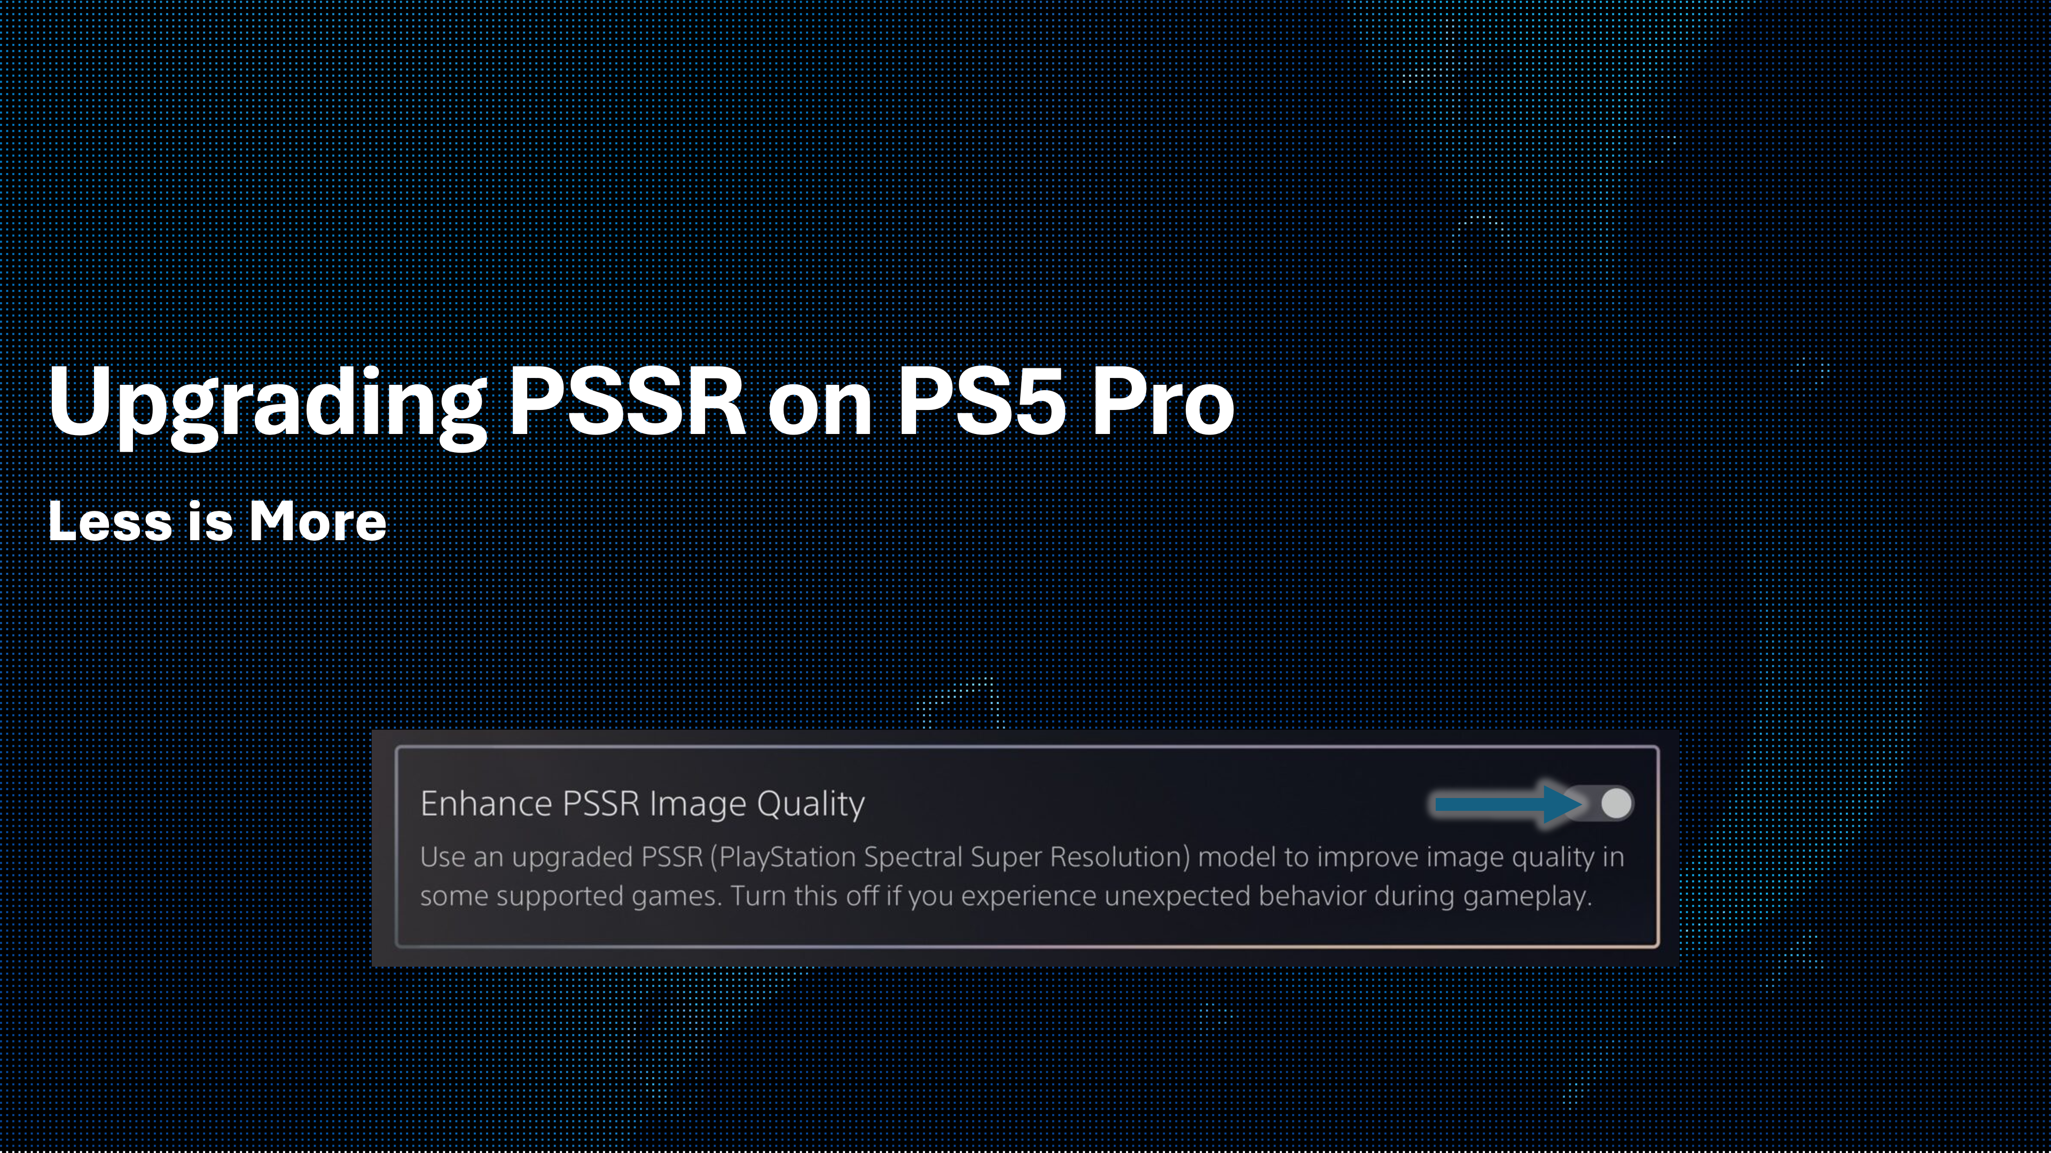
﻿---
title: Upgrading PSSR on PS5 Pro
author: Daniel Craig
date: 2026/07/21
---
Notes:
This talk covers the upgrade to PlayStation Spectral Super Resolution (PSSR), released earlier this year.

Slide 3
The Plan
Background / Introduction
  Why all of this?
Launch PSSR: Our first step
  A bit of post-mortem
Upgraded PSSR: Overview of Key Changes
  What changed and why it worked

Slide 4
PlayStation Spectral Super Resolution
ML-Driven Temporal Upscaling
Largely a direct replacement of TAAU (TAA + Upscaling)
Delivers higher quality output frames
At lower render resolutions
Freeing up GPU time for new effects
Notes:
The goal is not only higher quality than TAAU, but comparable quality at a lower render resolution, letting titles reclaim the GPU time saved.

Slide 5
PSSR Stats
One of 3 core pillars of PS5 Pro
Built on:
  Custom Hardware
  Custom Software
~100 titles have shipped with PSSR support
Notes:
Referenced in Mark Cerny's 2024 PS5 Pro technical deep dive. Built on custom hardware, software, trainer, and dataset. The ~100 titles include both the launch and upgraded versions.

Slide 6
Upgraded PSSR
A research collaboration with AMD (Project Amethyst)
  The implementation is custom for PlayStation hardware
  But based on the shared research and training
Replaces the launch PSSR version
System-level override allows use in shipped titles
  Override applies to all titles
  Without a title update
Notes:
Project Amethyst is a research collaboration with AMD; the upgraded model is a custom PlayStation implementation built on that shared research and training. Using the updated library directly gives the best quality and performance, while the system-level override upgrades already-shipped titles in place without a title update.

Slide 7
Improvements
Improved temporal stability
Improved details / sharpness
Less memory
Less GPU time

Slide 8
Sizzle Reel!
⛓️‍💥
Notes:
No third-party footage is shown; all comparisons use first-party demo content. Independent outlets and the official Sony blog have published additional before/after comparisons.

Slide 9
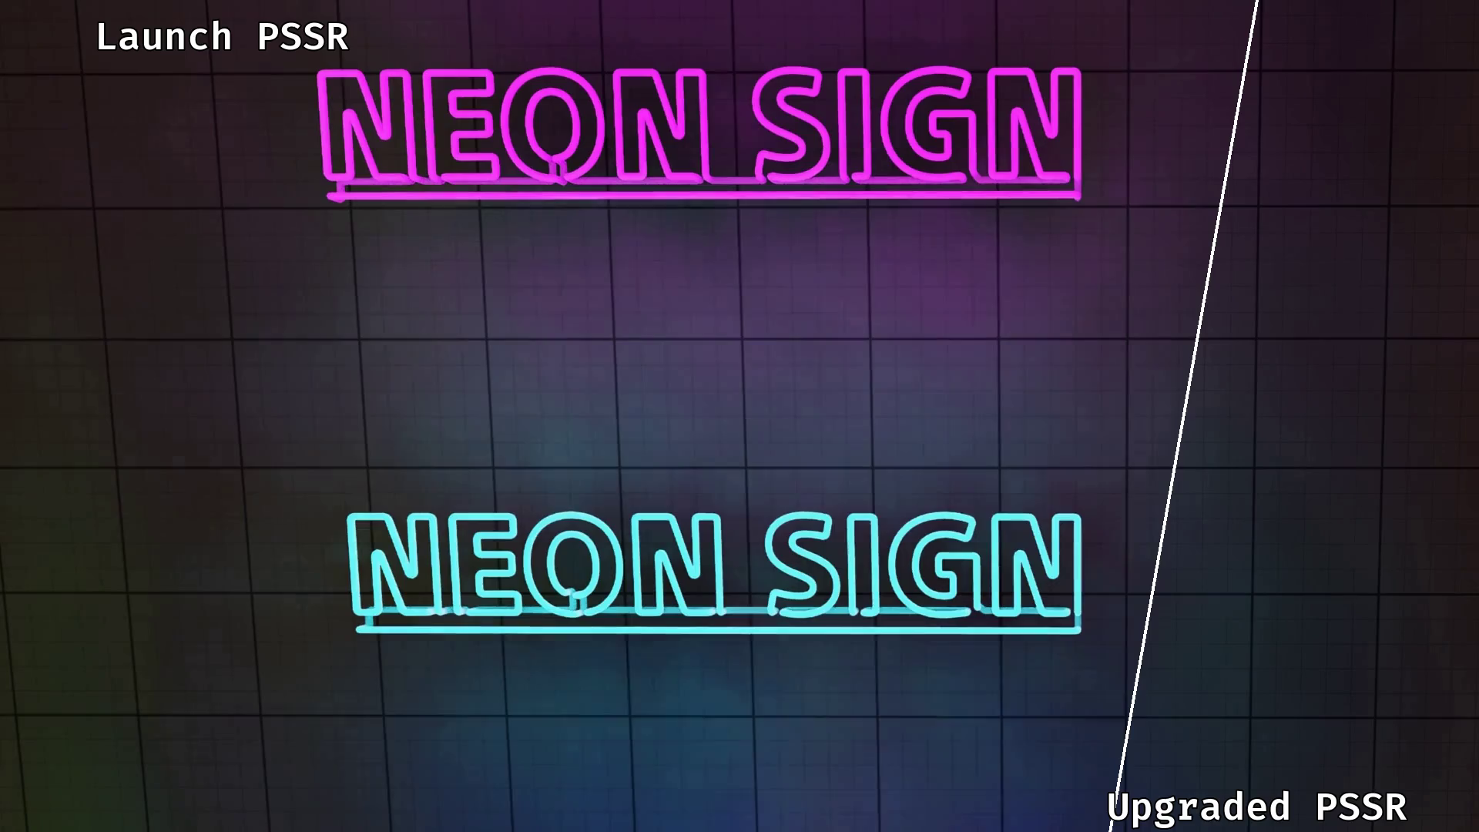
Notes:
Headline improvement is temporal stability, especially for low-frequency lighting updates. Left is Launch PSSR; right is Upgraded.

Slide 10
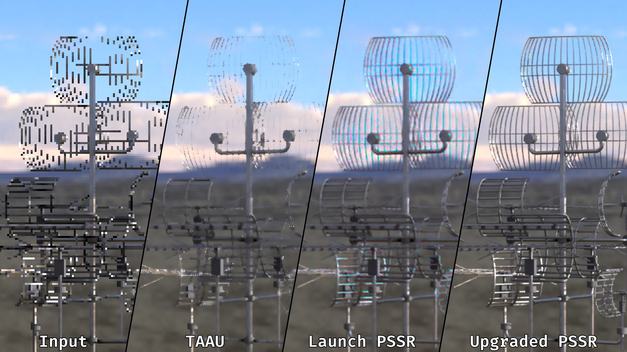
Notes:
A 3x upscale (720p input, 2160p output). The static comparison shows a clear increase in sharpness, among other improvements covered later.

Slide 11
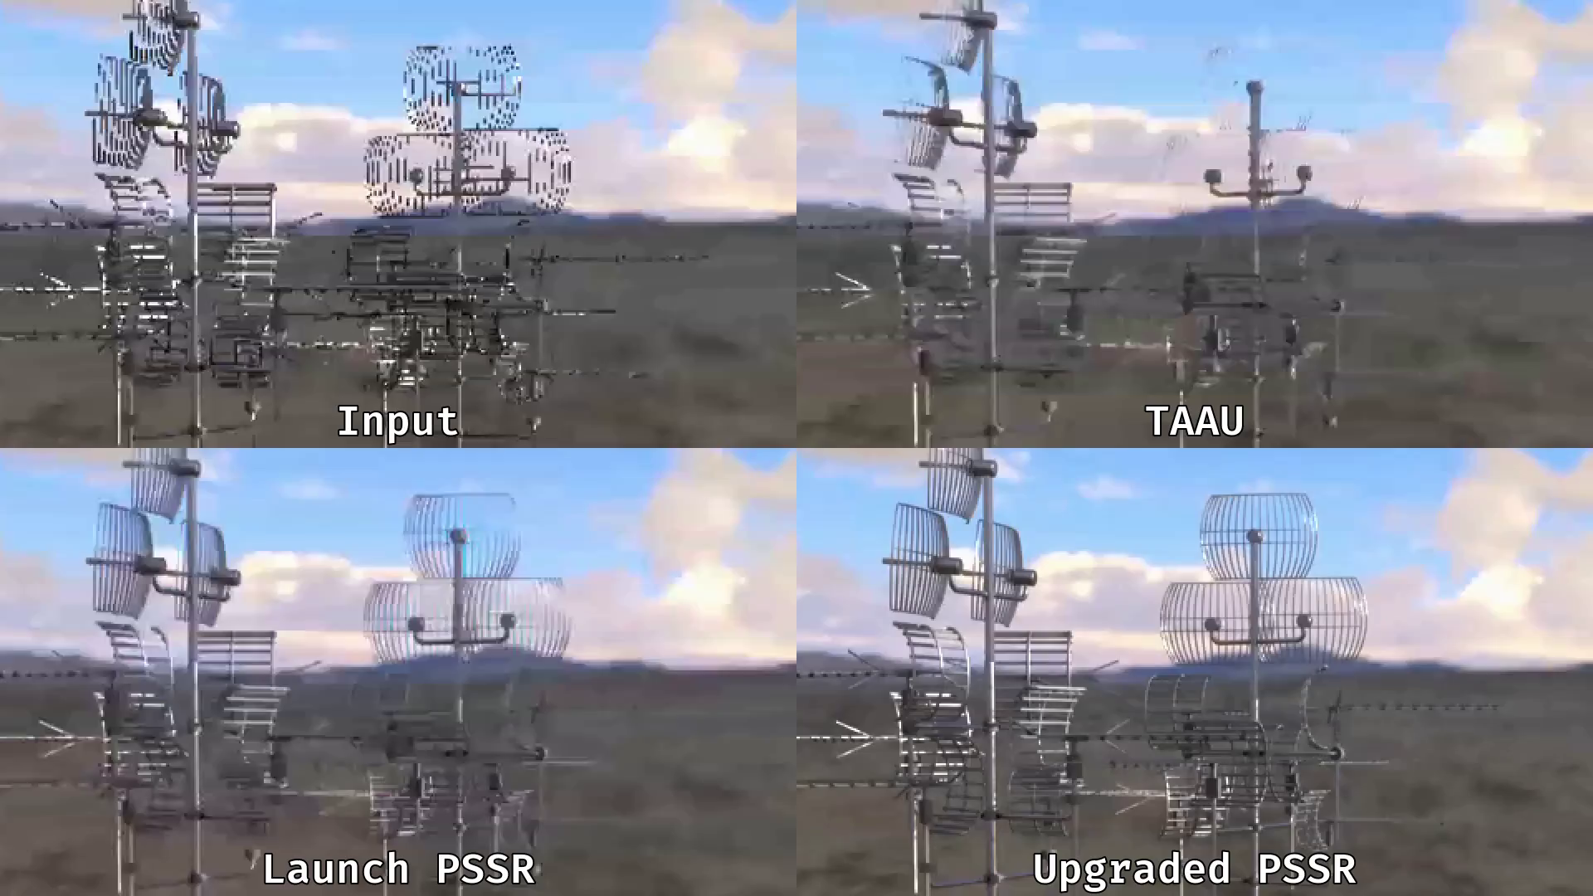
Notes:
Stability is also improved here.

Slide 12
Act I: Background / Introduction
Notes:
Framing for the section: ML is presented as a natural continuation of a long line of reconstruction algorithms, which is the mental model behind the approach taken.

Slide 13
Reconstruction: A Brief History
Classical Filters (Lanczos / Bicubic)
More and more use of spatial information
  FXAA [Lot11] / MLAA [JME11] / SMAA [JES12] / FSR1 [LG21]
And various means of integrating temporal information:
  TAAU [Kar14] / Checkerboard [Wih17] / TSR [Aba21]
Notes:
Upscaling and temporal anti-aliasing are now near-universal in AAA titles, which makes them a high-value target and raises the question of whether ML meaningfully helps here.

Slide 14
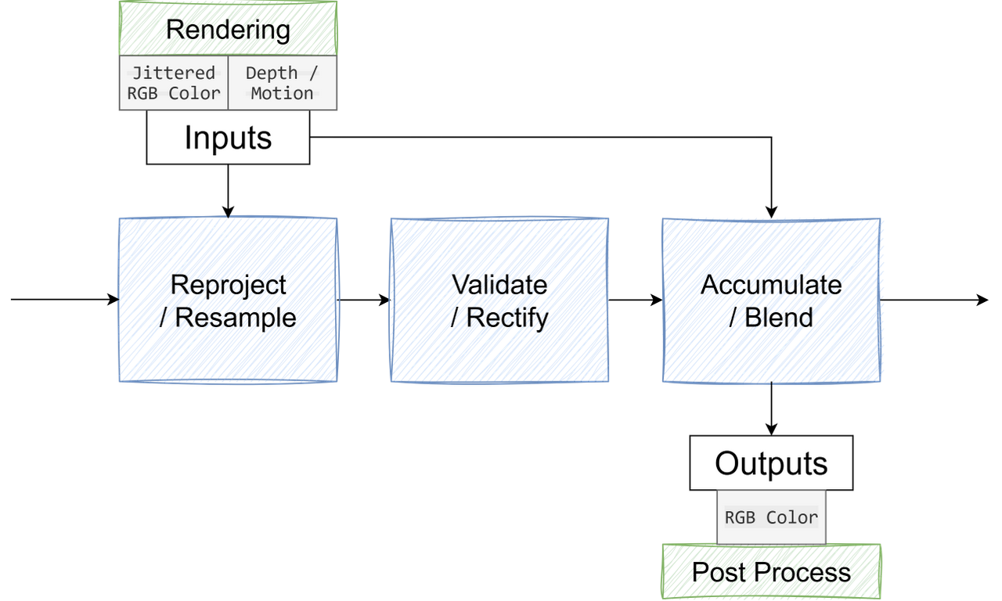
Temporal Reconstruction: The Process
Notes:
Temporal reconstruction reuses reprojected history frames to add usable information, at the risk of introducing artifacts.

Slide 15
Temporal Reconstruction: The Process
TAA is often split into 3 (logical) phases. [YLS*20]
Reproject / Resample
  Use MV/Z to reproject previous frame
  Remove Jitter from input color
Validate / Rectify
  Reject / Fix Invalid History
Accumulate / Blend
  Temporal / Spatial Blending
Notes:
TAA needs only a few inputs (jittered color, depth, and motion vectors), though some implementations use more. The three logical phases are shown on the slide.

Slide 16
Heuristics Abound
Many steps are classical filters
But temporal and spatial blending require decisions
Reject / Rectify History?
Antialias Edges?
Remove Fireflies? Leave Fireflies?
These decisions are often based on:
Hand tuned pattern and edge detection
Clever / opportunistic optimizations
Notes:
Most TAA steps are resampling and filtering; only a few require decisions with conflicting goals. Yang et al.'s survey describes history rejection and rectification as "a challenging and ill-posed task." Hand-tuned heuristics have shipped many games successfully, but both history and input color are becoming less reliable.

Slide 17
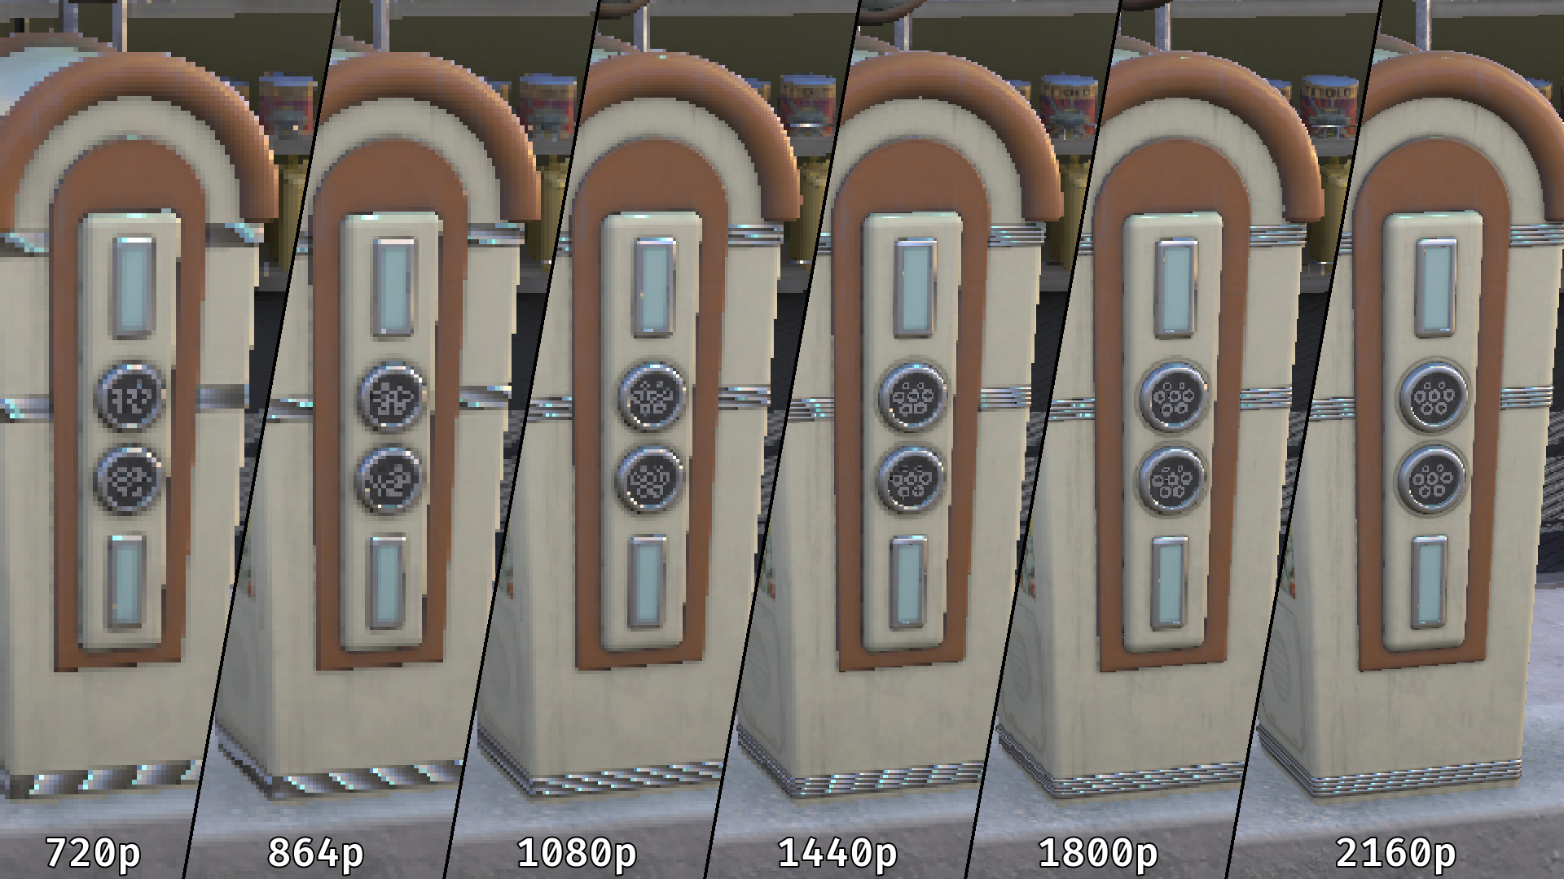
Notes:
Raw input color at decreasing input resolutions. As resolution drops, highly detailed content becomes hard to distinguish from noise in a single frame, and temporal patterns spread farther apart, making TAA's decisions harder. TAAU was not designed for 3x upscale, but that is the direction games are moving.

Slide 18
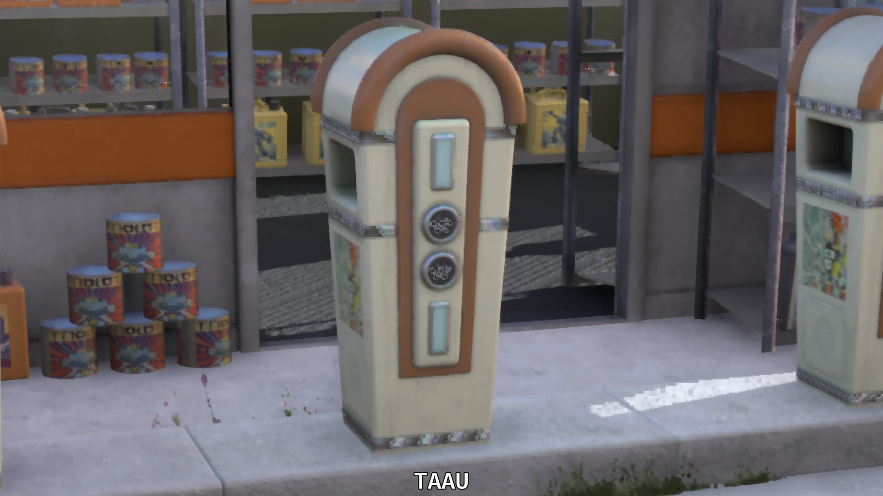
Notes:
Even in a still image, breakup appears in high-detail areas.

Slide 19
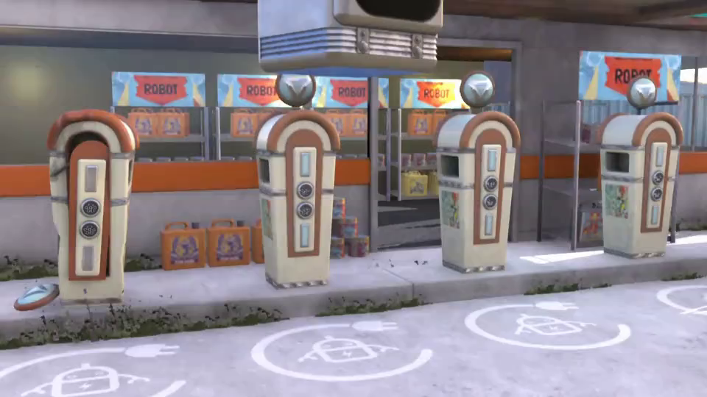
Notes:
In motion, the issues are temporal as well as spatial: history is hard to balance with so little, noisy information.

Slide 20
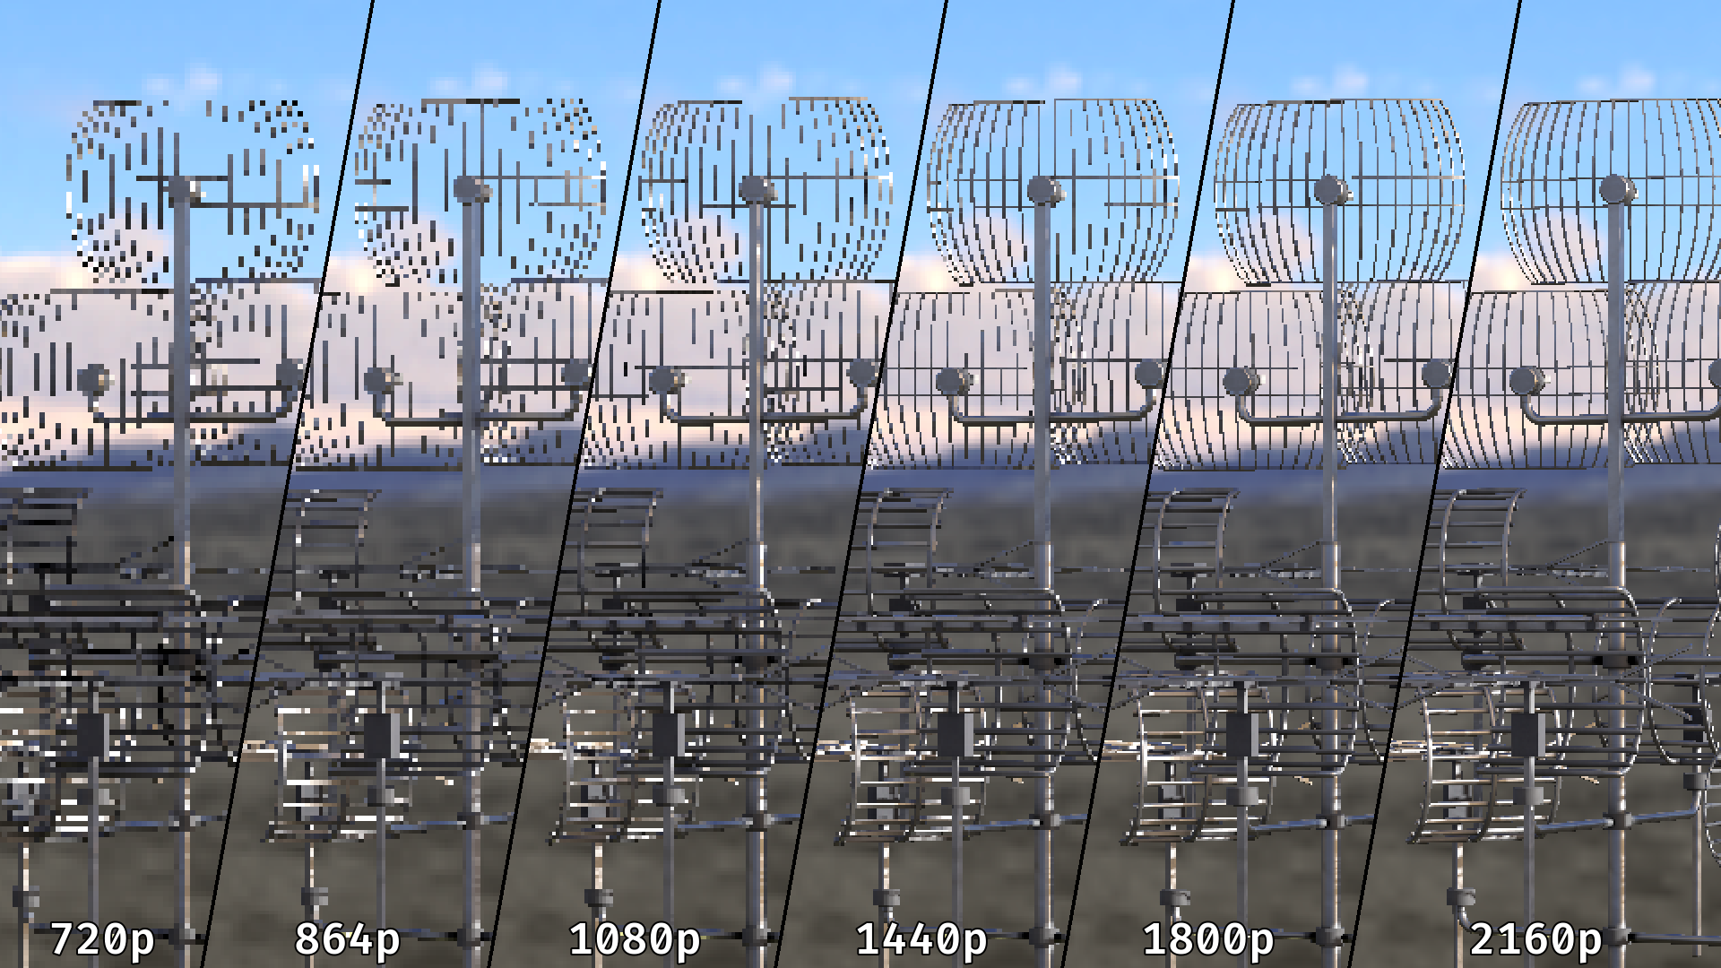
Notes:
Lower input resolution means less information per frame and less robust choices.

Slide 21
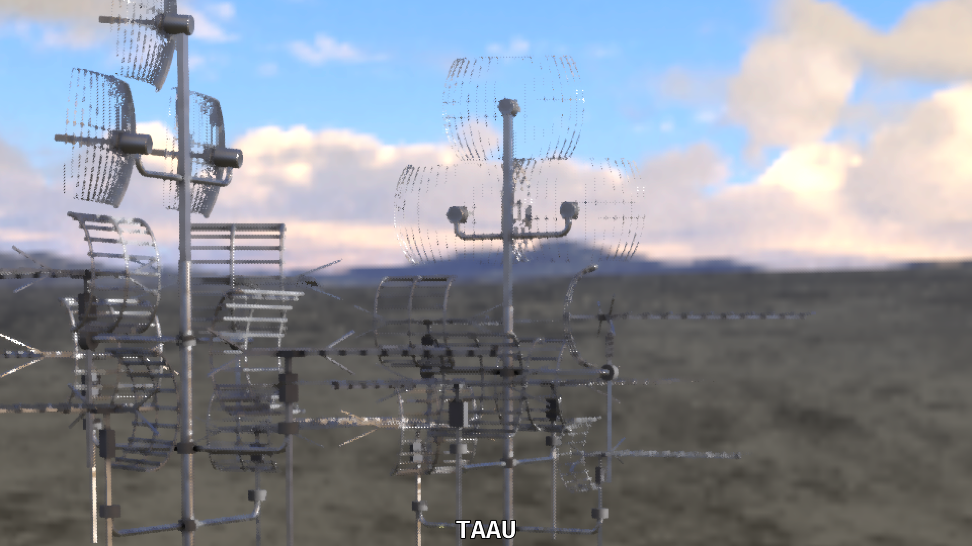
Notes:
Noisy input again causes issues.

Slide 22
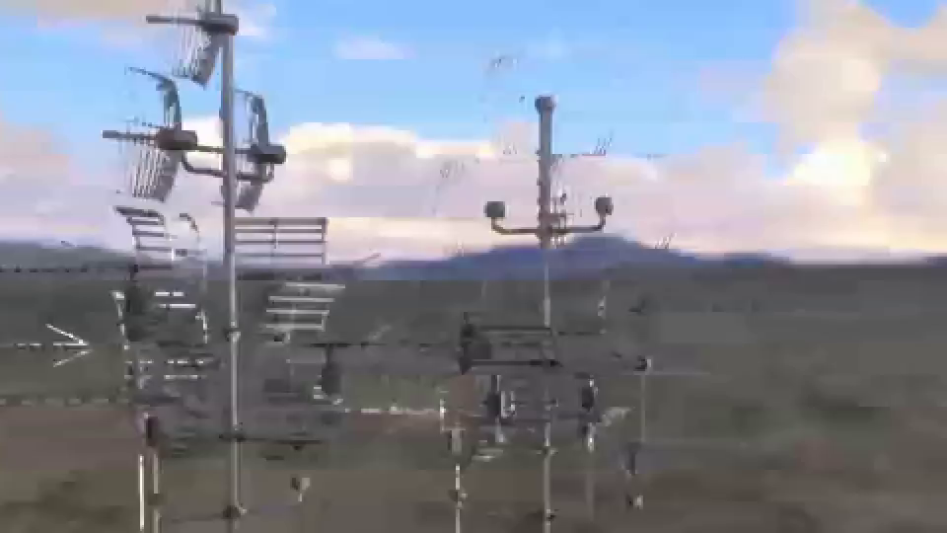
Notes:
In motion the temporal breakup is clear; edge-reconstruction heuristics do not hold up at this upscale.

Slide 23
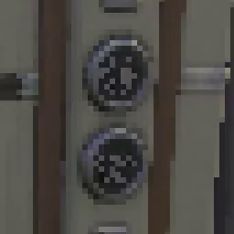
Content Is Becoming Noise
Content is quickly and intentionally approaching noise
Lower resolution renders (with aggressive mip bias)
While also becoming less coherent and less reliable
Particles / volumetrics / translucency
Stochastic Effects
Periodic temporal updates (lighting)
RT Effects
Inconsistent jitter
Notes:
Input is approaching noise for many reasons beyond low resolution. TAA is designed to resolve some of these (jitter, stochastic alpha); others were historically handled after TAA but are increasingly done before it to save GPU time.

Slide 24
Less Reliable Information Is a Temporal Problem
Higher upscale ratios mean:
Small features are only visited every few frames
Required information may be separated across frames
  Not in any single frame, or even sequential ones
Increased reliance on effects before upscale:
Multiple things to reconstruct, at multiple temporal rates
The patterns are still there — just far more complex
Existing patterns don't scale to the inputs we're using
Need to scale in both spatial and temporal dimensions
Notes:
As upscale ratios rise, the temporal incidence rate (how often related information appears) drops. Required detail may be spread across non-sequential frames, and pre-upscale effects push it farther apart. The patterns still exist but are far more complex, and must scale in both space and time.

Slide 25
A Way Forward
Need orders of magnitude more complexity
  Where TAA may be managing ~10 patterns
  I feel like we need 100s or 1000s of patterns
  Along with a complex state machine / decision tree
Cost is also an issue — (It can't be 100x more expensive)
  Need to stay highly HW-efficient

Slide 26
Act II: Launch PSSR
Notes:
Launch PSSR development began over five years ago, when even PC solutions were early. Rather than targeting existing hardware, the hardware architecture and instruction set were designed specifically for this model.

Slide 27
The Promise
"Quality Mode" at "Performance Mode" / 60fps
And it delivered in many titles
Initial reviews were positive
Notes:
The promise: "quality mode" visuals (from PS5 base, 30fps) at "performance mode" speed (60fps) on PS5 Pro, a 2x performance gain with similar or improved visuals. It delivered across many titles, with positive initial reviews, though some rough edges remained.

Slide 28
The Rough Edges
Main Issues
Low frequency temporal effects were a challenge
Details at 2.5x–3x upscale were also a challenge
Other issues were more manageable if not desirable
HDR color issues / Color bias
~4 GPU months training time impacted iteration
Notes:
The main challenges were temporal stability (notably low-frequency effects like RTGI) and sharpness at 2.5x-3x upscale; 2.5x proved more common than expected despite not being an official PC ratio. Secondary items were HDR color representation and a ~4 GPU-month training time that slowed iteration.

Slide 29
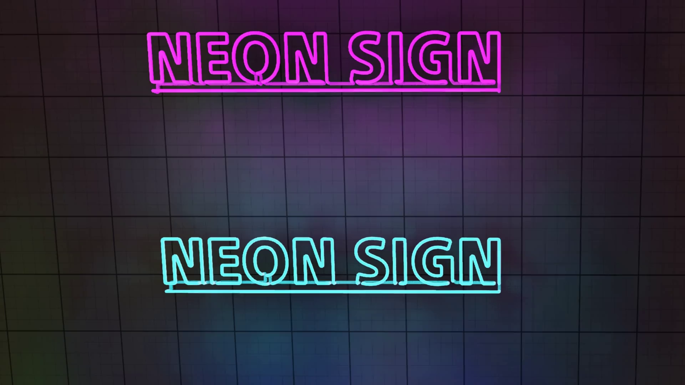
Notes:
Slow, low-frequency temporal changes were difficult for Launch PSSR to address without side effects.

Slide 30
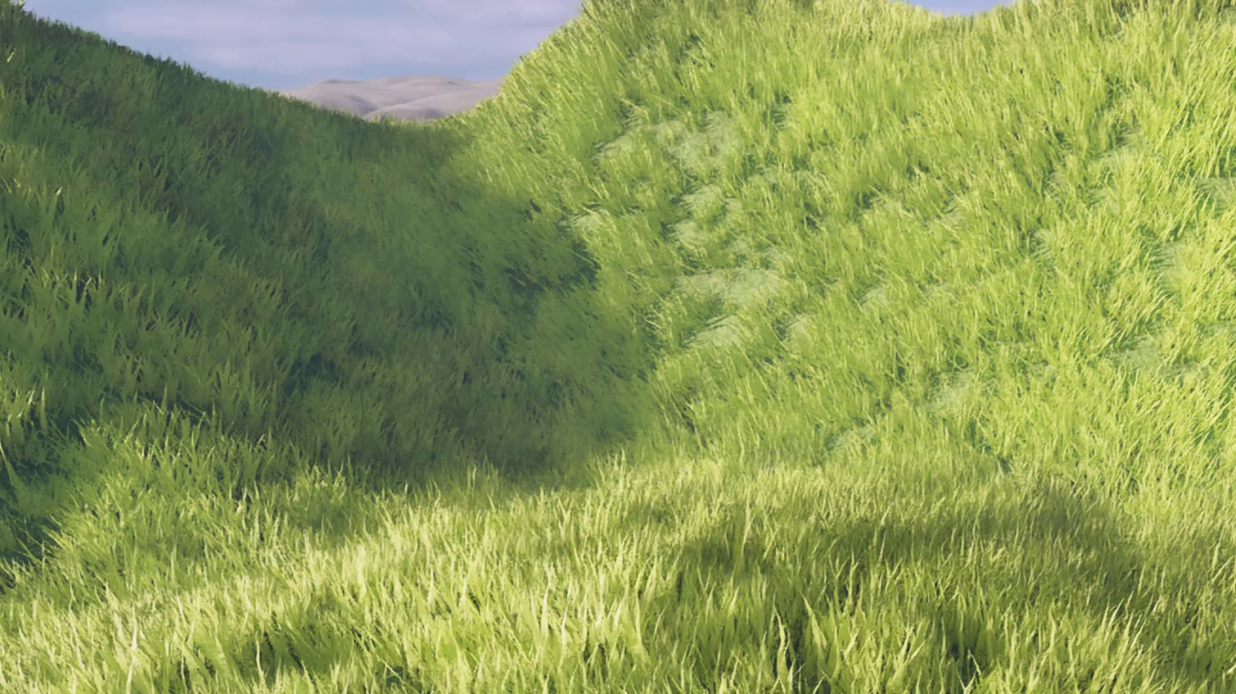
Notes:
A representative foliage example. It also shows the sharpness limitation covered next, which is clearer in the later comparison.

Slide 31
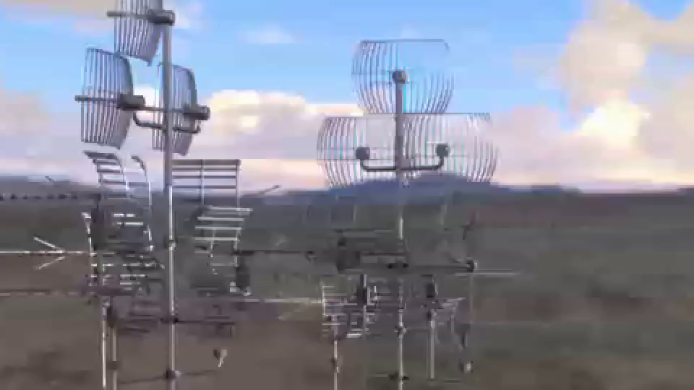
Notes:
A high-upscale detail example: stable and much improved over TAAU, with most detail present. Room remained for more clarity, plus rare, subtle color fringing at edges.

Slide 32
A Great Starting Point
High-level architecture followed the latest research:
  Color Predicting Network (CPN)
  Convolutional Neural Network (CNN)
  UNet-based architecture
Algorithmic reprojection / resampling preceded the model
  But most of the rest was done by the model
Notes:
For its time, this design was close to the research state of the art.

Slide 33
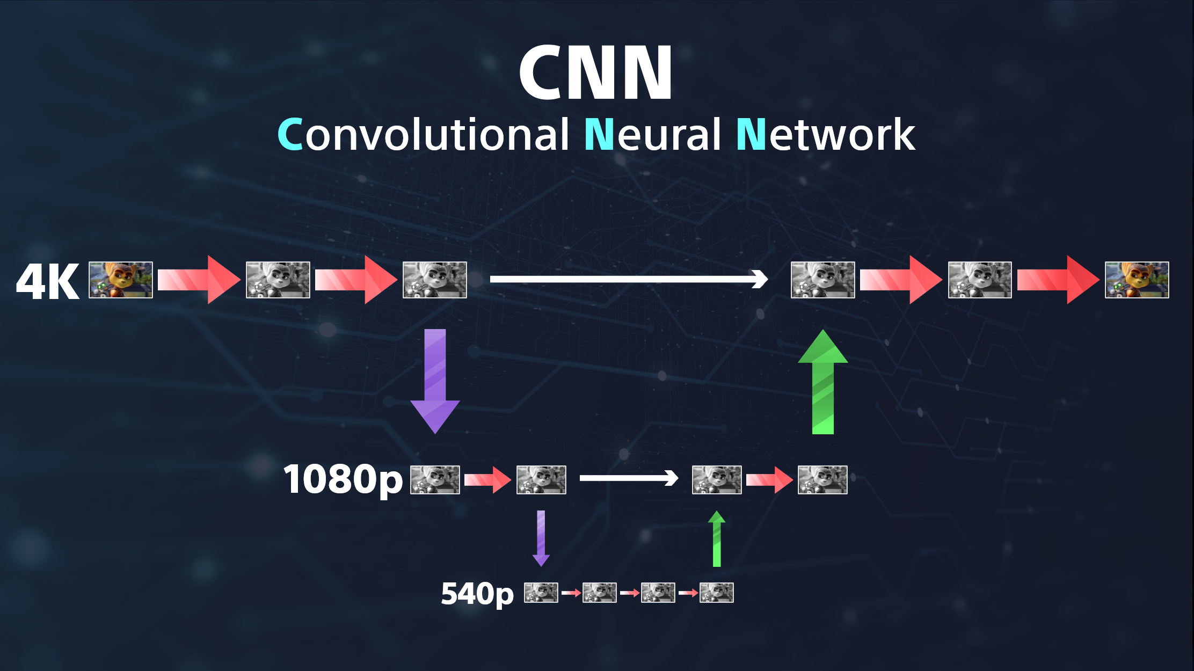
Notes:
Mark Cerny used this image in the original technical brief. The input frame is processed as a series of convolutions at multiple resolutions.

Slide 34
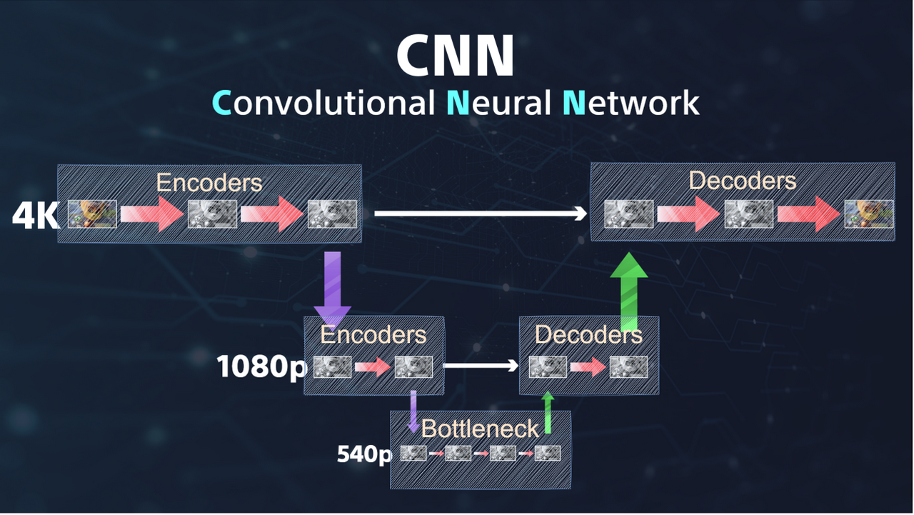
Notes:
Nomenclature: convolutions are matrix multiplies; a contiguous set at one resolution is a layer. Input-side layers are "encoders," the lowest is the "bottleneck," and output-side layers are "decoders."

Slide 35
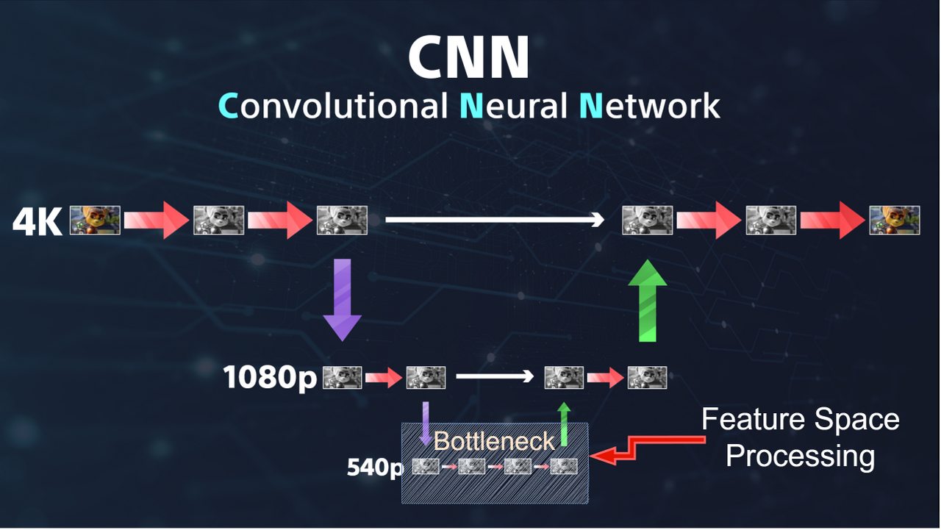
Notes:
In ML terms: encoders create a latent feature space, the bottleneck processes within it, and decoders convert back.

Slide 36
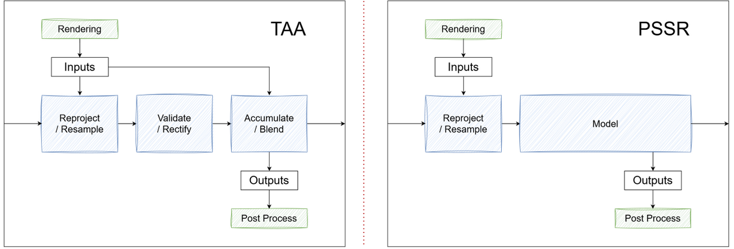
Notes:
"Color Predicting Network" means the model outputs color directly. Relative to the earlier TAA breakdown, the model takes over the validate/rectify and accumulate/blend steps.

Slide 37
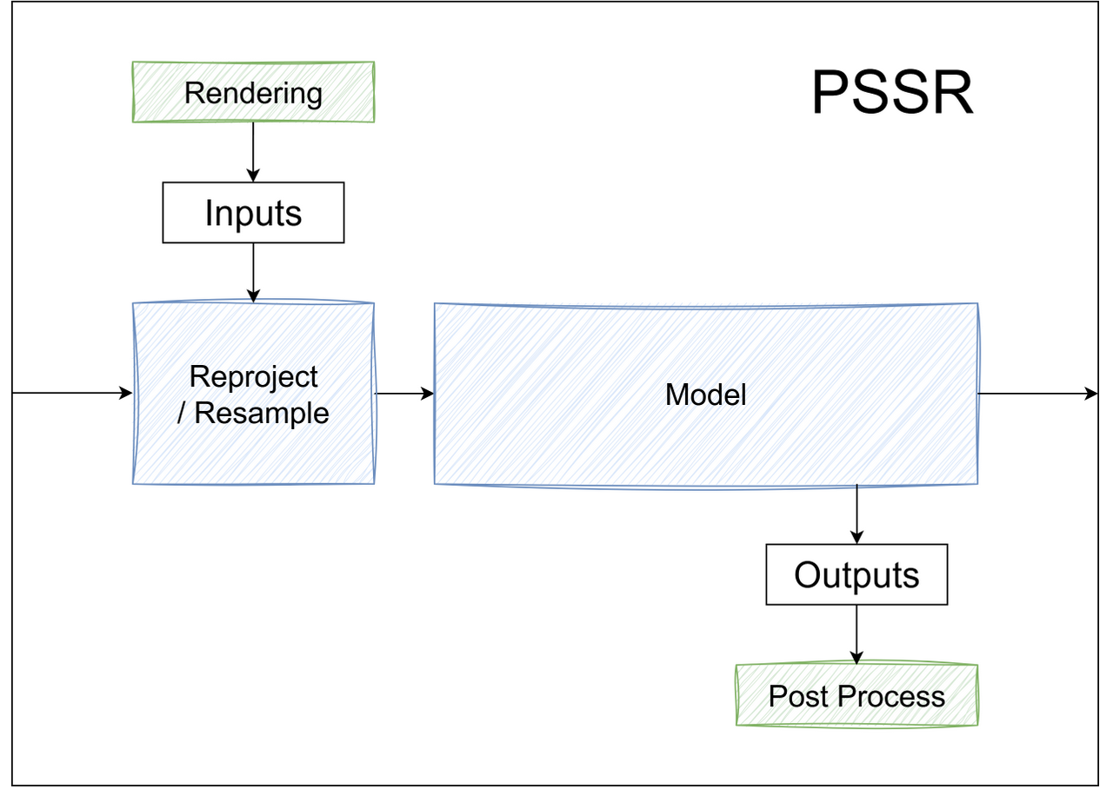
The architecture follows this initial intuition to
Give the model as much responsibility as possible.
Give the widest surface area possible to optimize against

Slide 38
Freedom Became Debt
Quantization
Storage / Recall
Learning Classical Math / Filters
Gradients
Notes:
In hindsight, giving a runtime-sized model such a wide optimization surface became a liability: several of these tasks are a poor fit for the model's instruction set. Each is covered next.

Slide 39
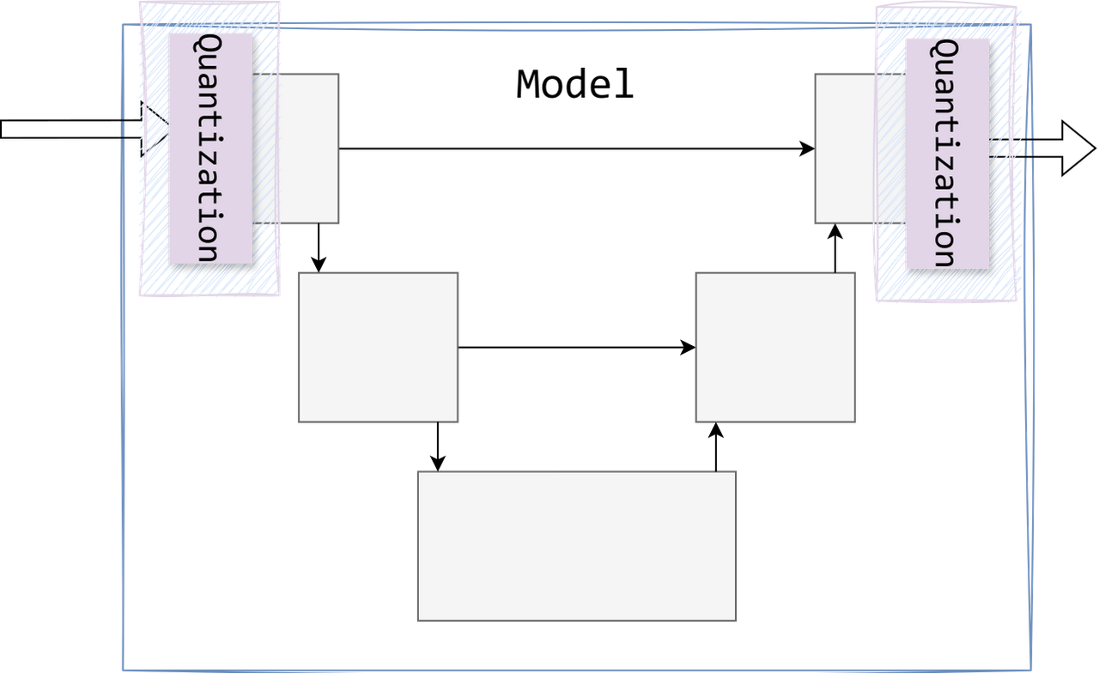
Quantization
Notes:
Quantization and dequantization are a real, expected cost.

Slide 40
Quantization
Input / Output is in 11:11:10 float
But the model is 8-bit
Notes:
Input and output are 11:11:10 float while the model runs 8-bit, so the model must learn a multi-channel encoding for HDR data. This also forced most training to run quantized and produced the rare color fringing shown earlier.

Slide 41
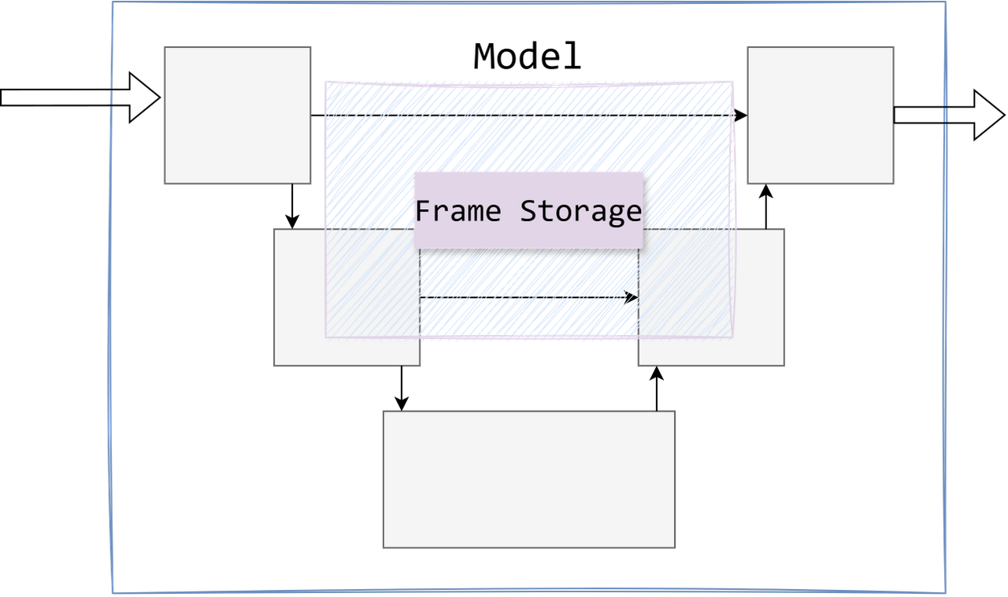
Storage / Recall
Notes:
The next fundamental issue is storage.

Slide 42
Storage / Recall
Where do frame buffers go in between?
While it's doing the real work?
Model must implicitly store and reproduce HDR color
(in 8-bit registers)
Notes:
The model must implicitly store and reproduce HDR frame buffers in 8-bit registers while it works. Whether via registers or an invertible encoding, this is an inefficient use of resources.

Slide 43
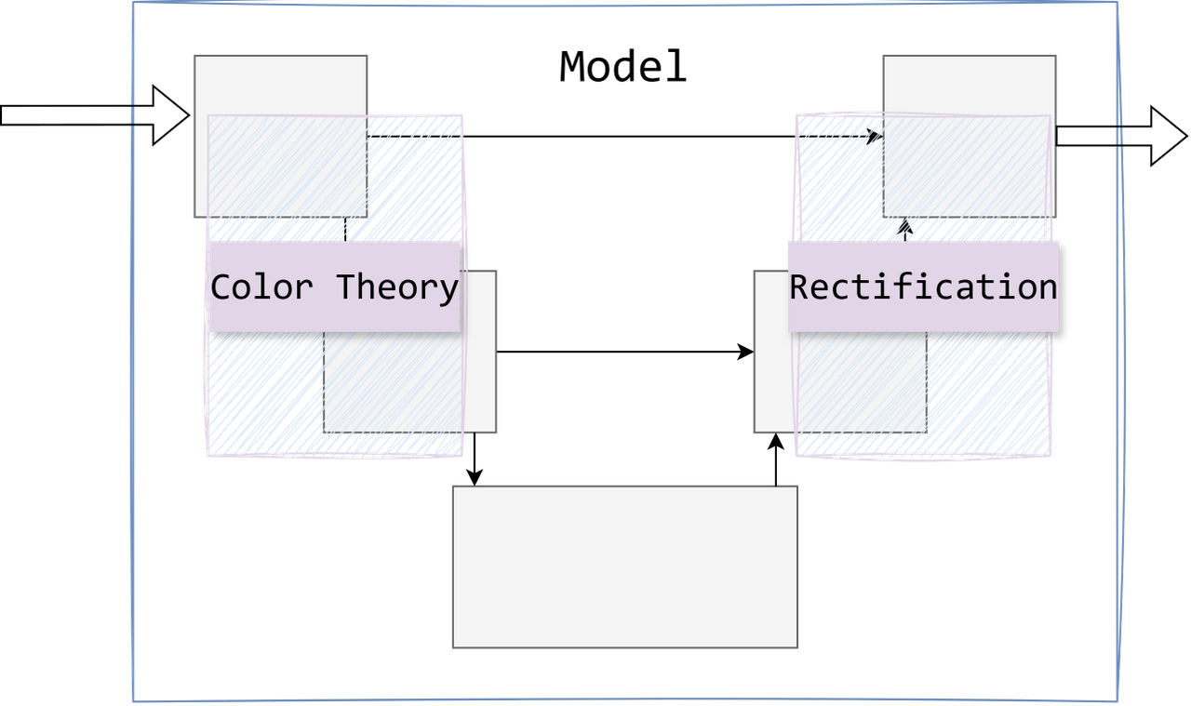
Learning Classical Math / Filters
Notes:
The model also has to perform substantial shader-style math.

Slide 44
Learning Classical Math / Filters
Model needs to learn much of the math involved in TAA
  History rejection
  History rectification
  Temporal blending
  Anti-aliasing
  Firefly rejection
Model must implicitly learn these
  With a very limited instruction set
Notes:
The model must implicitly learn the math of TAA's accumulate/blend step (history rejection, rectification, blending, anti-aliasing, firefly rejection) with a limited instruction set. It can, but whether that is efficient was worth testing.

Slide 45
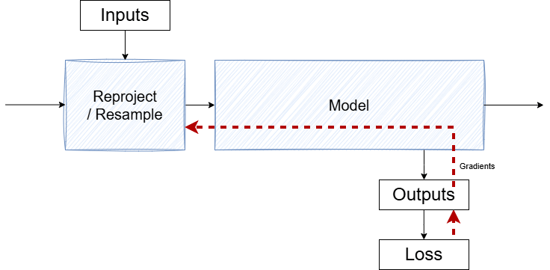
A Mathematical Problem
Notes:
A further challenge was purely mathematical, affecting both the model and the trainer.

Slide 46
How the Model Learns
The model parameters define
  The convolution filters (the patterns it looks for)
  The combination weights (the decisions it makes)
Training minimizes a single loss value, L
  By optimizing the parameters
Training nudges each parameter based on its gradient
  How much it moves the loss

Slide 47
Gradient Calculation
Mathematically, the gradient is
The product of the local terms of every operation it passes
Between the loss and the parameter
In practice, every operation reduces the gradient
The gradient for frame-N tunnels through the model N times
Distant temporal connections get almost no signal — they can't be learned
Notes:
The gradient is a product of local terms, one per operation on the path from loss to parameter, so every operation scales it down. This "vanishing gradient" effect accumulates, biasing the model toward shorter associations. Residual and skip connections reduce but do not eliminate it.

Slide 48
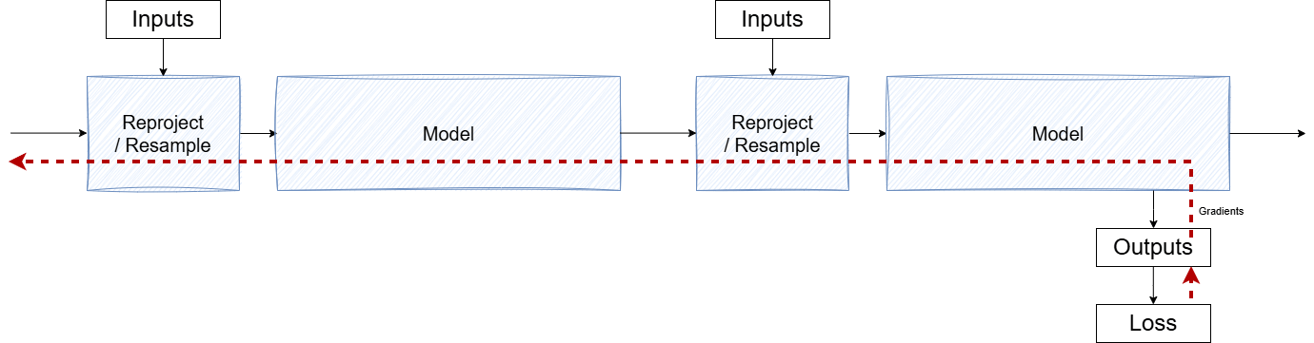
Notes:
As a result, distant temporal connections were very hard to learn regardless of model size. Launch PSSR handled a handful of frames well, better than TAAU, but struggled much beyond that.

Slide 49
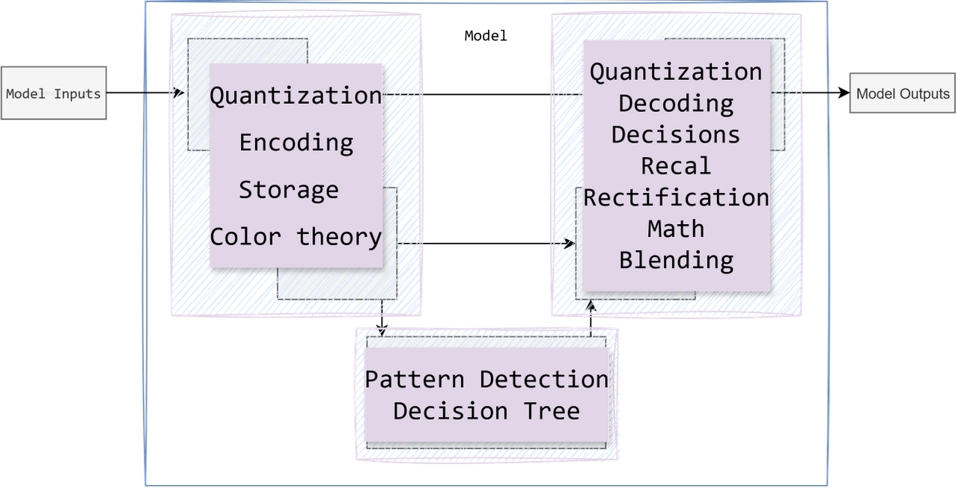
CPN: How It's Going…
Notes:
With a lot happening inside the model, the goal for the next version was to simplify it against clear quality targets and a clear technical plan.

Slide 50
Act III: Upgraded PSSR
Notes:
This section opens with a brief PC comparison for context.

Slide 51
SR Continues
On PC, ML-based upscaling / reconstruction was advancing
  By PSSR launch PC solutions were much more mature
  In many cases improving games in place
  Which is great!
Notes:
During Launch PSSR development, PC ML upscaling matured and increasingly improved games in place. On console the relevant framing is quality per cost.

Slide 52
Requirements
To succeed we needed:
Prominent / Conspicuous quality improvements
No (Prominent / Conspicuous) quality regressions
No performance regressions
No memory regressions
Notes:
On PC quality had scaled, but costs also scaled. This would not work for us.

Slide 53
Upgraded PSSR: Changed Everything
High-level architecture
Internal block architecture
Training data and augmentation
Training system optimization
Notes:
Every part changed: design, implementation, training, and optimization. This talk focuses on the high-level architecture, the most fundamental and impactful of these.

Slide 54
High-Level Architecture Change
Launch PSSR re-framed the problem
  Put almost all of the algorithm into ML
Upgraded PSSR re-framed the problem again
  To walk some of that back
  To more closely match hand-authored solutions
Notes:
Where Launch PSSR moved almost the entire algorithm into ML, the upgrade walks part of that back, using closed-form solutions where possible and giving the model more focus on pattern detection and decisions.

Slide 55
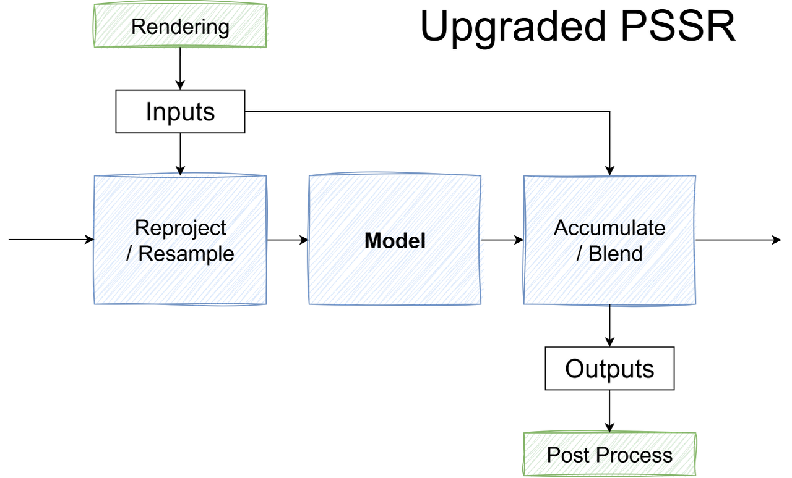
Separation of Concerns
Play to the strengths of both sides:
Restore closed-form solutions
  That is, deterministic (and efficient) filters
Dedicate the model resources to pattern detection
  Increase % of model in the middle
Focus model output on making decisions
Notes:
Closed-form solutions exist for many of these steps, and the GPU instruction set runs them efficiently; the ML instruction set is built for pattern detection. The approach uses each for its strengths.

Slide 56
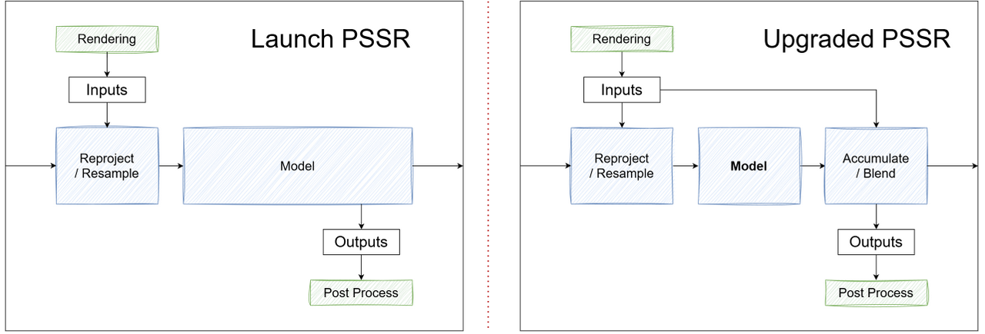
Separation of Concerns
Notes:
This largely restores TAA's three logical blocks, with the model focused on the heuristics in the middle.

Slide 57
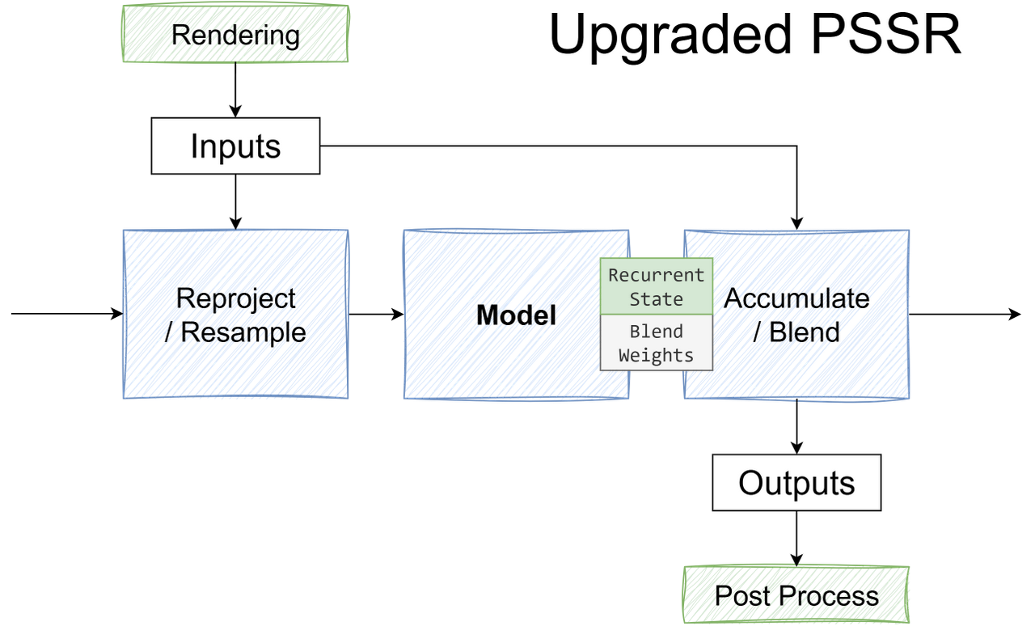
KPN: Move the Math Out
Notes:
The CPN was replaced with a Kernel Predicting Network (KPN): the model outputs blend weights rather than color, driving the filtering while the blend is applied explicitly. As a result the model no longer stores or blends HDR color in 8-bit; blend weights fit naturally in 8-bit, and encoder/decoder blocks spend less effort on overhead and more on the intended work.

Slide 58
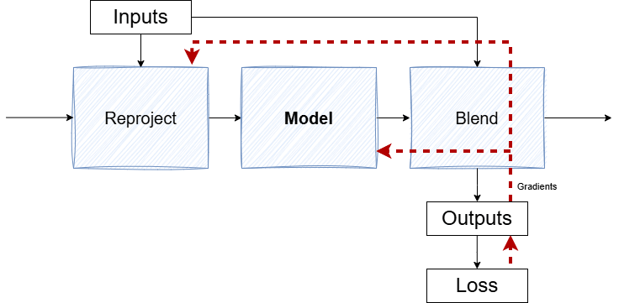
Gradient Flow
KPN outputs blend weights
Gradient to history color is then a single multiply
The signal flows around the model
Straight to reprojection
In ML terms this is considered a GRU
  (GRU = Gated Recurrent Unit) [CMG*14]
Now:
Distant temporal associations much easier to learn
Temporal feedback is more effective
Notes:
Adding the explicit blend and reconnecting it to the inputs fixed the gradient-flow problem: with a weighted sum, the gradient to history color is a single multiply. This gating structure is a GRU.

Slide 59
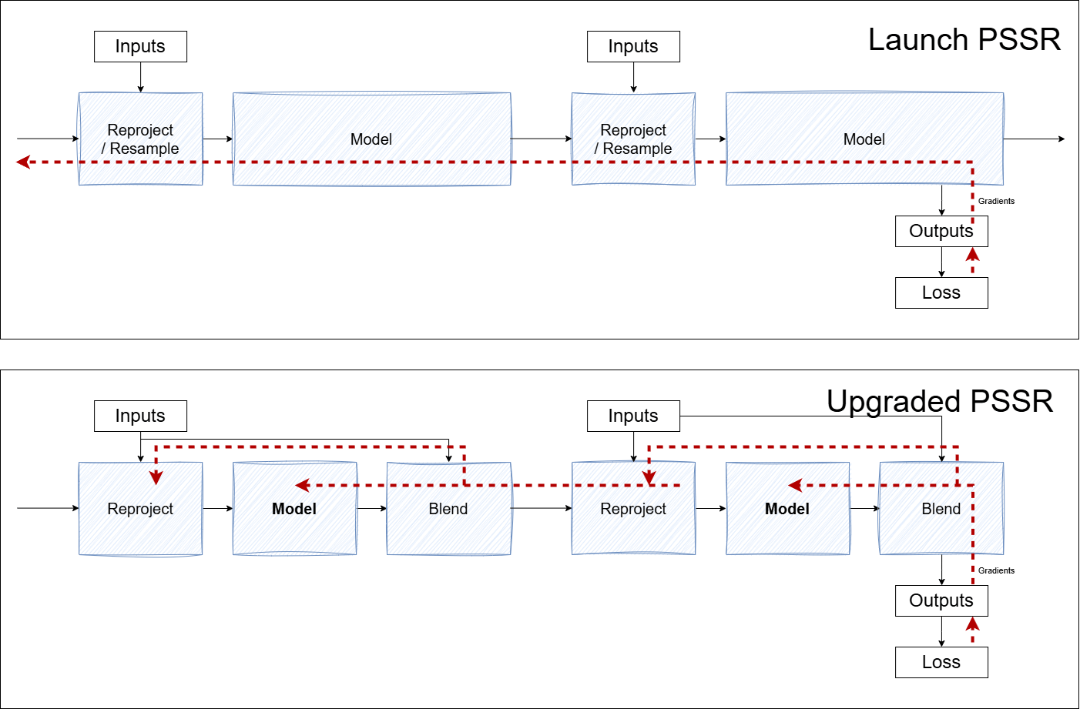
Notes:
The learning signal now routes around the model directly to reprojection and the prior frame instead of tunneling through it serially, the mathematical fix that enabled much more distant temporal connections.

Slide 60
What Was Still Missing
High upscale quality was improved, but needed to be better
Model was still learning color theory
Kernel outputs had implicit correlations
Notes:
Progress from a small change, but more was wanted: further reduce implicit math on inputs and outputs, improve input color handling, and improve detail at higher upscale ratios (2.5x, 3x).

Slide 61
Input Flexibility
CPN required full color because it needed to reconstruct it
But with KPN… We had more flexibility
Using luma instead of RGB was an obvious test, but:
  Caused significant ghosting in practice
Model needs more than luma alone
Notes:
The CPN needed full color to reconstruct it; the KPN's blend-weight outputs allow more flexible inputs. Luma alone was an obvious test but caused significant ghosting, so the model needs more than luma.

Slide 62
Make Color Relative
Convert RGB → YCbCr (input + history)
Pass luma (Y_in, Y_hist) directly
Pass chroma distance (ΔCbCr) instead of raw chroma
Notes:
Color is made relative rather than absolute via a "color distance": luma passed directly, chroma passed as a distance (delta CbCr). The simple option proved effective.

Slide 63
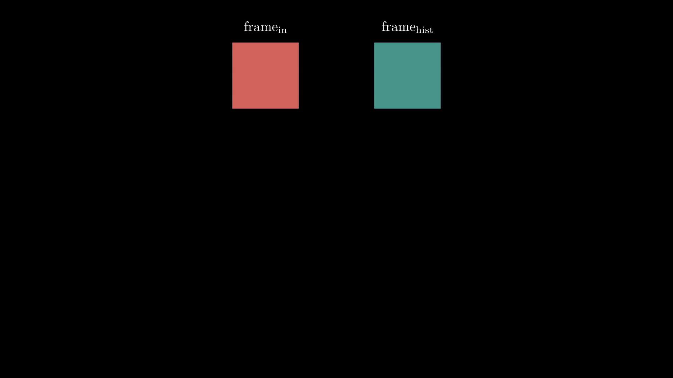
Color Distance
Notes:
Color distance is the Euclidean distance between the input and history Cb,Cr channels. The model becomes aware of color differences without needing absolute color, which trains well, correlates with outcomes, and generalizes, while avoiding absolute-color biases from the training data (e.g. "particles are orange," "sky is blue").

Slide 64
Output Issues
3×3 kernel outputs were highly correlated
Didn't generalize well at high upscale ratios
Could they be more concise and scale with input?
Notes:
The 9 outputs of the 3x3 kernel trained acceptably and improved on the CPN, but were highly inter-correlated and did not generalize well at high upscale, suggesting room for a more concise, input-scaling representation.

Slide 65
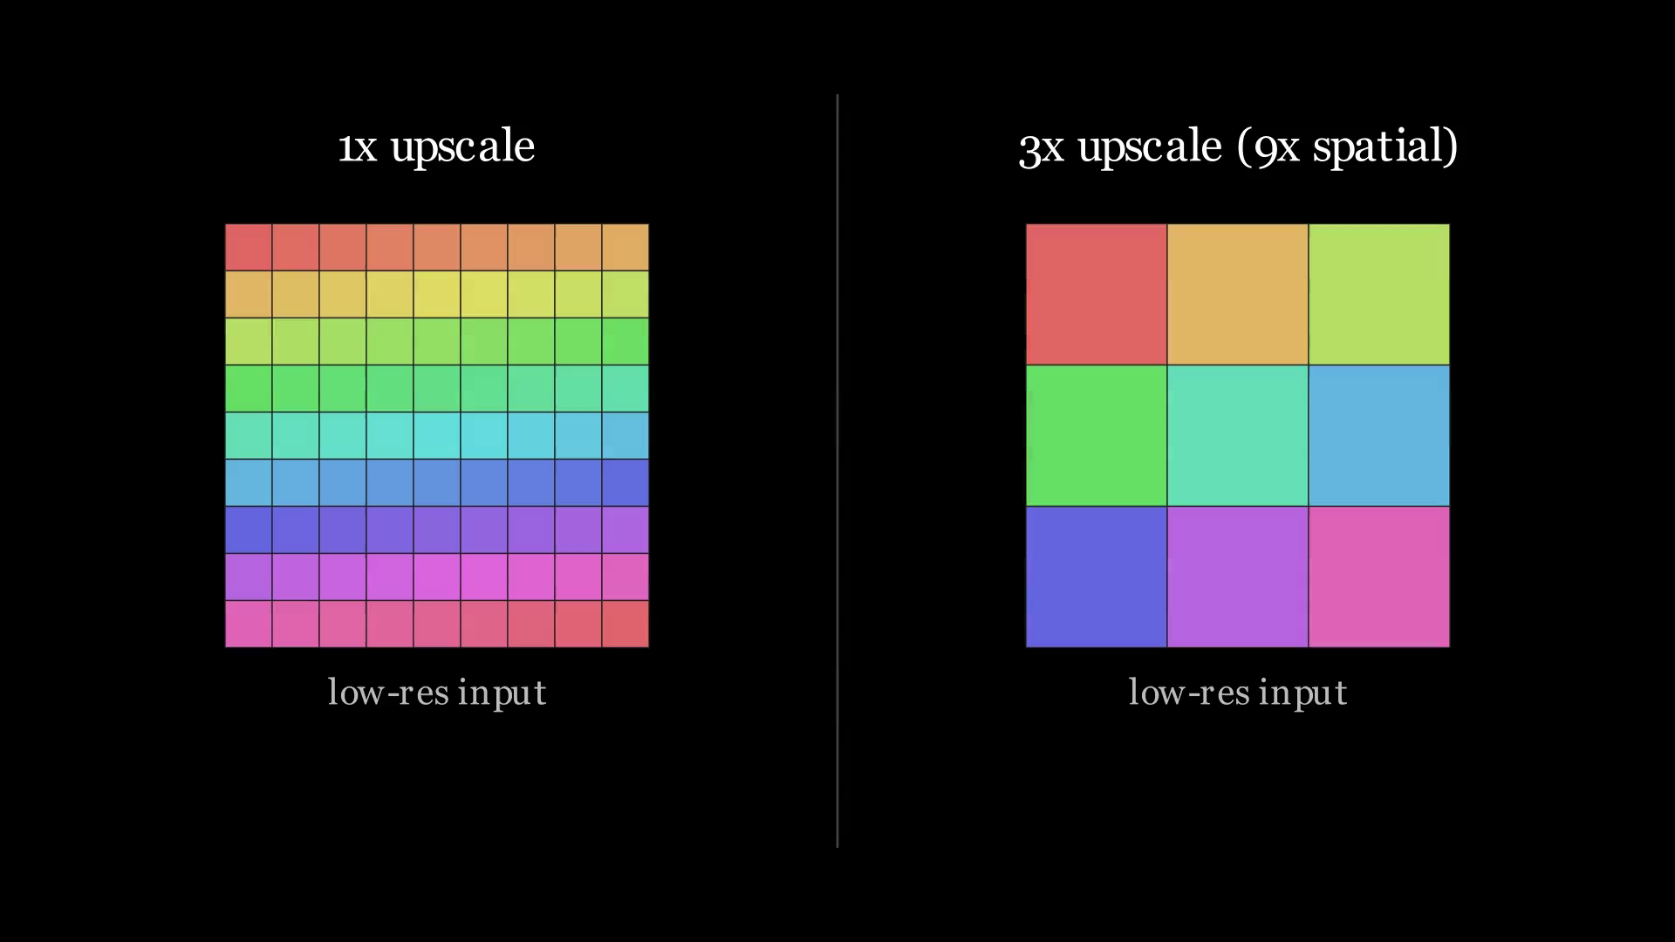
Kernel Reach
Notes:
The canonical kernel is applied at output resolution, so its reach in input pixels shrinks as the upscale ratio rises. At 3x it provides almost no blending.

Slide 66
Anisotropic Gaussian Blending
A return to classical filtering (elliptical filter methods)
Compressed the outputs 9 → 3
Into a coherent, decorrelated feature space
(with a few more benefits — coming up)
Notes:
The chosen solution returns to classical elliptical filtering with an anisotropic Gaussian, compressing the 9 outputs to 3 and decorrelating them, with further benefits following.

Slide 67
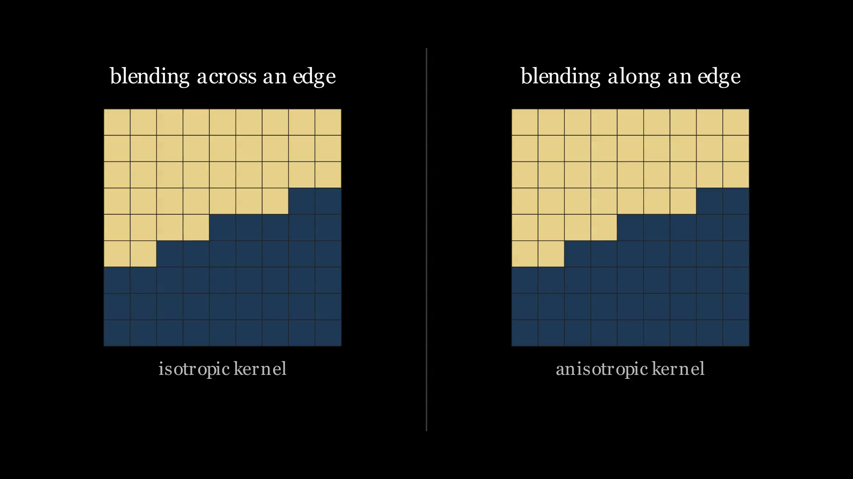
Blending Along Edges
Notes:
Elliptical blending lets the model blend along oriented edges, effective for building and retaining detail, driven by local feature strength and orientation.

Slide 68

Blending in Input Space
Notes:
The kernel is also scale-invariant. Applied in input space, it always has 9 distinct input samples and performs real blending whether at 1x or 3x, with reach that scales with input resolution, a significant gain in high-upscale detail.

Slide 69
Preserving Artistic Intent
Another benefit is tied to preserving artistic intent
  Kernel prediction practically prevents hallucination
  Output is confined within the convex hull of input samples
  Hence the "reconstruction" nomenclature
Early on we worried that limiting the model would degrade quality
  Instead it has consistently outperformed expectations
  And our previous model
Notes:
Kernel prediction structurally limits content changes: the Gaussian cannot exceed the convex hull of the input samples, so the model is demonstrably reconstructive rather than generative, which is useful when addressing teams' concerns. Early worries about a quality cost did not materialize; results were consistently positive.

Slide 70
Output Impact
Quality jumped up for high upscale ratios
Model was more efficient

Slide 71
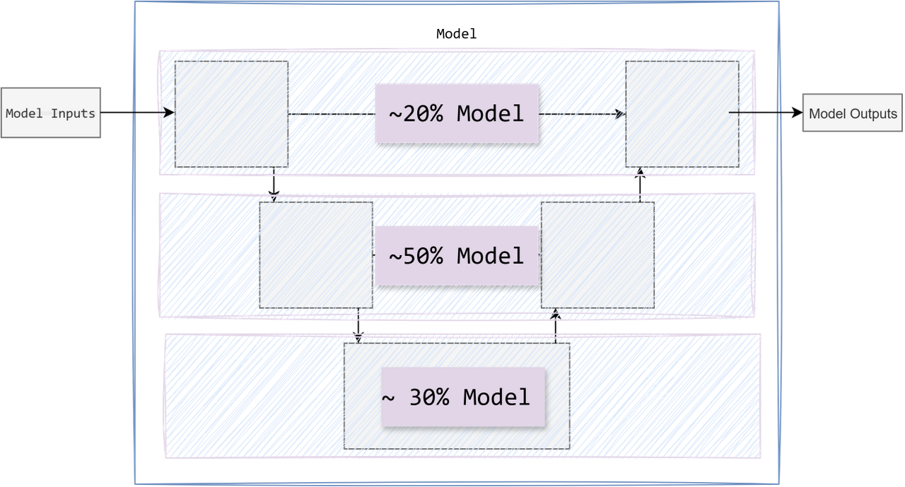
CPN/Before:
Notes:
Weight distribution of the CPN versus the intended design: much of the capacity sits in the upper (high-resolution) levels, leaving only ~30% of parameters at the lowest level (540p).

Slide 72
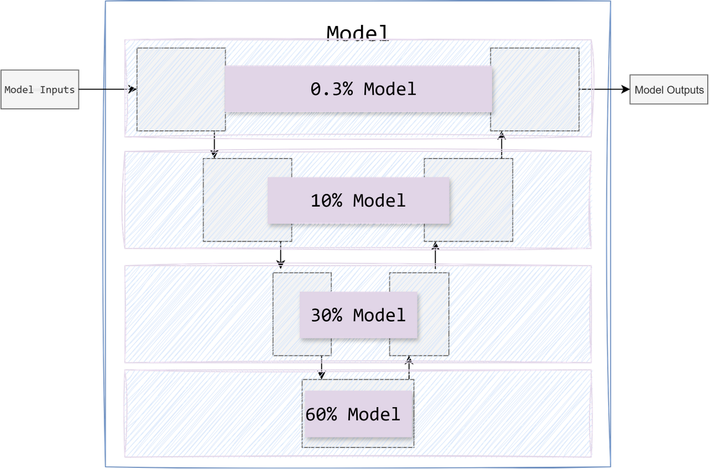
KPN/After:
Notes:
The KPN does very little at 4K and adds a new lower layer, placing ~90% of parameters at 540p or below, matching the intended distribution toward lower levels.

Slide 73
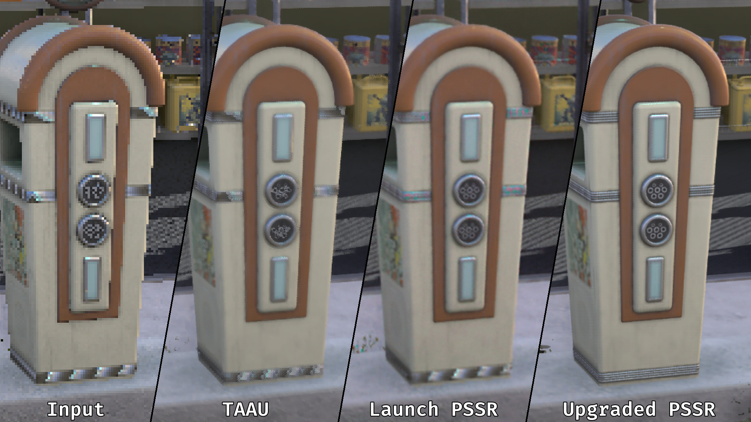
Notes:
Returning to several earlier images, plus new ones.

Slide 74

Notes:
The same charging scene on Upgraded, showing detail recovered in the high-frequency regions that broke up under TAAU.

Slide 75
Notes:
The antenna zoom from the opening: sharper, with the fringing gone.

Slide 76
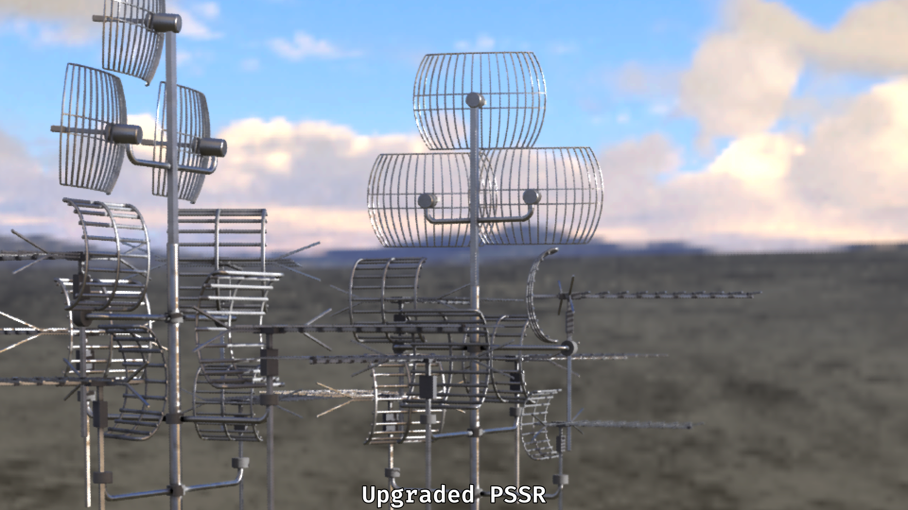
Notes:
The full frame: stable, with detail holding together.

Slide 77
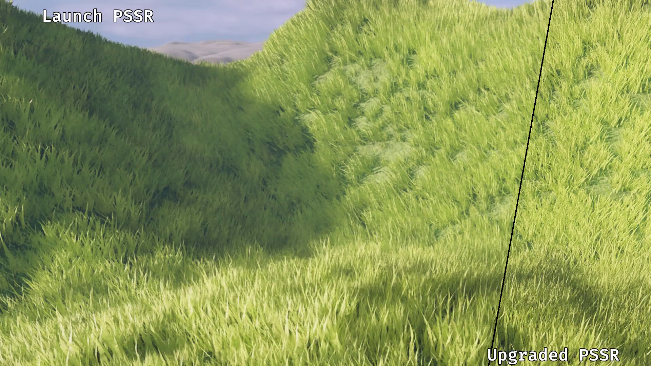
Notes:
Foliage with lighting flicker: sharpness and detail hold up, and the flicker settles relative to Launch.

Slide 78
Notes:
The neon comparison again: pulsing on the left (Launch), stable on the right (Upgraded).

Slide 79
Results
Improved:
  Image quality
  Temporal stability
  Lower memory + runtime cost
Training: ~4 GPU months → <1 GPU week
Notes:
Higher quality at all input resolutions and notably at lower ones, reduced temporal instability, and lower GPU time and memory. Training time dropped from ~4 GPU months to under a GPU week, largely from the quantization changes, enabling much faster iteration.

Slide 80
Acknowledgements
Project Amethyst SR Research Team
Sony PSSR Research Team
Sony PSSR SDK / Production Team
Mark Cerny
Luis Villegas
Shigetaka Kudo
Rui Yamada
Geoff Norton
Maurizio Cerrato
Natalya Tatarchuk
Marta Orlinska
Benjamin Coquelle
Maria Chiara Monti
Yuji Yamada
Yiannis Andreopoulos
Aaron Chadha
Sebastian Lutz
Paulwei Wang
David Simpson
Kleber Garcia
Notes:
Acknowledgements span the research teams (AMD / Project Amethyst and Sony's PSSR researchers), the SDK and production teams, and those who reviewed and approved the deck. Research is a small part of what it takes to ship.

Slide 81
Questions

Slide 82
References
[Lot11] FXAA — Timothy Lottes — 2011 - NVIDIA — https://developer.download.nvidia.com/assets/gamedev/files/sdk/11/FXAA_WhitePaper.pdf
[JME*11] Practical Morphological AntiAliasing. — JIMENEZ J., MASIA B., ECHEVARRIA J. I., NAVARRO F., GUTIERREZ D. — 2011 - GPU Pro 2
[JES*12] SMAA: Enhanced Subpixel Morphological Antialiasing — Jorge Jimenez, Jose I. Echevarria, Tiago Sousa, Diego Gutierrez — 2012 - EUROGRAPHICS Volume 31, Number 2

Slide 83
References
[LG21] Improved Spatial Upscaling through FidelityFX Super Resolution for Real-Time Game Engines — Timothy Lottes, Kleber Garcia — 2021 - Advances in Real-Time Rendering in Games, SIGGRAPH
[Kar14] High-Quality Temporal Supersampling — Brian Karis — 2014 - Advances in Real-Time Rendering in Games, SIGGRAPH
[Wih17] 4K Checkerboard in Battlefield 1 and Mass Effect — Graham Wihlidal — 2017 - Game Developers Conference — https://www.ea.com/frostbite/news/4k-checkerboard-in-battlefield-1-and-mass-effect-andromeda

Slide 84
References
[Aba21] Temporal Super Resolution in Unreal Engine 5 — Guillaume Abadie — 2021 - Advances in Real-Time Rendering in Games, SIGGRAPH
[YLS*20] A Survey of Temporal Antialiasing Techniques — Lei Yang, Shiqiu Liu, and Marco Salvi — 2020 - EUROGRAPHICS Volume 39, Number 2 — http://behindthepixels.io/assets/files/TemporalAA.pdf
[CMG*14] Learning Phrase Representations using RNN Encoder–Decoder for Statistical Machine Translation. — Kyunghyun Cho, Bart van Merriënboer, Çağlar Gülçehre, Dzmitry Bahdanau, Fethi Bougares, Holger Schwenk, and Yoshua Bengio. — 2014 - EMNLP — https://arxiv.org/pdf/1406.1078

